Slide 1
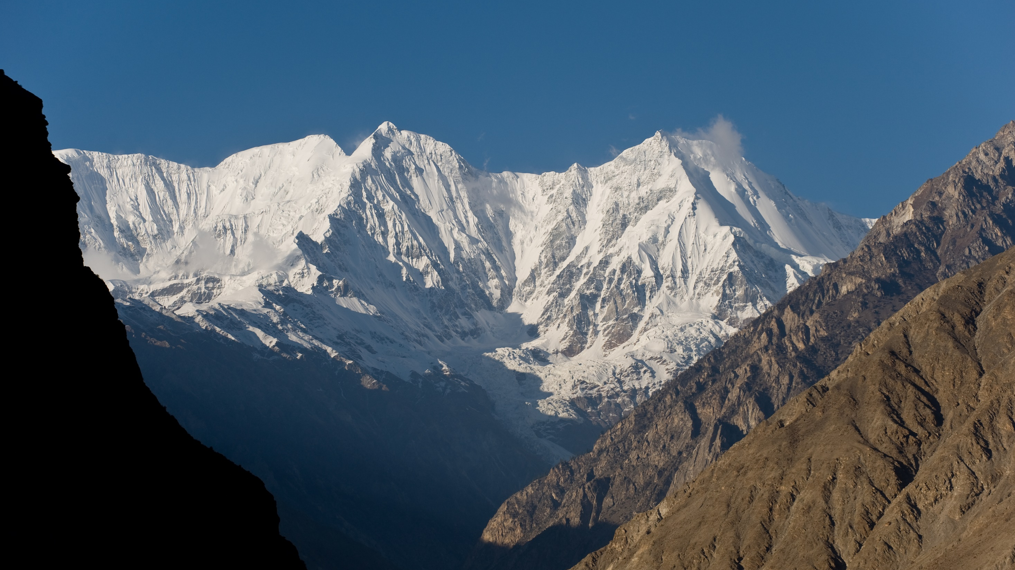
Alternative Development for Sustainable Development of Mountain and Highland Areas
Golam Rasul
Date: 22 Dec 2019

Slide 2
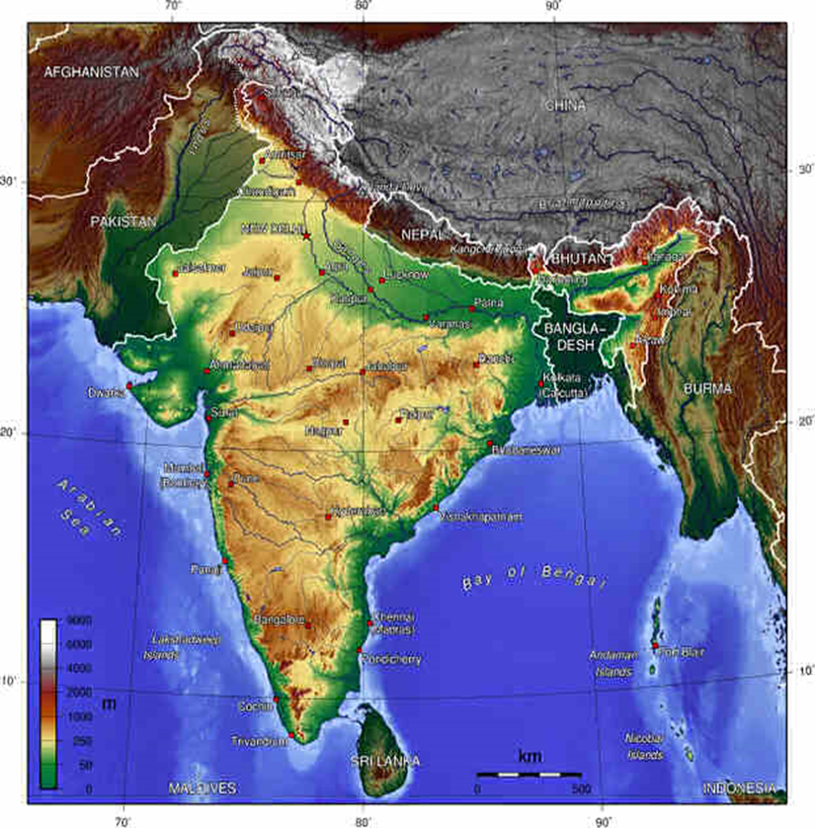
Characteristics of Mountains and Highlands
Limited Accessibility-Isolation, remoteness, difficult terrain
High Fragility & vulnerability - steep slope, high altitude
Poor infrastructure, high transportation cost
Sparse population, small production - low economies of scale
Marginality - socio-economic & environmental
Poses Environmental & economic constraints

Slide 3
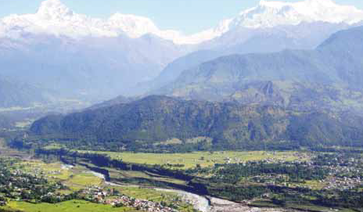
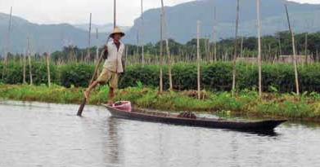
Niche & Comparative advantage of Mountains & Highlands
Climatic, biological & natural resource diversity- unique products & services
Significant comparative advantages to
  Hydropower, Tourism
  Horticulture, Timber, medicinal herbs
  Biodiversity, Indigenous knowledge
Mountains are the water towers of the world

Slide 4
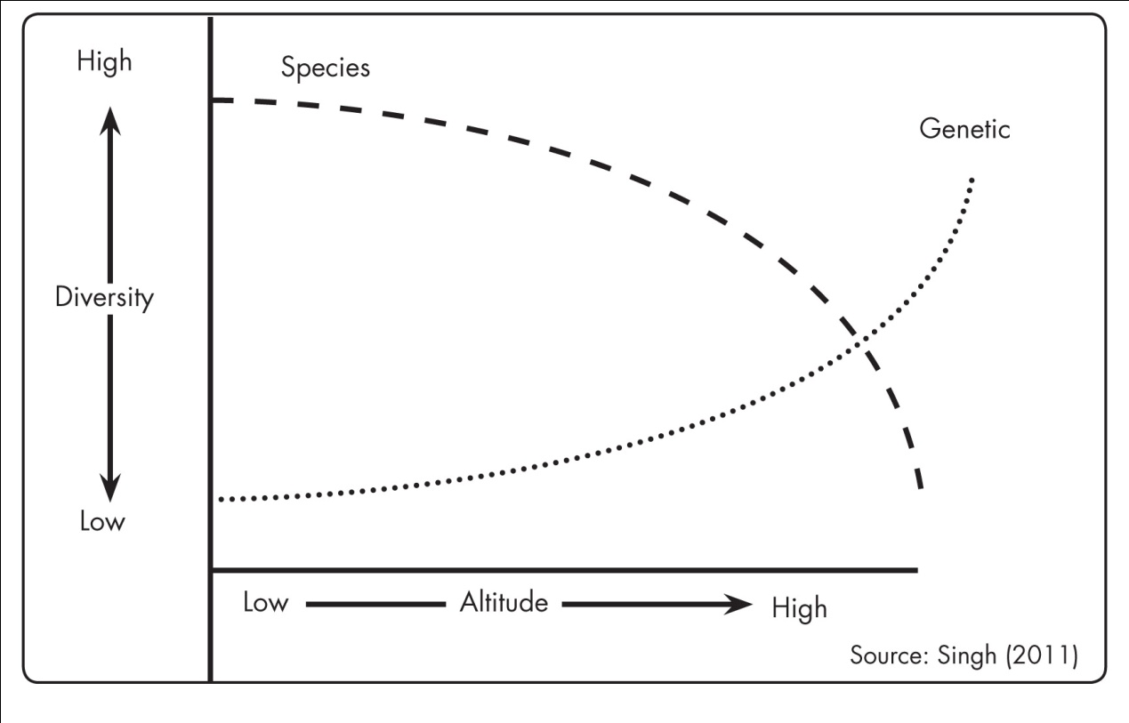

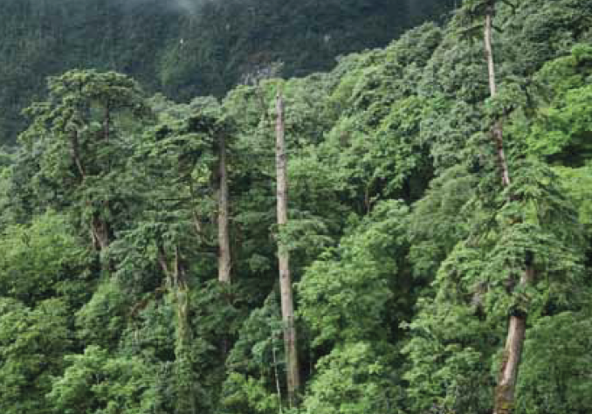
Niche & Comparative advantage of Mountains & Highlands
Biodiversity
  Mountains support 25% of the planet’s biodiversity, have 50% of the world’s biodiversity hotspots
  32% of global Protected Areas (PA )are in mountains
  Himalayan has 488 PAs covering 39% of the region’s terrestrial area
Agrobiodiversity
  Six of 20 plant crop species that supply 80% of the world’s food originated in the mountains
Mountains: a source of cultural, spiritual & recreational resources
Notes:
Mountain communities are custodians of agrobiodiversity

Slide 5
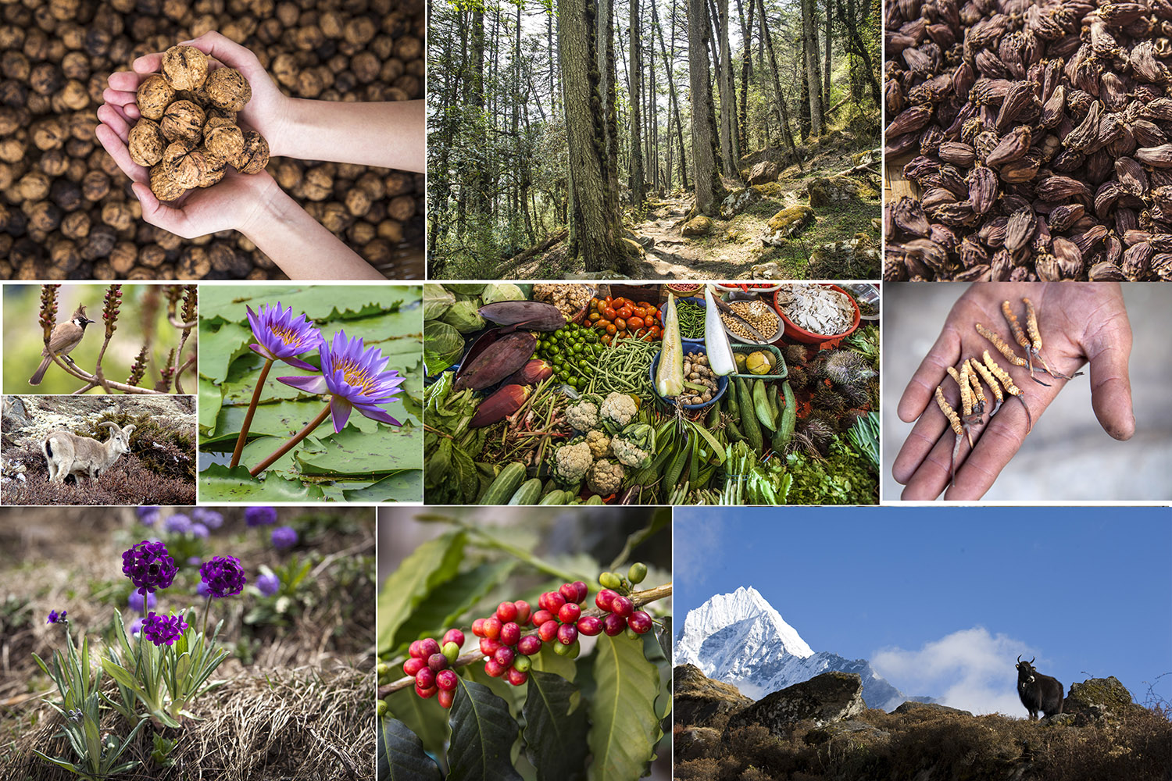
Niche Products for Agribusiness from Mountain Agroforestry

Slide 6
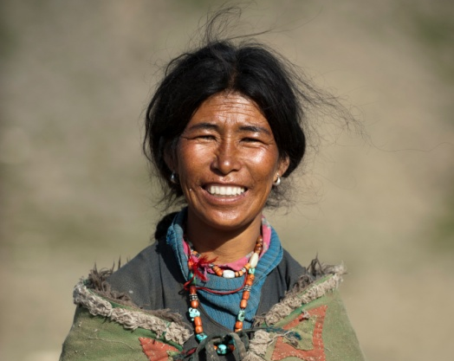
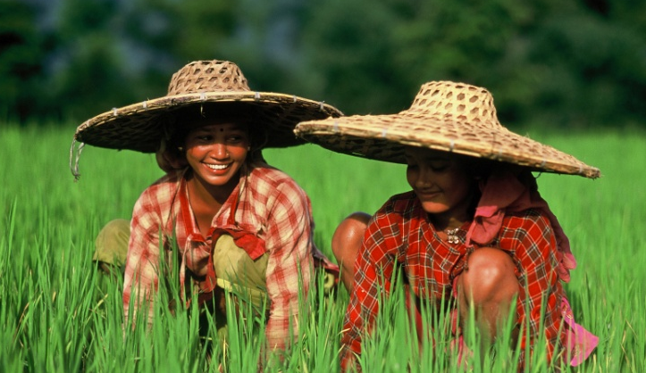
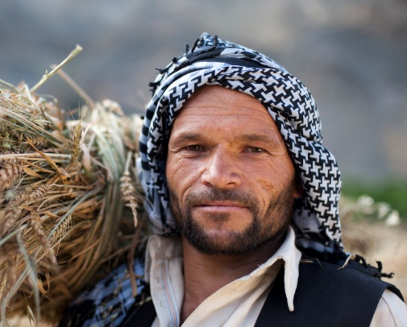
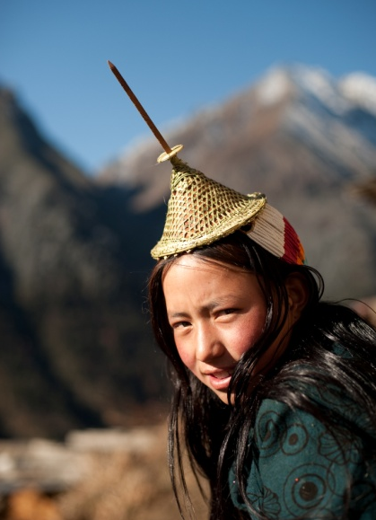

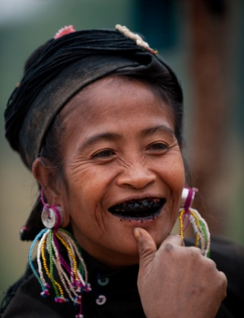
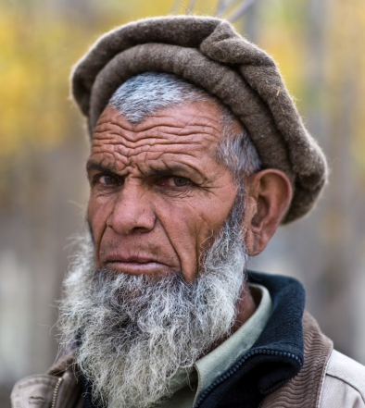
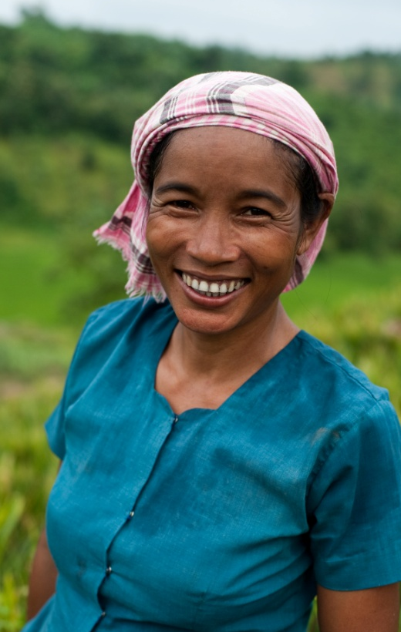
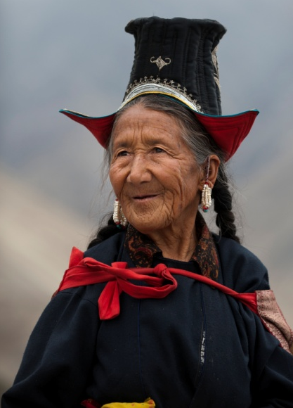

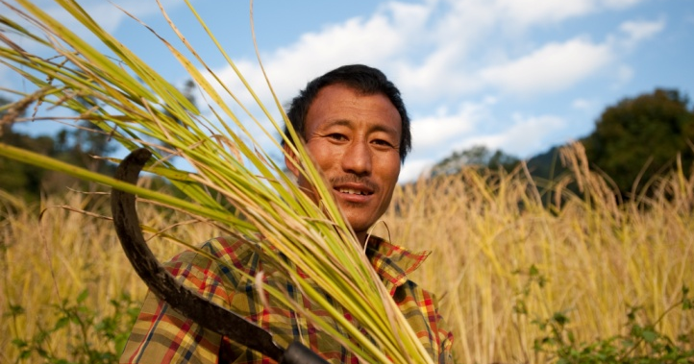
Mountain and Highlands are home to many tribal & indigenous peoples: Langue's & Cultural Diversity
Notes:
The poorest of the poor, the marginalized groups are more dependent on forest resources for sustaining their livelihoods. Hence safeguard mechanisms are well integrated into ICIMOD’s interventions.

Slide 7
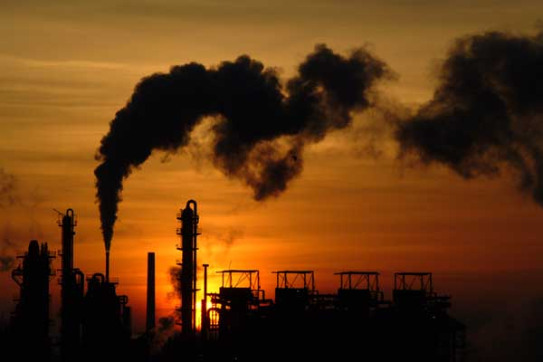
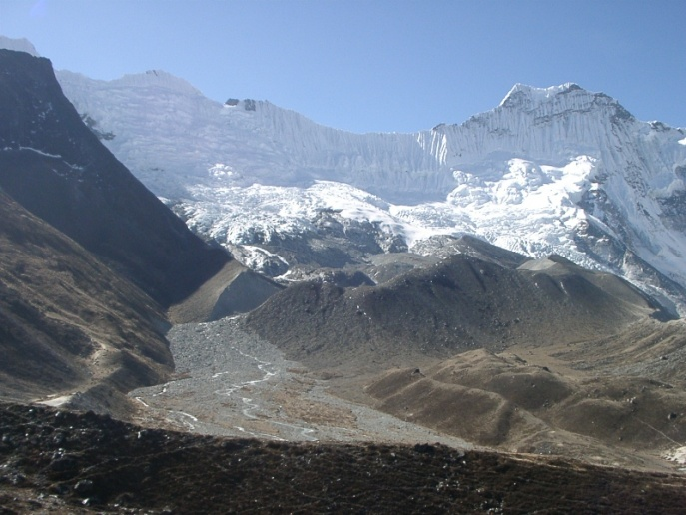
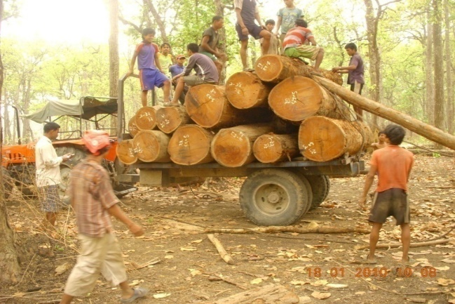
Growing Environmental & Social Risks
Conventional economic model failed to sustain economic growth, reduce poverty, protect environment
High carbon emissions, climate change, accelerated melting of glaciers, Sea Level Rise
Resource depletion, loss of biodiversity, energy crisis, water shortage, food insecurity
Persistent poverty & growing inequality
Economic inequality reinforces inequalities between regions, ethnicity, race, caste- leading to protracted conflicts
Notes:
Conventional growth oriented economic model
Inequality is growing- between rich & poor, rural & urban, plain & mountain

Slide 8
Multidimensional poverty: Mountain vs National

Slide 9
China - Rural Mountain Poverty

Slide 10
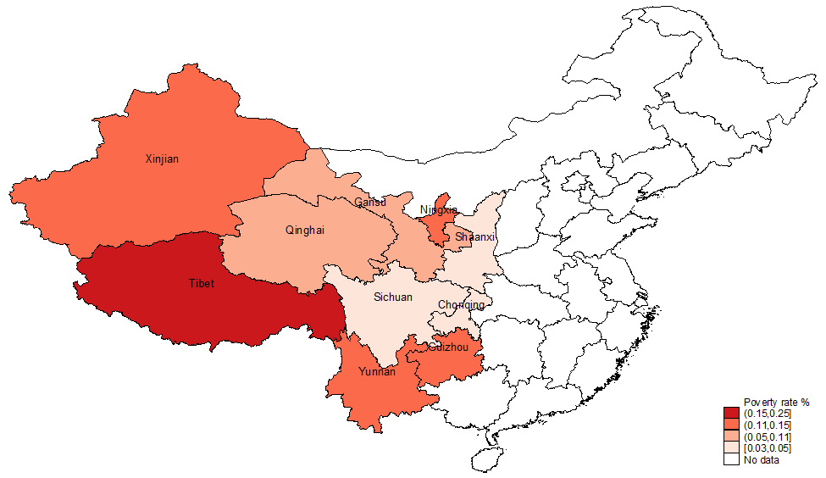
China- Mountain Poverty
Poverty is mountain phenomenon
Notes:
Causes of mountain poverty in China differs from place to place: eastern mountain - shortage of human capital and information technology; Central Mountain - poor transport; Western Mountain – lack of natural endowment, are the main causes of poverty.

Slide 11
India – Mountain Poverty (Income)

Slide 12
Myanmar –Multidimensional Poverty

Slide 13
Challenges to sustainable development
How to overcome mountain environmental challenges & harness niche products & services for sustainable development?
How to integrate mountain/ highland communities to mainstream economies & societies?
How to increase productivity without degrading resources?
How to adapt with stress, shocks (scarcities/floods/droughts) and rising pressure on fragile resources?
What pathways are available?

Slide 14
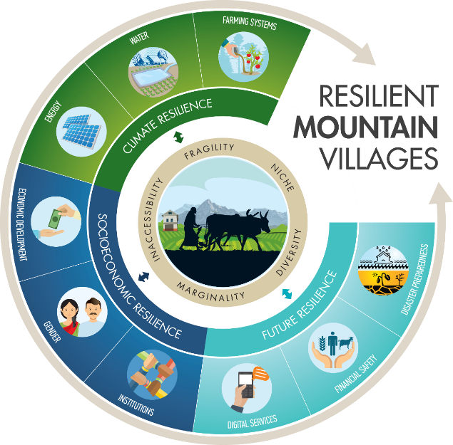
Pathways to sustainable development
Understanding biophysical, socio-economic, & cultural context & specificities
Adopting Site -specific strategies & approaches
Recognizing and addressing the trade-offs between the immediate economic gain & long-term risks
Integrated solution

Slide 15
A few examples from different countries of the Himalaya Regions
This template uses ICIMOD blue. Do not use other colors except blue if you are using a blue template throughout the presentation.

Slide 16
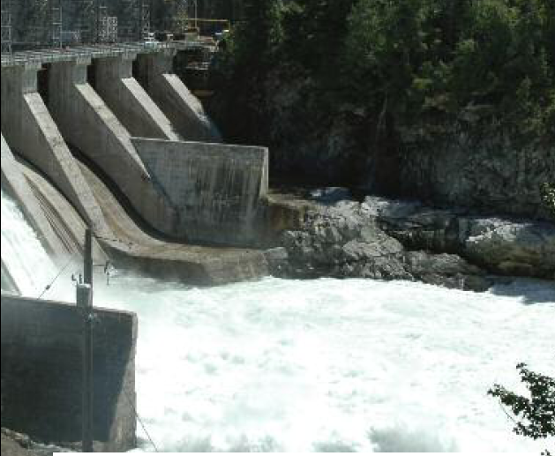
Harnessing Hydropower for Clean Energy: Bhutan
Bhutan Rich in water resources -30,000 MW of hydro-electricity potential
Currently, it generates 1, 600 MW electricity
More than 98% of households in Bhutan have access to electricity
80% exports to India
Power exports generates 25% of GDP & expected to increase by 56% by 2025
Hydropower is the major source of export earning
Hydropower is the backbone of Bhutan economy
Bhutan- carbon negative, 70% land under forest
Notes:
Bhutan: 70% of its land area under forest
1,020 MW Tala Hydropower Plant (Another milestone in power sector )
•Spiked the GPD growth rate to 19.7% in the following year
•Share of electricity to GDP rose to 22%

Slide 17
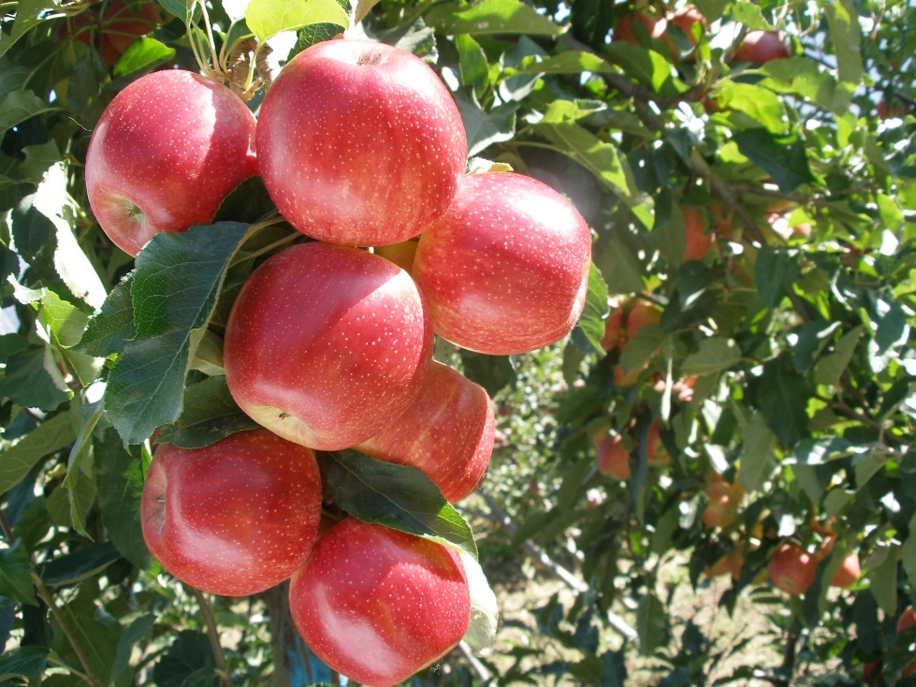
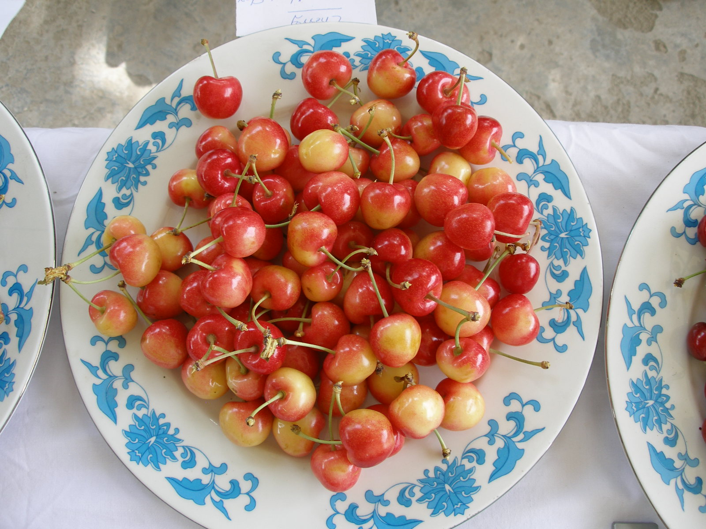
Horticulture based development in Himachal Pradesh, India
Himachal Pradesh suitable agro-climatic for growing subtropical & temperate fruits
Government supported horticulture development
Horticulture revolution in Himachal
About 500,000 farmers are engaged in Horticulture
Himachal - Fruit Bowl of India
Employment Generation- livelihood diversification- high economic growth, low poverty
Notes:
Subsistence annual crops are converted to horticulture
Economic backbone of Himachal Pradesh
The topography of Himachal Pradesh is such that being a mountainous region with an elevation ranging from 350 meters to 6,500 meters above the mean sea level, horticulture seems to be the only viable-hope in the future.
Fruit crops offer better market and higher income than any other agricultural commodity
Trees contribute to soil conservation in even in the sloping ground profile.

Slide 18
India – Mountain Poverty (Income)

Slide 19
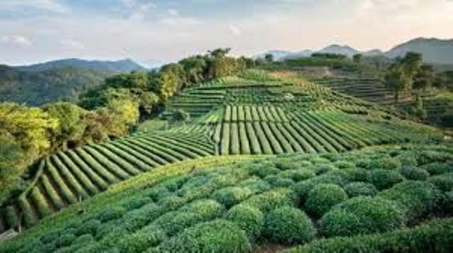
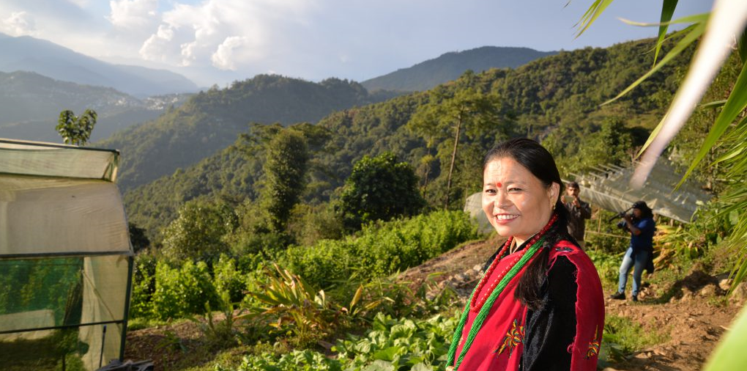

Organic agriculture in Sikkim, India
Sikkim is not suited for intensive agriculture
Sikkim moved to organic agriculture for health & ecosystems
Sale & use of chemical fertilizers & pesticides are banned
Productivity of a few fruits reduced slightly, but many crops has remained stable
Premium price for organic food
New organic image - New attraction for tourists
Carbon neutral- First organic state in the world
Notes:
Due fragile s environment, Sikkim is not suited to intensive agriculture

Slide 20
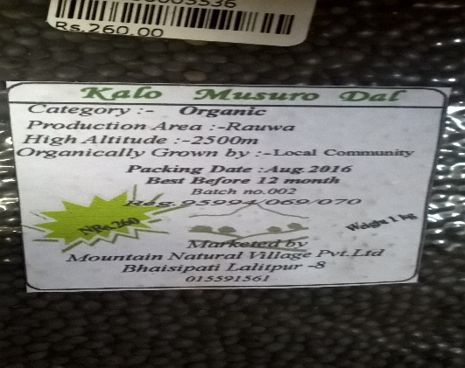


High value nutritious crops: High Mountain of Nepal

Slide 21
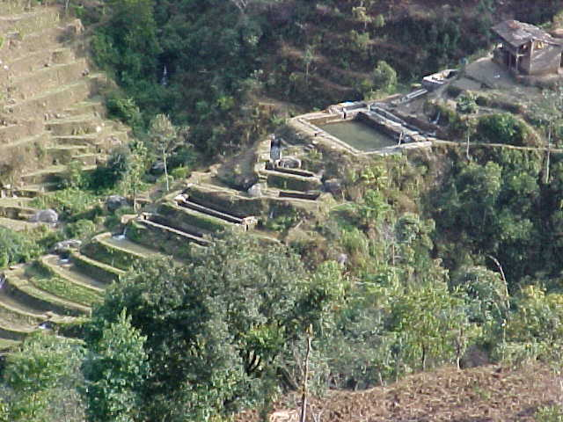
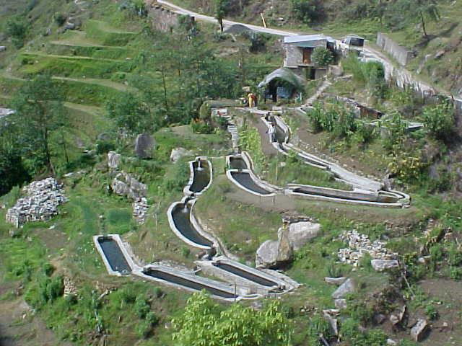
Trout farming in Terraces in Nepal
Notes:
Rainbow trout for cold water aquaculture

Slide 22
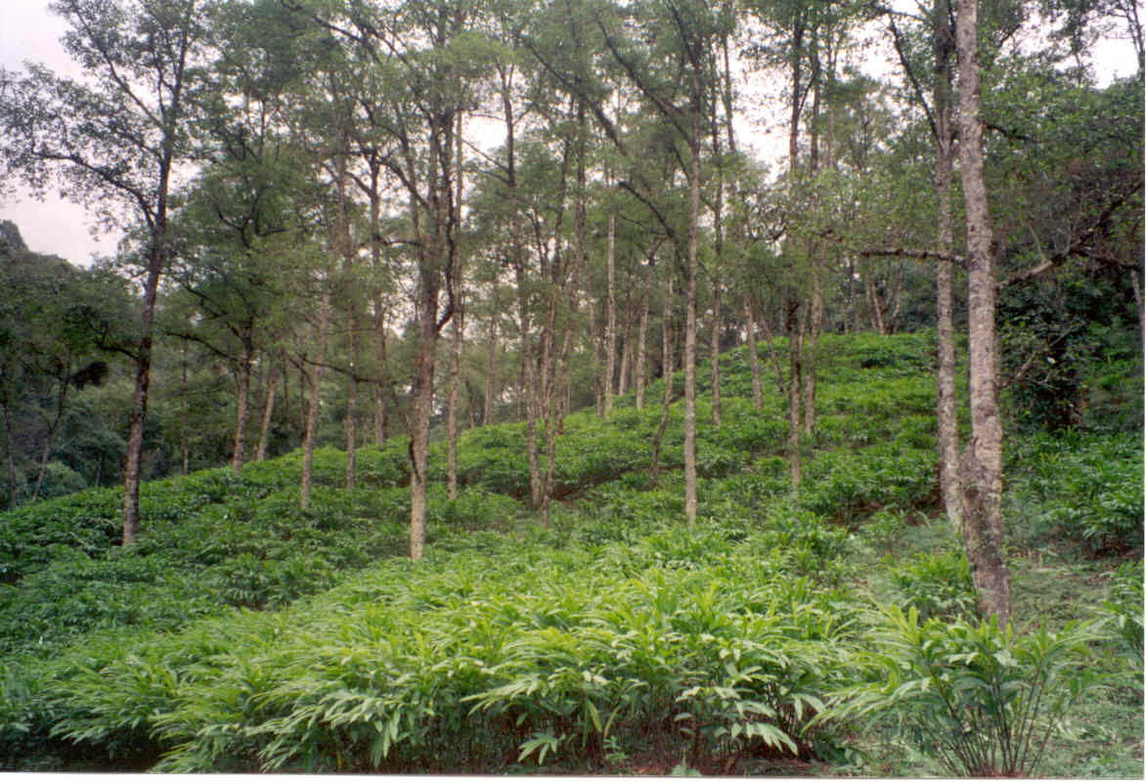
Large cardamom based agroforestry – marginal lands
Cash-crop, high value, low-volume, low-input, not labor intensive, non-nutrient exhaustive, non-perishable
Fulfilling Mountain Specificity
Nitrogen fixing Himalayan Alder shade tree with large cardamom
Notes:
High valued products and value chains, ecotourism
Empowering women
Benefit sharing, REDD+
Upstream-downstream linkages
Mountain specific policies
Clean energy, green technology
South/South learning on common regional issues
Cross border scientific cooperation
Regional & global investments (i.e., one belt one road, green climate fund)

Slide 23
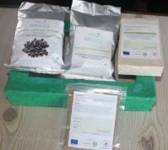


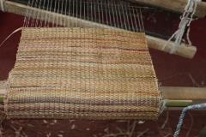
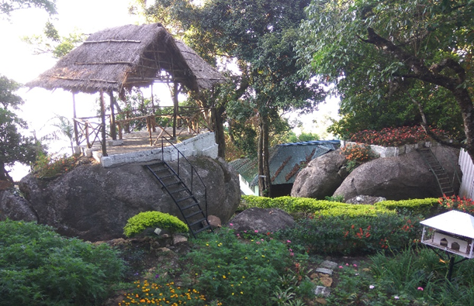
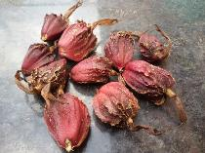
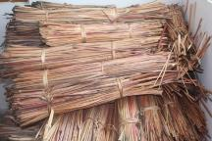
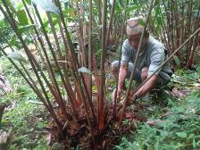
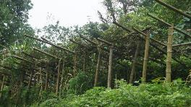
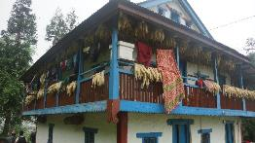
Resource use efficiency: Byproducts from Cardamom
Spice garden tourism
Spice garden tourism
CRA practices
Notes:
High valued products and value chains, ecotourism
Empowering women
Benefit sharing, REDD+
Upstream-downstream linkages
Mountain specific policies
Clean energy, green technology
South/South learning on common regional issues
Cross border scientific cooperation
Regional & global investments (i.e., one belt one road, green climate fund)

Slide 24

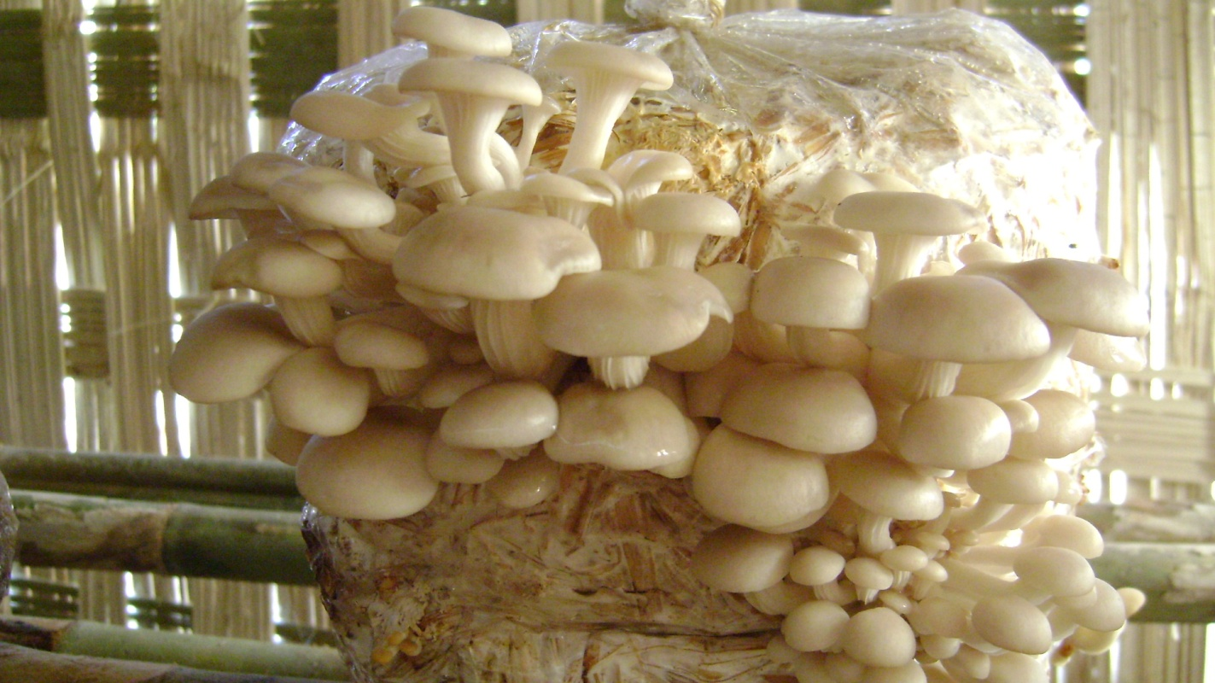
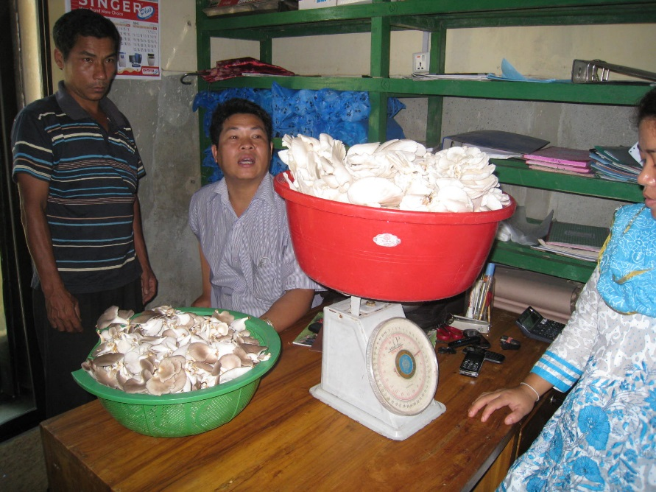
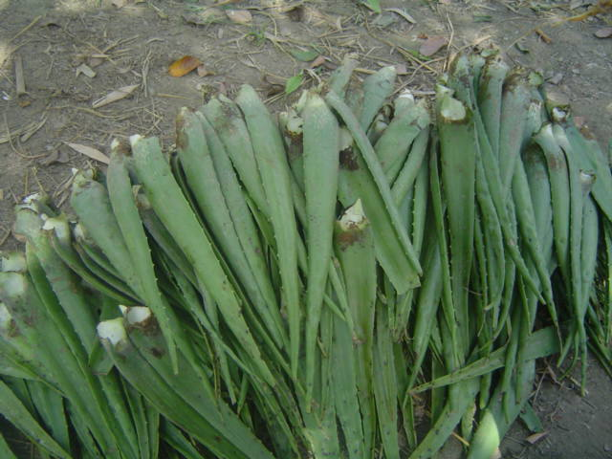
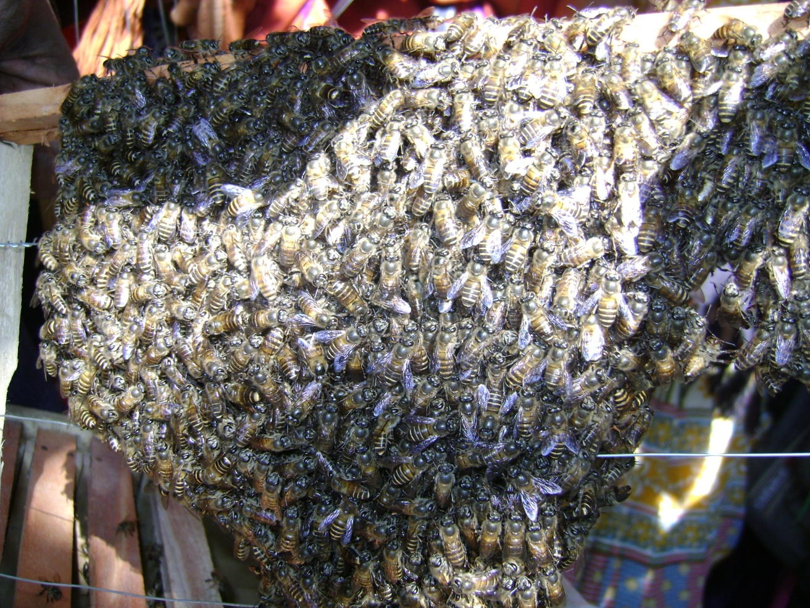
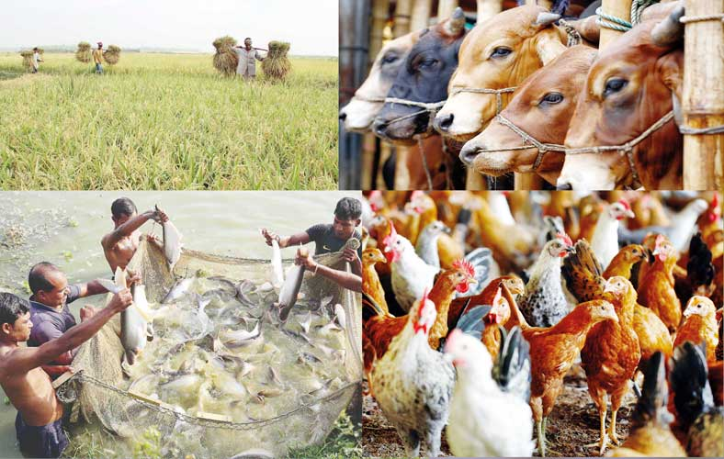
Diversification of high value cash crops

Slide 25
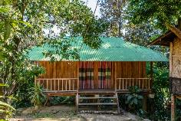
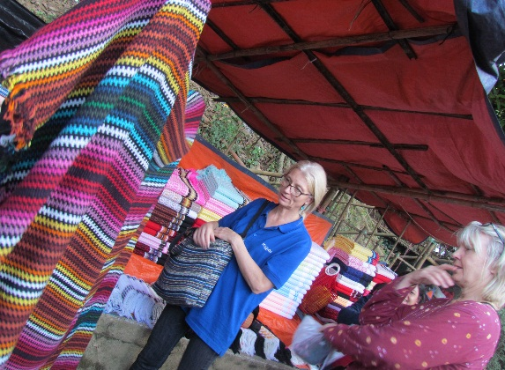
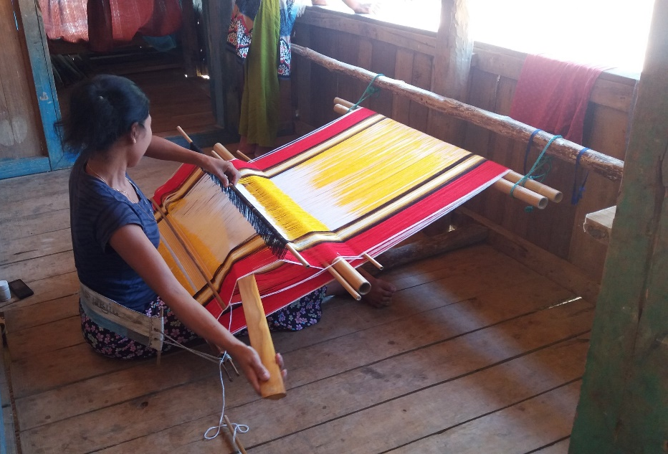
Diversifying livelihoods: Off-farm activities
Diversifying Livelihoods of CHT Hill Tribes
Notes:
Seizing opportunities from emerging from tourism growth for ending poverty and achieve prosperity in CHT (SDG 1)

Slide 26
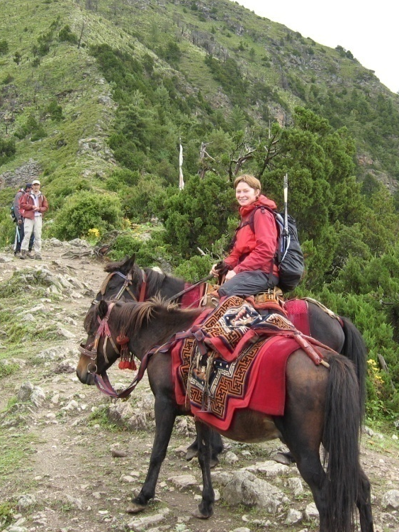
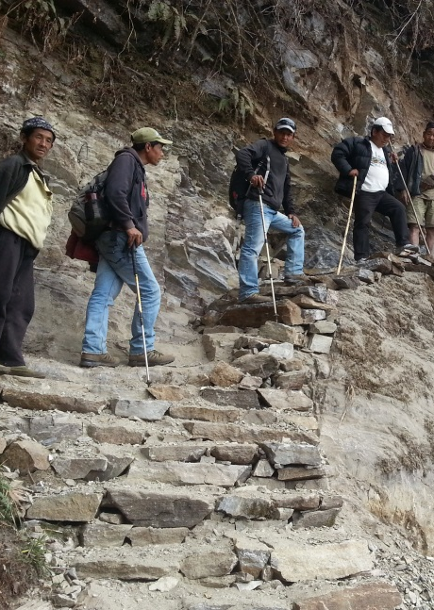
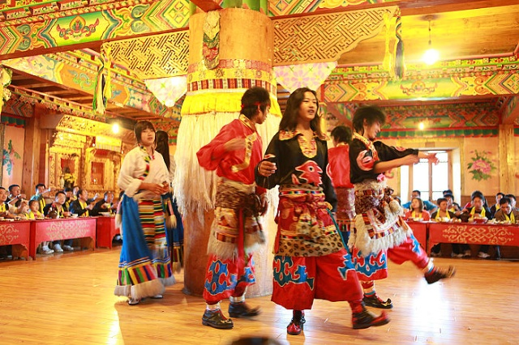
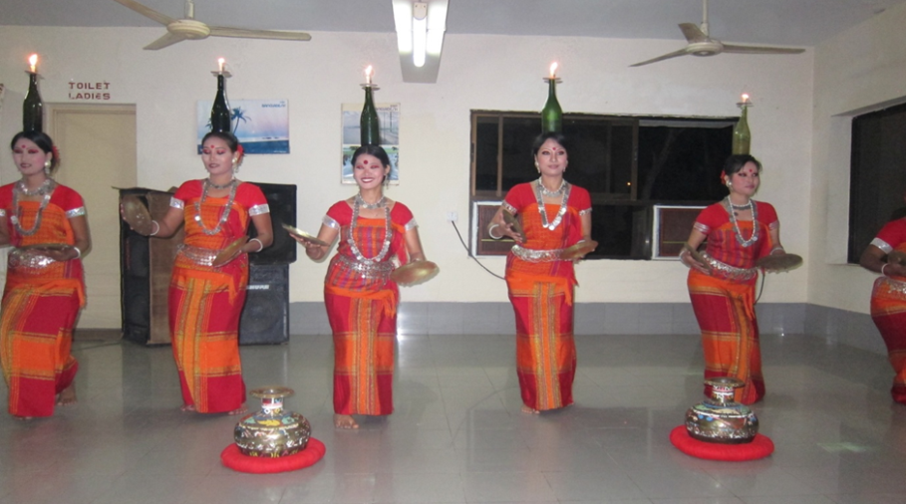
Tourism

Slide 27


Trophy Hunting in Chitral, Pakistan
Mountain goats (Markhor) were at the verge of extinction in Chitral due to illegal poaching
Community based conservation introduced in 199trophy
A hunting trophy license is issued after a proper auction
Annually, four hunting trophy licenses are issued for Markhor hunting
80% of the money collected is distributed among the local community, 20% is kept by the wildlife department
Trophy hunt tourism

Slide 28


Integration of REDD+ in forest management
REDD+ : Forestry for prosperity
Community based forest management & carbon storage
Notes:
In 2020 we intend to assist the countries to contribute collectively to the UN Declaration on Decade of Ecosystem Restoration.

Slide 29


1987
2010
Community Forestry in Nepal

Slide 30

Notes:
Use one slide from three options to end your presentation

