Slide 1
Panel Discussion
Socio-Economic and Marketing Sustainability
under Alternative Development

Slide 2
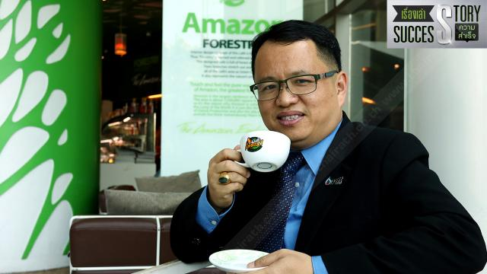
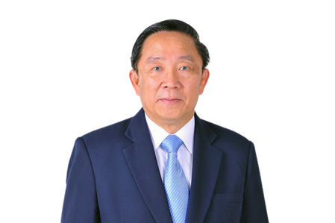
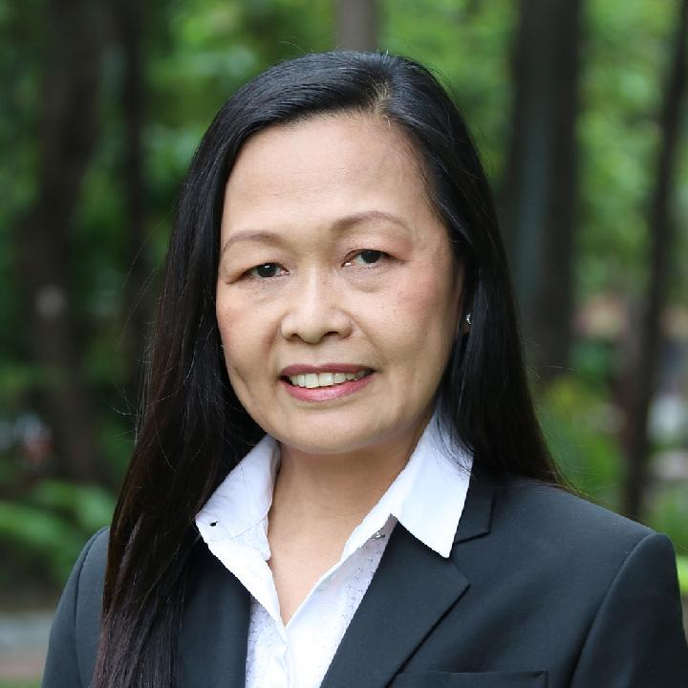
Panel Discussion – Socio-Economic and Marketing Sustainability under Alternative Development
Panelists : AD farmers from RPF and HRDI, Thailand, Myanmar and Lao PDR
“Marketing and Logistics Development”
“Green Marketing Strategy”
“Health Care and Malnutrition”
“Community Forest Conservation and Development”
1. Dr. Anchan Chompupoung
2. Mr. Suchat Ramarch
3. Prof. Emeritus Dr. Kraisid Tontisirin
4. Assist. Prof.
Dr. Sapit Diloksumpun
Assistant Director, Royal Project Foundation Office, Chiang Mai
Senior Executive Vice President, Non-Oil Retail Business PTT Oil and Retail Business Public Company Limited
Kasetsart University: Community Forest Conservation and Development
Senator: Health Care and Malnutrition
Moderator: Assoc.Prof.Dr. Avorn Opatpatanakit, Vice President, Research and Academic Services, Chiang Mai University

Slide 3
Dr. Anchan Chompupoung
Head of Research and Development Division, Royal Project Foundation
Assistant Director, Royal Project Foundation, Chiang Mai Office
Board of Directors, Doi Kham Food Products Co., Ltd
Research and Development Sub-committee, Highland Research and Development Institute
Academic Committee: Good Agricultural Practices for Food Crop. (TAS 9001-2013)
National Bureau of Agricultural Commodity and Food Standards, Ministry of Agriculture and Cooperatives
“Marketing and Logistic Development”

Slide 4
Mr. Suchat Ramarch
Senior Executive Vice President, Non-Oil Retail Business PTT Oil and Retail Business Public Company Limited
Business Manager, Café Amezon
Marketing Manager, government and private sector
Trainings: TLCA Executive Development Program
Director Certification Program (DCP)
“Green Marketing Strategy”

Slide 5
Professor Emeritus Kraisid Tontisirin,M.D., PhD
A Senator
A Senior Advisor, Institute of Nutrition, Mahidol University (INMU)
Chairman of Mahidol University Council
Vice President of Mahidol University on Planning and Research from 1987-1991
A member of the National Food Committee, and the Chairman of the Planning Committee for the Strategic Framework for Food management of Thailand
Director of Food and Nutrition Division, FAO from 2000-2006
Director of INMU from 1991-1999
Having received numerous recognitions and awards
“Sustainable Highland Development: Health cares and nutrition”

Slide 6
Assistant Professor
Dr. Sapit DILOKSUMPUN
Background: M.Sc. (Forestry), Ph.D. (Biological Science)
Head of Department of Silviculture, Faculty of Forestry, Kasetsart University
Researcher, Royal Forest Department, 1992-2002
Senior Researcher, Department of National Parks, Wildlife and Plant Conservation, 2002-2006
“Community Forest Conservation and Development”

