Slide 1
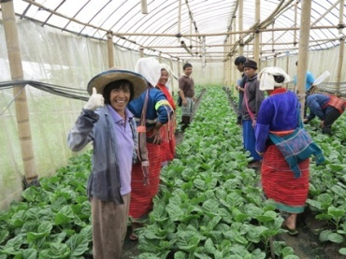
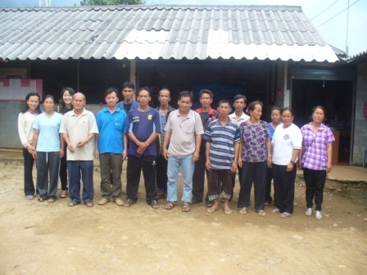
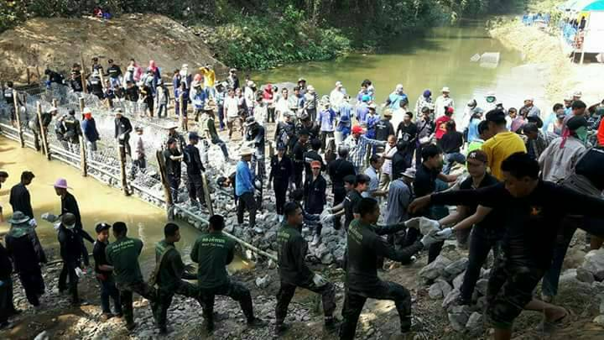
Highland Sustainable Development using Royal Project System
and Next Step to National and International Sustainable Development

Slide 2
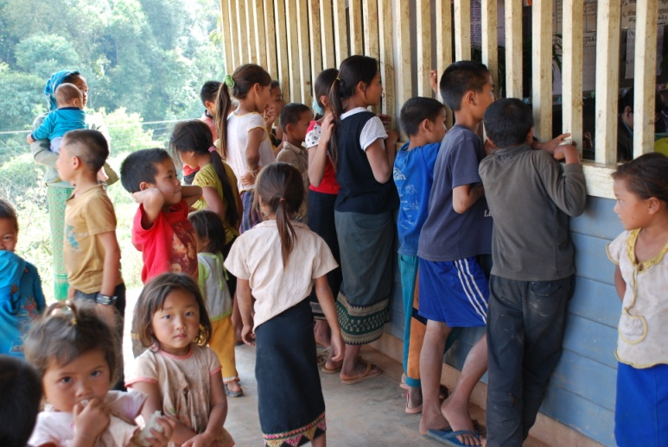
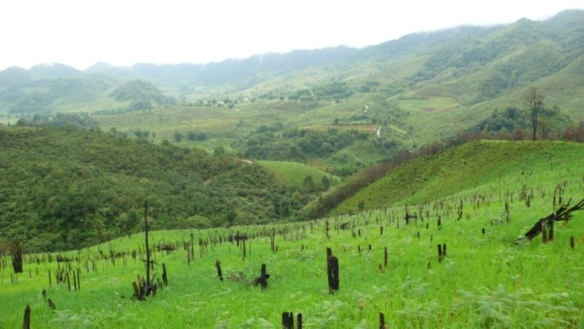
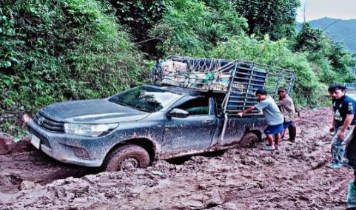
Key Points
1. Sustainable Highland Development using Royal Project System
2. 12-Year Royal Project Model towards the Thai Highland Development
3. Next Step to the National and International Sustainable Development

Slide 3
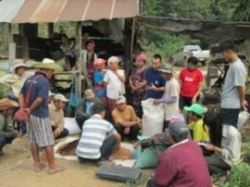
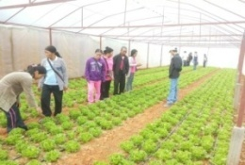
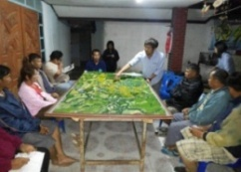
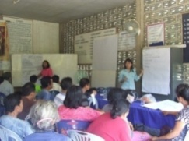
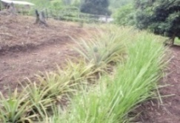
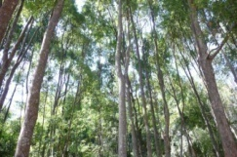
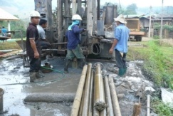
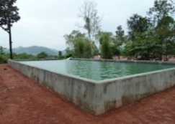
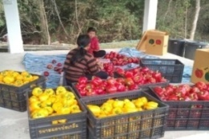
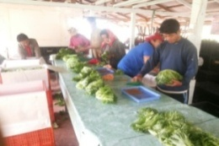
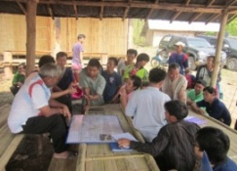
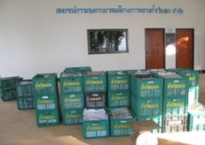
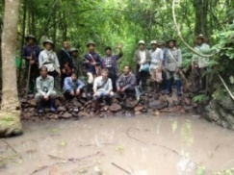
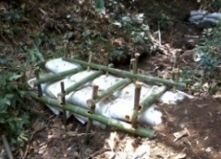
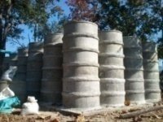
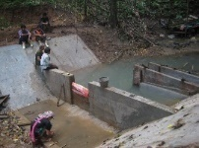
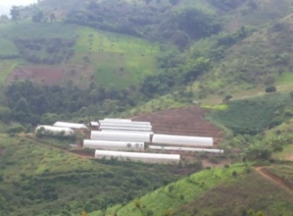
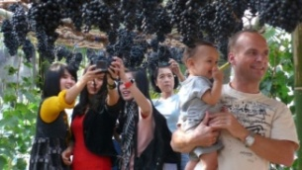
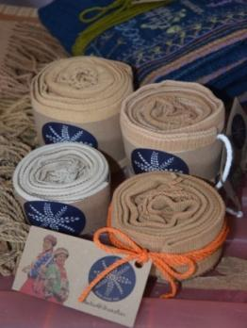
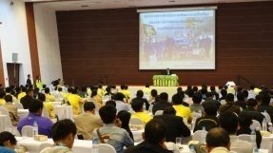
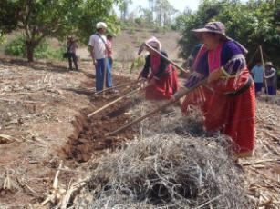
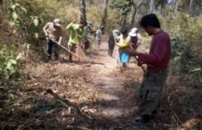
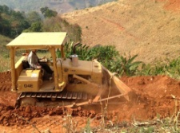
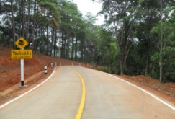
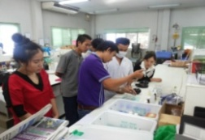
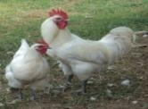
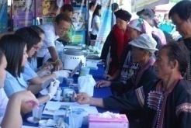
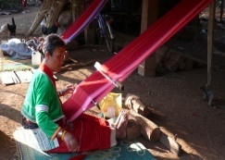
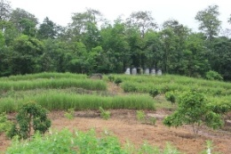
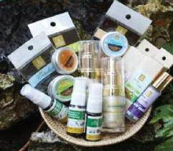
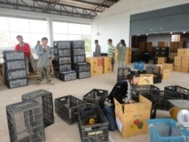
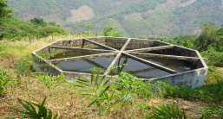
The Royal Project
The King’s Philosophy: Sustainable Highland Development Model
Communities have been strengthened.
Natural Resources have been conserved and restored.
Agricultural Extension
Programme
Community Capacity Building
Natural Resources
Conservation
and Restoration
Basic Infrastructure
Development
ถ่ายทอดควารู้
Vocational supports
Participatory
Community Plan
Vertiver grass
Community forest
Groundwater
Water storage
Market
Post-harvest management
Capacity building
Farmers’ Institute
Water source restoration
Check dams
Water storage
Water storage
Ecological farming practices
Non-vocational training
Local wisdoms
Good governance workshops
Soil fertility improvement
Forest conservation
Roads
Roads
Market management
Food Safety Standards
Livestock
Hygiene
Culture/rituals
Soil and water conservation
Biodiversity
Water storage
Sufficient Economy Philosophy/ Geographical development/Knowledge and information/
Community participatory/Integrated working between multi-organisations

Slide 4
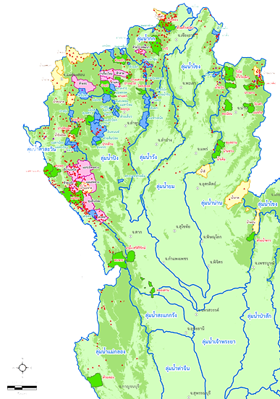
Royal Project Model: the Prototype of the Thai Highland Development
“When the Royal Project has been successful in piloting highland development, His Majesty King Rama IX told Mr. Anand Panyarachun (Former Prime Minister) in 1992, that the Government should establish an organization to extend the Royal Project work to other highland areas.”.
HSH Prince Bhisatej Rajani’s speech given on 7 March 1996 in the oyal Project Foundation Board meeting
Highland Research and Development Institute (Public Organization)
Highland Development Division
1992
2005

Slide 5
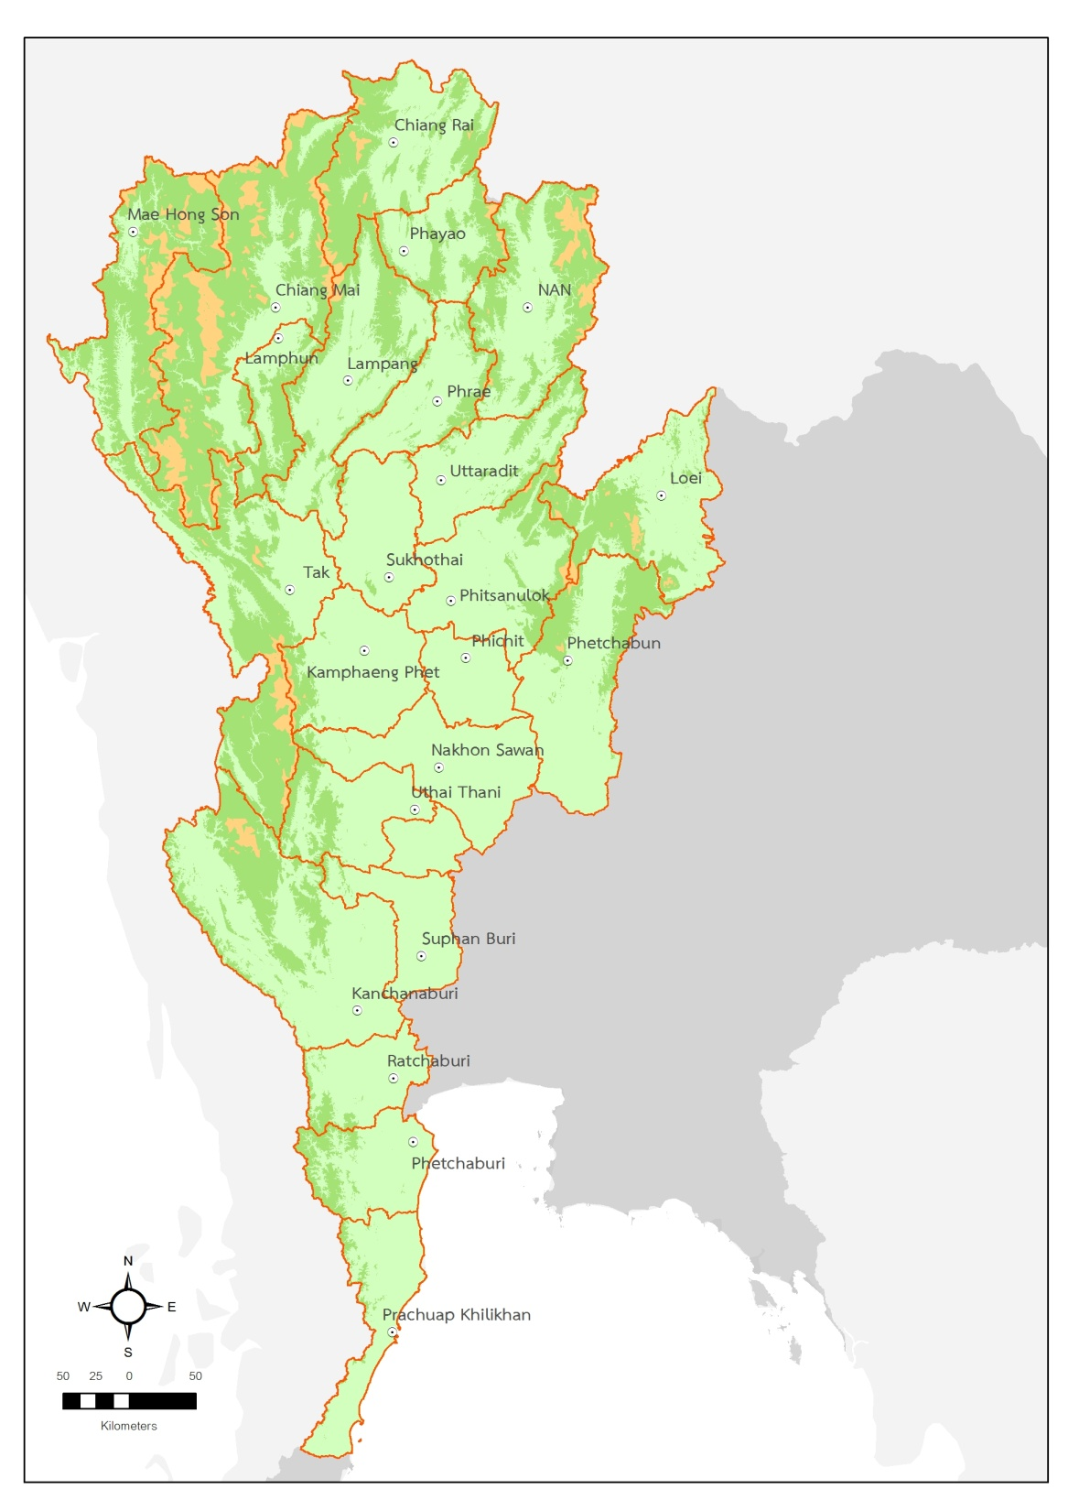
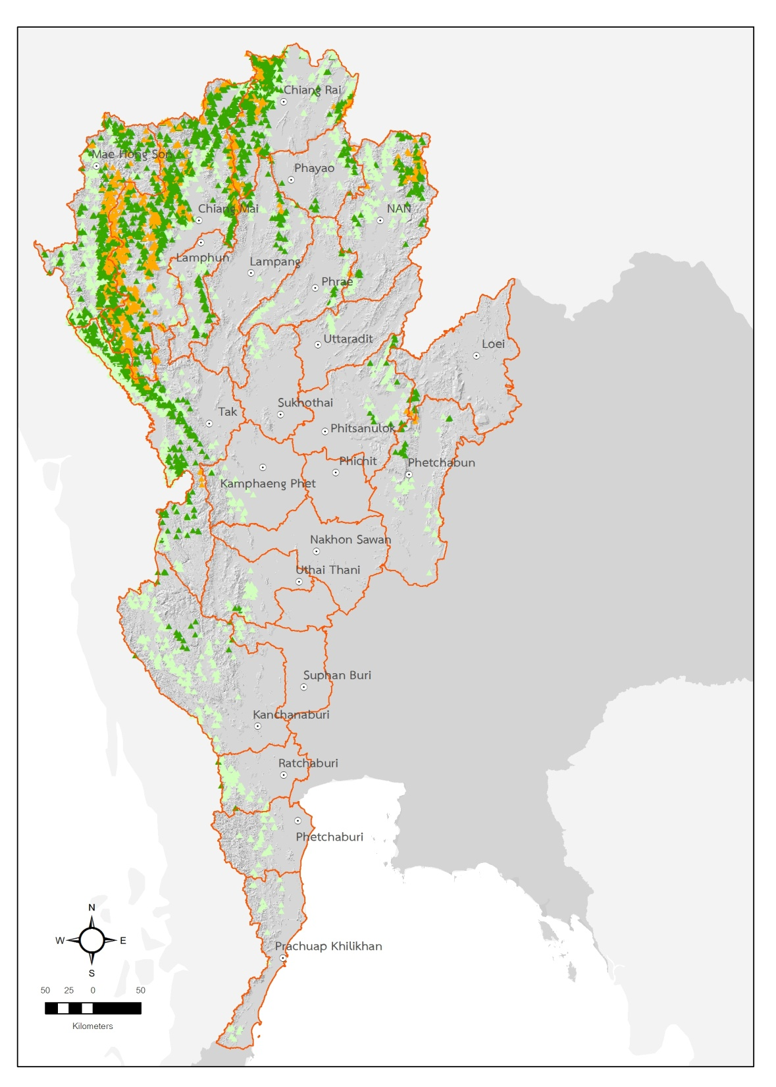
Thai Highland Village Clusters
AREA | Altitude (msl.) | Highland Village Clusters | Percent
 | Less than 500 meters | 1,447 | 35.00
 | 500-1,000 meters | 1,985 | 47.00
 | more than 1,000 meters | 774 | 18.00
 | Total | 4,206

Slide 6
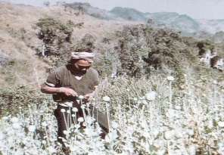
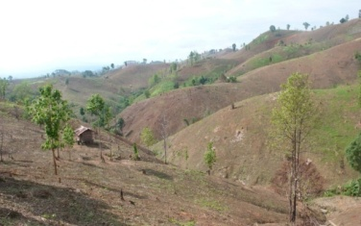
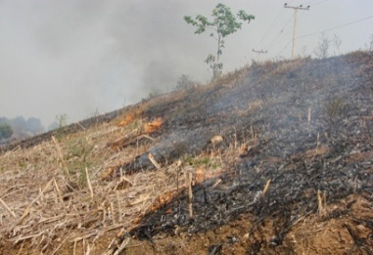
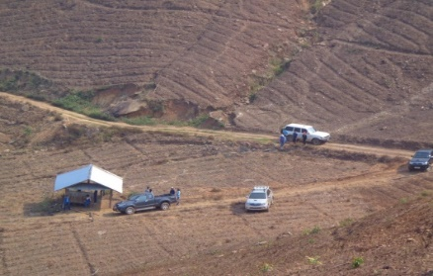

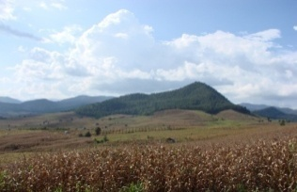
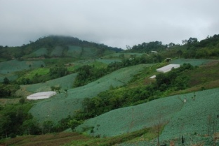
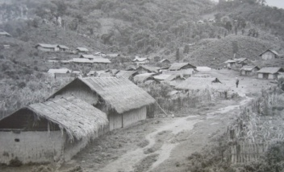
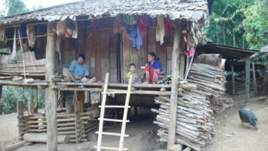
Problem Changes in the Thai Highlands
Degradation of natural resources
Illicit opium crops
Shifting cultivation and non-sustained agricultural practices
Poverty
1969
Estimated highland population: 275,000 people
Poverty / Inequality
2005
Estimated highland population: 800,000 people

Slide 7
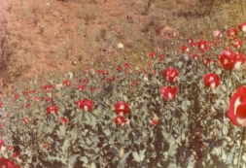



Royal Project Model: the Prototype of the Thai Highland Development
Alternative development for illicit crops substitution and watershed forest rehabilitation
Altitude of higher than 1,000 m. a.s.l.
(744 clusters)
Alternative development for poverty and inequality reduction and natural resources and environment conservation
Altitude of 1,000 m. a.s.l.
(4,202 clusters)

Slide 8






Royal Project Model: the Prototype of the Thai Highland Development
Research for Alternative Crops
Temperate climate fruit trees
Cash crops
Community Development
Geographical development
Knowledge development
Agricultural extension
“ …to encourage and support the hill tribe people for a better living, being able to cultivate and receive gains. Despite living in rural areas, they can have knowledge to achieve self-sustainability.”
His Majesty King Bhumibol Adulyadej’s Royal Speech
Given on 10 January 1974 at Faculty of Agriculture, Chiang Mai university
Marketing
Competitiveness
Food Safety Standard

Slide 9




The Extension of the Royal Project Success to Solve the Problems in the Thai Highlands

Slide 10



Sustainable Highland Development Operational Areas Using the Royal Project System
1. Thai highlands cover 67.22 mill. rai in 20 provinces, 4,148 villages, 950,000 people
2. The Royal Project covers 6 provinces in 468 villages
3. Highland Development Using Royal Project System by HRDI operates 3 projects in 18 provinces, 1,530 villages
Poverty Reduction
Environmentally-friendly Career Promotion
Natural Resources and Environment Conservation

Slide 11
Highland Development Project Using Royal Project Model
Strengths-based well-being community and development of natural resources and environment
Highland Developent Project Using Royal Project Model
1. Career Promotion
2. Strengths-based community building
3. Natural resources conservation and restoration
4. Basic infrastructure development
Private sector
Communities/
Leaders
Government
sector
Headquarters support staff
Sub-district Administration Organization
On-site officers

Slide 12



The Problems on the Highlands
1. Remote and rural, no access to transport services
2. Lack of employment opportunities and market limitation
3. Degradation of natural resources: soil, water, forest from unsustainable farming
4. Inadequate public health, education and social-welfare services
5. Lack of basic infrastructure required for living and career opportunities

Slide 13

Development Results
Pang Dang Nai Highland Development Project Using Royal Project System
Replanted watershed forest
Buffer zone forest
Forest Plantation: 3 Forests for 4 Benefits
Settlement
Community forest
Forest Plantation: 3 Forests for 4 Benefits
Perennial fruit trees
Greenhouses
Perennial fruit trees
Aerial photograph 2019

Slide 14














Development Results: Balanced Development
(Pang Dang Nai Highland Development Project Using Royal Project System)
Infrastructure Development
Irrigation System
Electricity/Groundwater
Soil and Water Conservation
Agricultural Extension
Agricultural System
Grapes
Greenhouse vegetables/
Perennial Fruit Trees
Farmer’s Institute and Marketing
Post-harvest Management
Co-operative Groups
Self-sustained Communities
Natural Resources Conservation and Restoration
Maize-soybean Intercropping
Firebreaks
Community Forest
Check Dams

Slide 15




Development Results: Self-Sustained Communities
Self-Driven Natural Resources Conservation and Restoration
Zoning: Forest and Farming Areas
Environmentally-Friendly Agriculture
Natural Resources and Environment Conservation and Restoration

Slide 16



Environmentally-Friendly Agriculture: From Maize to Perennial Fruit Trees
Lhongcord Highland Development Project Using Royal Project System, Chiang Mai Province
Lhongcord Highland Development Project using Royal Project System, Chiang Mai Province
Field crops/ Maize 93 rai
Arable land 1,924 rai
2013 : Maize 1,064 rai
2018 : Maize crops decreased almost 100%
More diverse crops
Recovery of forest areas
Economic Forests
(mango, longan, wood)
1,075 rai
Conserved Forest
13,662 rai
Watershed Forests
3,009 rai
Rice 269 rai
Mae Sai Na Lao Village 18,995.16 rai
Reforestation Areas 487 rai

Slide 17








Environmentally-Friendly Agriculture: From Maize to Perennial Fruit Trees
Mae Jarim Highland Development Project Using Royal Project System, Nan Province
Land Use 2002 : Google Earth
Lans Use 2015 : Google Earth
Land Use 2017 : Drone
Land Use 2017 : Drone

Slide 18


Environmentally-Friendly Agriculture: From Maize to Perennial Fruit Trees
Mae Jarim Highland Development Project Using Royal Project System, Nan Province
Forest
Settlement
Maize
Perennial trees
Rice
Fruit trees
Horticulture
Agroforest
2012
2016

Slide 19










Development Results: Production Standard, Post Harvest Management and Marketing
(Mae Jarim Highland Development Projects Using Royal Project System, Nan Province)
Makro, Nan
Mae Jarim
Bangkok

Slide 20






Development Results: Environmentally-Friendly Agriculture Replacing Field Crops
Bo Kluer Highland Development Project Using Royal Project System, Nan Province
Coffee
National Park
National Preserved Forest
Terrace Paddy Field
Vegetables and Fruit in Greenhouses

Slide 21









Development Results: Environmentally-friendly Agriculture
Shifting cultivation
Environmentally-friendly farming

Slide 22






Development Results: Career Opportunities and Living Conditions
Parents
Children
Grandchildren
Grandchild
Mother
Child
Previous Living
Sustainable Living

Slide 23


















Development Results: Burning Reduction with the Environmentally-Friendly Farming
(Highland Development Projects Using Royal Project System, 11 Areas in Chiang Mai)
Hotspots (January - April 2019)
Environmentally-friendly farming
Natural resources conservation and restoration
Hotspot
Map Legend
District
Project Area
≤ 500 m a.s.l.
≥ 500 m a.s.l.

Slide 24














Development Results: Strengths-Based Communities with Self-Driven Development

Slide 25



Highland Sustainable Development Using Royal Project System
1. Development based on problems, needs and social geography of the communities
5-year Master Plan (2018-2022) Highland Development Using Royal Project System
แผนชุมชน
5-year Master Plan (2018-2022) Highland Development Using Royal Project System: Area-based and village plan
Community Plan
Annual Plan: Area-based plan
with integration practice
24 organisations

Slide 26









Highland Sustainable Development Using Royal Project System
2. Development based on database
Water Analysis
Soil Analysis
Data management
-results from analysis of water and soil
-unassessed data
Passed
Poor
Passed
Good
Not passed
Excellent
Good
Passed
Soil fertility analysis for chemical use reduction
Poor
Good

Slide 27



Highland Sustainable Development Using Royal Project System
3. Development based on knowledge management
(Example) Khun Sathan Highland Development Project Using Royal Project System, Nan Province
Capsicum Growing in Greenhouse
Chemical use 11.12 L/rai/p.a.
Sale revenue 211,200 TBH/rai/p.a.
Grape Growing in Greenhouse
Chemical use 7.2 L/rai/p.a.
Sale revenue 779,154 TBH/rai/p.a.
Cabbage Growing in Greenhouse
Chemical use 22 L/rai/p.a.
Sale revenue 5,800 TBH/rai/p.a.

Slide 28














Knowledge…..Development Power……The Key to Problem-Solving
Multiple Alternative Careers
Delicate production with high returns

Slide 29










Knowledge…..Development Power……The Key to Problem-Solving
ระยะตัดดอกที่ 2
ระยะตัดดอกที่ 1

Slide 30











Development based on Knowledge Management
(Example) Highland Development Projects Using Royal Project System
11 areas, 96 communities, Nan Province
Problems
Research and Development
Well-being Communities
Learning Centres
1
2
3
8
7
4
5
6
9
10
11

Slide 31











Highland Sustainable Development Using Royal Project System
4. Promotion of environmentally-friendly careers and marketing management

Slide 32




Food Safety Standards/ Post-harvest Management/ Sustainable Markets

Slide 33

Farmers’ Market / Farmers’ Institutions
Highland Sustainable Development Using Royal Project System
Operation Process
Highland Development Project
Production and marketing analysis, plan and promotion for farmers’ groups / technology transfer / production quality standard improvement
Farmer
Define career opportunities
Make plans for production and marketing
Establish and develop farmers’ groups
Marketing
Demand survey
Local marketing development
Production and marketing plan
Farmers’ groups management improvement
Specialists
Production and marketing analysis, plan and promotion for farmers’ groups / technology transfer / production quality standard improvement
Good Agricultural Practices: GAP (production and post-harvest management)
Farmers groups
Local markets
Local merchants
Contract farming
Royal Project market

Slide 34





Highland Sustainable Development Using Royal Project System
5. Development of basic infrastructure for career opportunities and well-being

Slide 35







































Highland Sustainable Development Using Royal Project System
6. Integration Practice and Community Participation
อนุรักษ์พันธุ์ปลา/ ฝายชะลอน้ำ
- ส่งเสริมอาชีพ และการตลาด
- สร้างความเข้มแข็งของชุมชน
- การอนุรักษ์และฟื้นฟูทรัพยากรฯ
พัฒนาถนน และไฟฟ้า
(อบต., การไฟฟ้า)
Officers
พัฒนาแหล่งน้ำ
ระบบอนุรักษ์ดินและน้ำ
พัฒนาระบบน้ำ (บ้านแม่วาก ต้นน้ำแม่มะลอ)
อนุรักษ์และฟื้นฟูป่า
ป่าสร้างรายได้
พัฒนาแหล่งน้ำ
Operational sites
ส่งเสริมการเกษตร
Multi-parties
Highland Research and Development Institute
Community
Community leaders

Slide 36













Highland Sustainable Development Using Royal Project System
6. Integration Practice and Community Participation
Fish conservation and check dams construction
Vocational supports
Community capacity building
Natural resources conservation and restoration
Infrastructure development (electricity and roads)
Water resource development
Provincial Working Group on Highland Development Projects
(Chairman: Governor)
Soil and water conservation
Irrigation system development (Mae Wak Village and Mae Ma Lor Village)
Forest conservation and restoration
Non-timber forest production
Water resource development
Agricultural Extension Programme
District Working Group on Highland Development Projects
(Chairman: District Chief)

Slide 37





Development Results: Environmentally-Friendly Agriculture with Integration Practice
(Huay Kayeng Highland Development Project Using Royal Project System, Kanchanaburi Province)
Department of Water Resource
Solar panels
Check dam
Water tanks
HRDI
Community

Slide 38



Highland Sustainable Development Using Royal Project System
7. Community Leader Capacity Building to Drive the Development
Uplifting the community development following the Sufficiency Economy Philosophy,
using information and knowledge management
Highland Community Leaders

Slide 39



















Farmer Leader Development
Mr. Vichian Siriyot
land area: 10 rai
Environmentally-friendly agriculture and natural resources and environment conservation
1
Mrs. Suree Sriburin
land area: 10 rai
2
2
3
1
Map Legend
Land Map
Stream
Road
Mr. Pornpipat Wonglek, land area: 20 rai
3

Slide 40










Highland Sustainable Development using Royal Project System
8. People-centric and Continued Development

Slide 41

Highland Sustainable Development Using Royal Project System
Following the Sufficiency Economy Philosophy
Sufficiency Economy Philosophy
Community
Well-being Communities
1. Environmentally-friendly career with sufficient income
2. Natural resources and environment conservation
3. Strengths-based communities
4. Access to basic infrastructure
Reasonableness
Institution
Moderation
Self-immunity
Organizations
Knowledge
Integration and Participation
Ethics
Sustainable Development
Principle Thinking
Analyse, Plan, Develop

Slide 42





International Cooperation
Bhutan
Lao PDR
Myanmar
Colombia
Afghanistan

Slide 43






Highland Sustainable Development Using Royal Project System:
Step to International Alternative Development
Thai –Lao Technical Cooperation (2009 – 2014)
The Royal Project Foundation and HRDI joined hands with Lao PDR and UNODC on technical cooperation project, encouraging alternative development to improve the quality standard of Lao people
Udomxai Province
Na Saeng Kham
Village
Huayoun Village
Livelihood Development Programme
after eradication of opium poppy cultivation

Slide 44





Poverty Reduction with Alternative Career Opportunities
Poverty
Lack of career opportunities after stop growing opium

Slide 45


























Promotion of Alternative Development in 2 Pilot Villages

Slide 46








Achievement
2 pilot villages has been developed with alternative career opportunities and become learning centres
Extension programme to over 20 villages in Oudomxai Province and other provinces.

Slide 47






Marketing Leads Production ….. The Key to Development Success
Market survey for development plan
and support of alternative career opportunities

Slide 48






Career Development and Promotion
Promote new varieties of fruit trees, greenhouse vegetable under safety standards with sustainable markets
Increase of rice yield

Slide 49









Knowledge Transfer with Hands-on Training and Continuous Learning

Slide 50












Knowledge Transfer with Hands-on Training and Continuous Learning

Slide 51






Basic Infrastructure Development

Slide 52









Understand, access and develop…The Key to Success

Slide 53






Afghanistan
Building Development-Oriented Rural Enterprises Project
Support local agricultural business and training

Slide 54




COLOMBIA
Land Use Planning and Management
Research for Development
Post-Harvest Process and Quality Management
Coffee Post-Harvest Process and Transformation
Organic & Specialty Coffee Marketing

Slide 55



BHUTAN
Basic landscaping and designing
Cut-flower production and management on roses, orchids & chrysanthemum
Orchid production and management
Strawberry production and post-harvest technology
Temperate ornamental fruit tree production and management
Basic principles of flower arrangement techniques

Slide 56





BHUTAN
Mushroom production and post-harvest technology
Vegetable production techniques and post- harvest technology
Compost, soil and land management technology
Sub-tropical germplasm fruits & Nuts collection techniques
Inland fisheries technology and management practices

Slide 57

ขอบคุณมากครับ
Notes:
57

