Slide 1
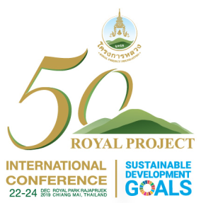
Marketing and Logistic Development
Anchan Chompupoung
Assistant Director of Royal Project Foundation Chiang Mai Office
Chief of Research and Development Division
The International Conference On Rising to the Challenge of Sustainable
Development Gaoals (SDGs) through Sustainable Highland Development:
The Royal Project Model
Royal Park Rajapruek, Chaing Mai
22-24 December 2019

Slide 2
Out line
1
Royal Project Alternative Development Model
2
Marketing under Royal Project Sustainable Alternative Development Model
3
Achievement from Marketing under Alternative Development
4
Way Forward

Slide 3
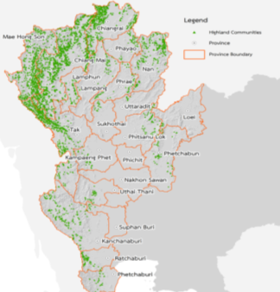
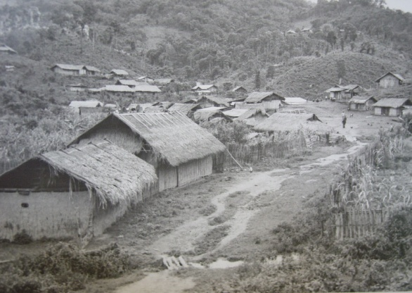
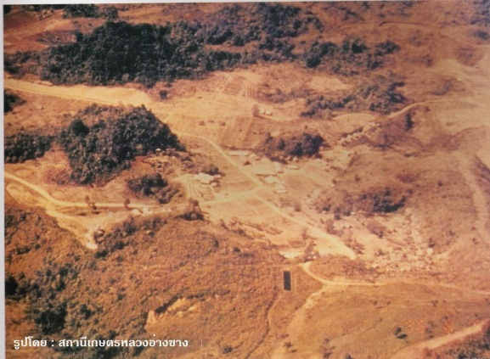
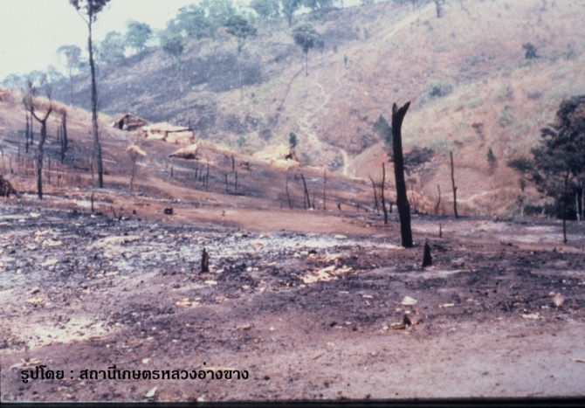
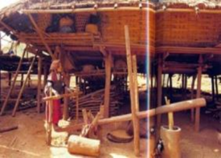
Statement of Thai Highland Problems in 1960s
Hill tribe communities had settled in remoted mountainous areas in 20 provinces
Forest land clearance by slash and burn farming
Limited access to basic
needs and infrastructure
Extreme poverty

Slide 4
The Royal Project Alternative Development Approach for Sustainable Development in the Highland
King’s Philosophy
Work Principle
Sufficiency Economy Philosophy
Area approach
Understand.. Access… Develop
The Royal Project Alternative Development Approach for Sustainable in the Highland
Eradicate opium poppy cultivation
Building a better quality of life
Rehabilitation and conservation of natural resources and environmental
people-centric development
Intregeted Agencies
Key program of operation
- Research
- development
- Marketing

Slide 5
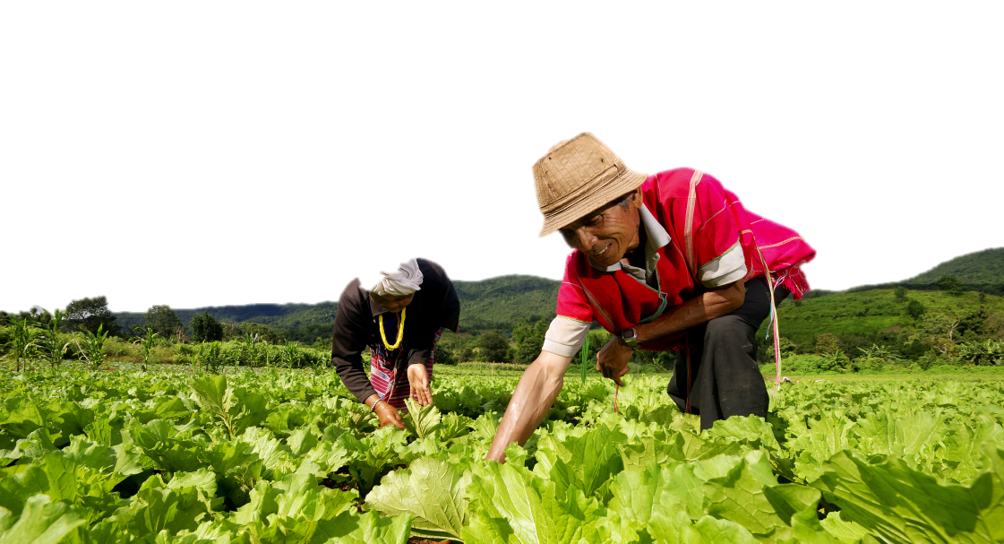
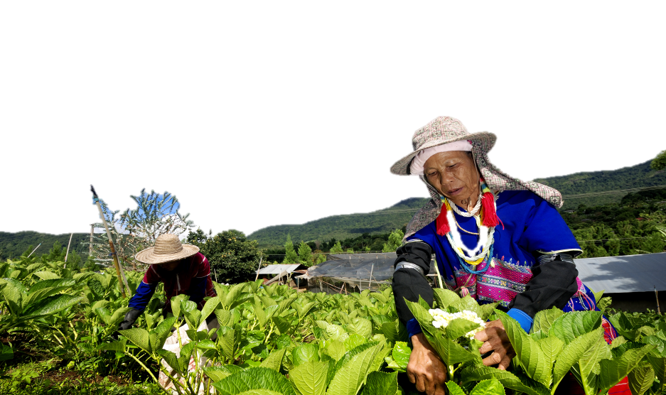
Key Programs for Sustainable Development
The Royal Project’s alternative development approach comprises of three interlinked programs intervention.
Research
Marketing
Development
“Research is imperative on what are not known”
Research on suitable crops with suitable cultivation and livestock have been conducted continuously.
“Knowledge transferring”
Temperate crops with cultivation technology and livestock have been introduced to hill tribe farmers as sources of income generation.
“Marketing” key part of sustainable development success
Marketing is an important part of success for crops replacement of opium poppy cultivation.

Slide 6
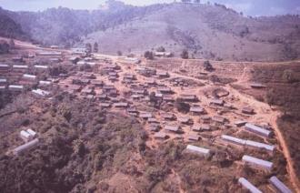
Marketing Establishment
Hill tribe people were unable to sell the produce by themselves due to
Hill tribe need income for household’s expense
Most communities were far from city.
Transportation was in poor condition.
Temperate crops were not known to the market.
The marketing managed by private company was not properly functioned.
while “opium can be traded in the highland area.”

Slide 7
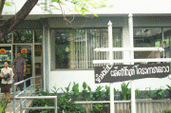
Marketing Unit Establishment
Establishing Marketing to support the sale of agricultural product for cash income
Royal Project comprehensive marketing is a social and non-profit enterprise aiming at helping the farmers
Marketing unit cooperated with 2 universities.
1981 Chiang Mai office in Chiang Mai university
1983 Bangkok office in Kasetsart University

Slide 8
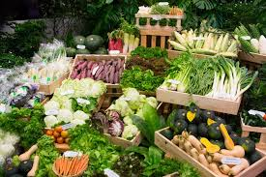
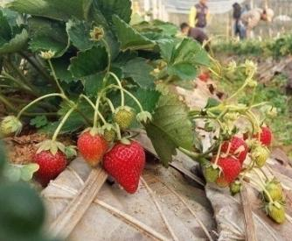
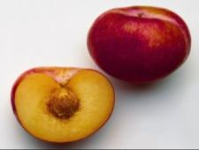
Marketing Strategy of Highland Development Product
Safety Product
Various product types
Product identity
Marketing Strategy
Research and
Development support
Niche market product
Food
sustainability
Friendly -environmental cultivation product

Slide 9
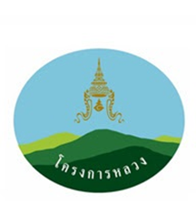
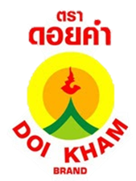
Building Customer Awareness
Branding
At present
Modification range
The Royal Project produce is certified by domestic and international food safety standard.
At the inception phase
Doi Kham brand was replaced with the new brand called “Royal Project” that conveys the organization image and trust in high quality produce – freshness, hygiene and food safety.
Having “Doi Kham” as the product brand that means fertility mountain and being as valuable as gold

Slide 10
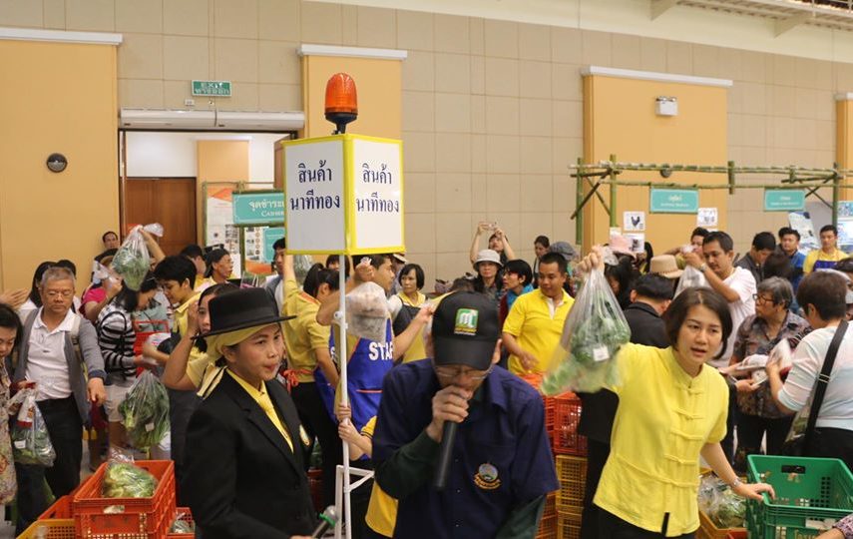
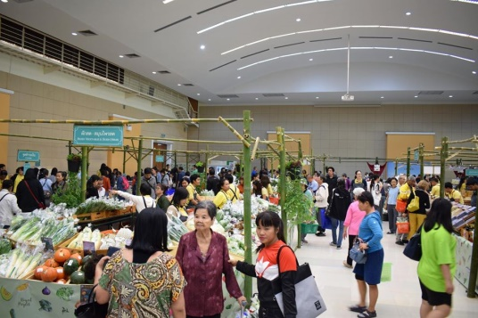
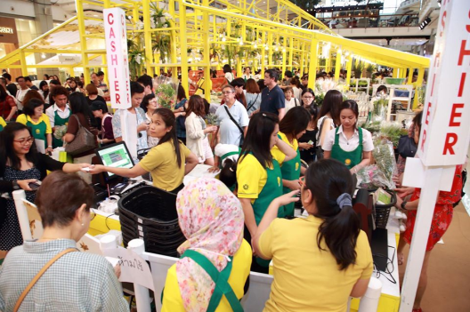
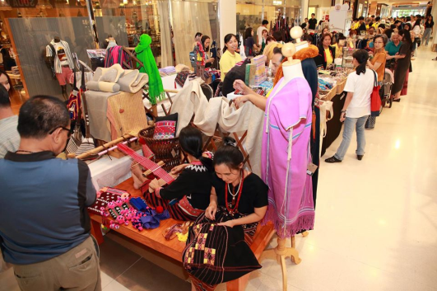
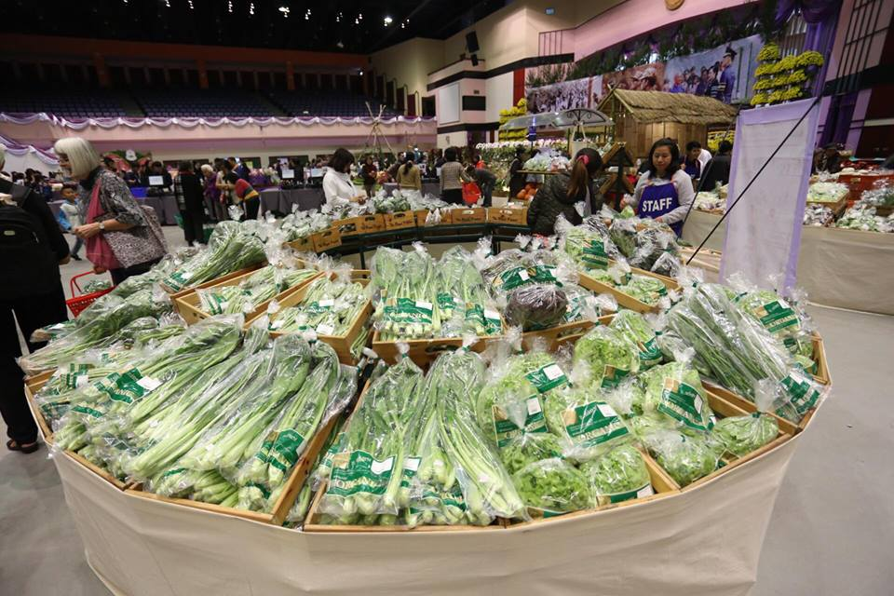
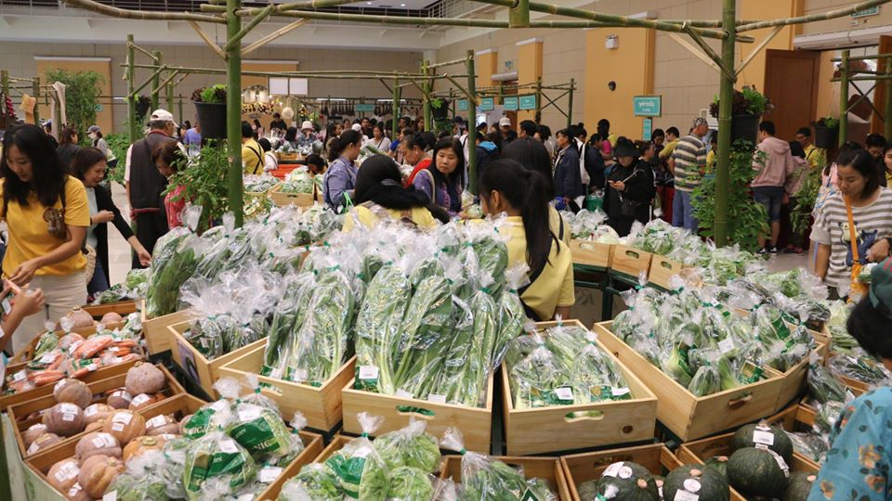
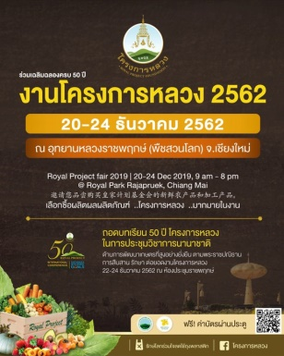
Building Customer Awareness
Promotion
“The Royal Agriculture Fair” was organized firstly
in Bangkok in 1980
At present, Royal Project Fair has been annually organized in Bangkok and Chiang Mai since 1989.

Slide 11
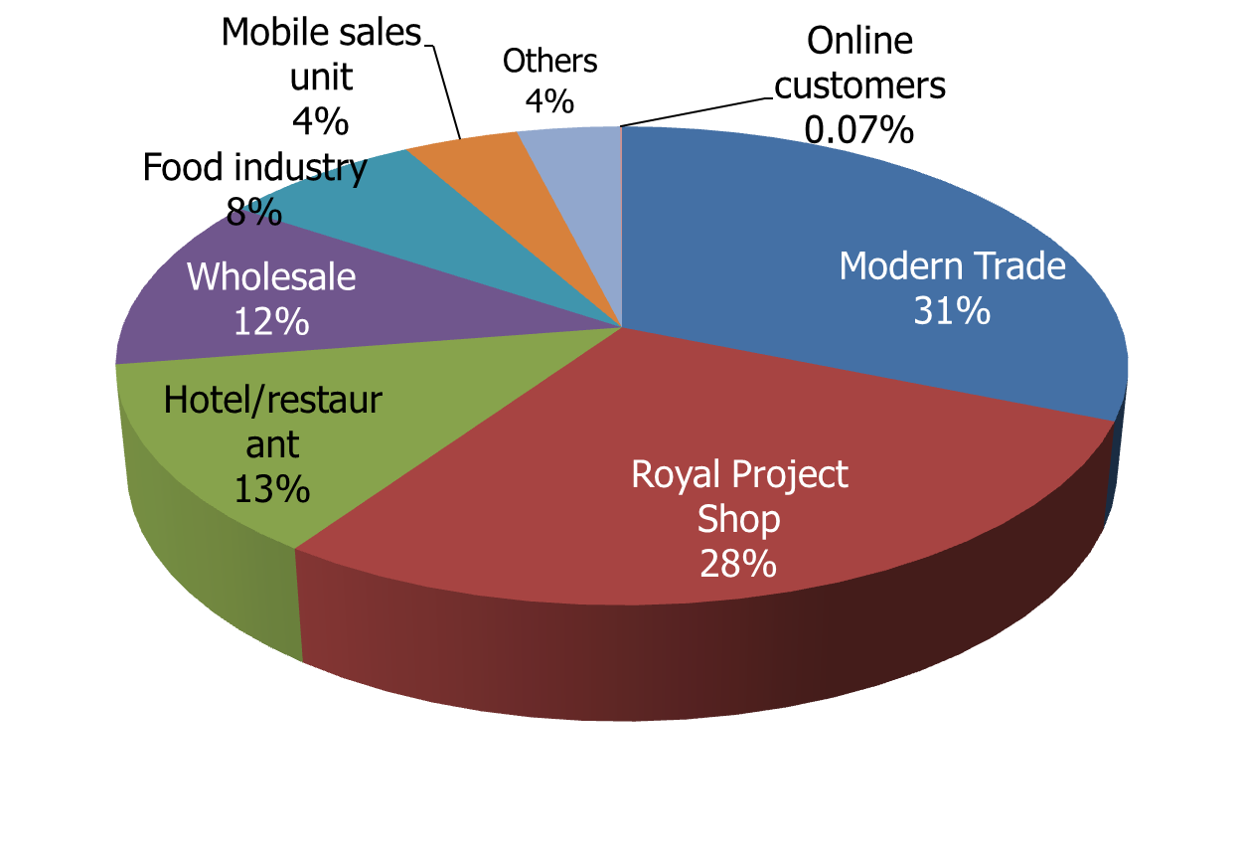
Marketing Channels
Marketing channel of highland produces
Royal Project Shop
Chiang Mai Airport Plaza
Central Plaza Chiang Rai
Royal Mae Hia Project Store (Outlet 1)
เชียงราย
Chiang Mai Airport
เชียงใหม่
Chiang Mai 89 Plaza
Suthep Road
Central Plaza Udonthani
อุดรธานี
Ramathibodi Hospital
Suvarnabhumi
Don Mueang Airport 1
Bon Marche
M.O.F
The Old Siam Plaza
The Old Siam Plaza
Kasetsart University
Don Mueang Airport 2
Future Park Rangsit
กรุงเทพ
There are 17 Royal Project shops, in total
10 in Bangkok, 5 in Chiang Mai, 1 in Chiang Rai and 1 in Udorn

Slide 12
Royal Project comprehensive marketing
Farming
Product processing
Distribution channels
Postharvest
-Zoning land use
- Food processing
- Soil & water conservation
- Pesticide residue analysis
- Non-food processing
- Food factory
- Modern Trade
Crop Planning
Extension program
Product processing
Distribution channels
Postharvest
- Production standard system
-GMP/HACCP
- The Royal Project shops
-Pre-cooling
system
-GMP/HACCP
GAP
- Hotel & Restaurant
Global GAP
Organic
- Reduce chemical pesticides
use
Traceability
Research & Development
Basic infrastructure support from government agencies

Slide 13
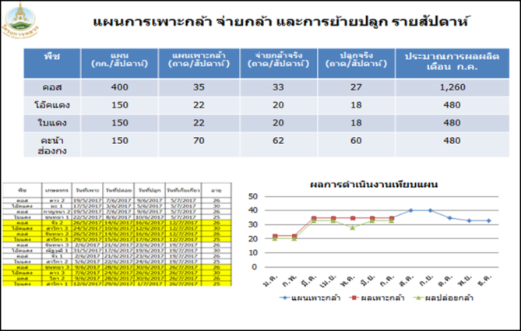
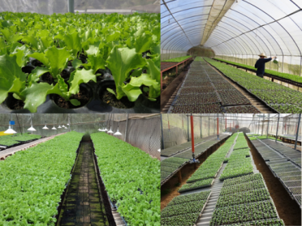
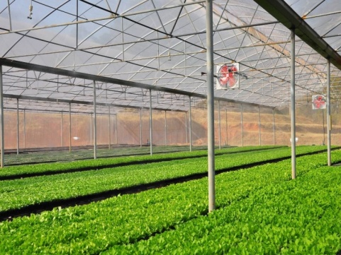
Quality Management System – food safety and environmental-friendly production
Crop planning
Weekly plan seeding preparation, seeding distribution, transplanting
For reducing the marketable risk, crop planning follows marketing demand.

Slide 14
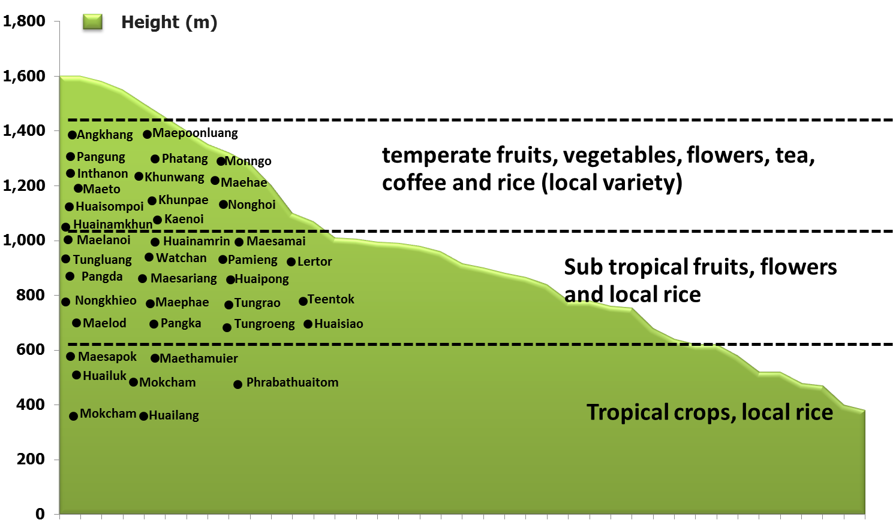
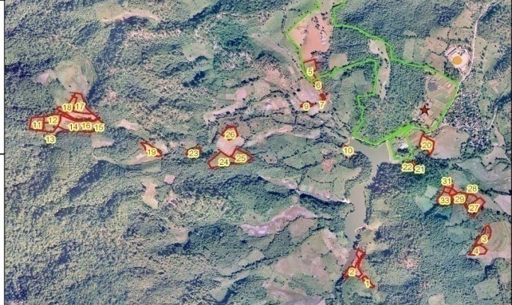
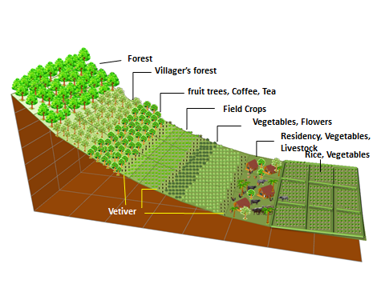
Quality Management System – food safety and environmental-friendly production
Zoning and Controlling farmer land use
Setting up the appropriate crop type to the area height
Promote hill tribe to cultivate crops with the concept of soil and water conservation system

Slide 15
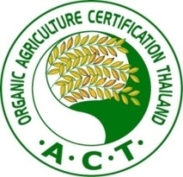
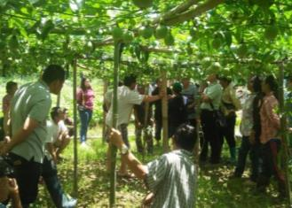
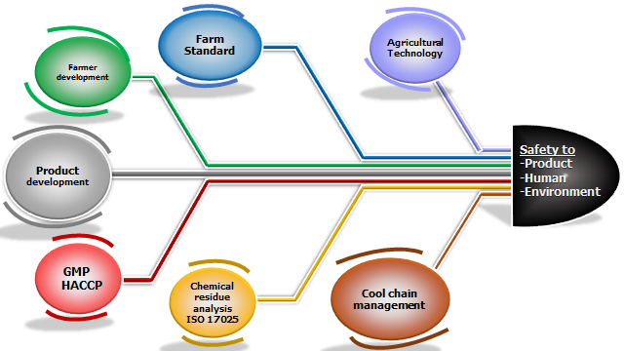
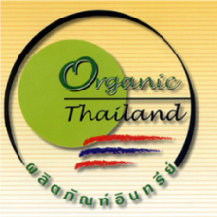
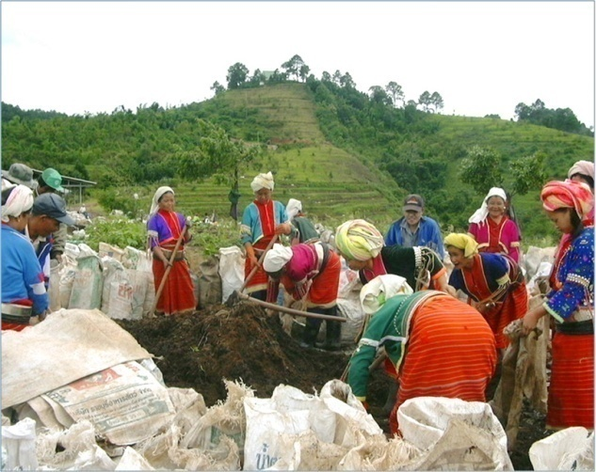
Quality Management System – food safety and environmental-friendly production
Farm management
GAP
Global GAP
Organic
Traceability system
Pre-cooling system
Cool chain truck
Postharvest

Slide 16
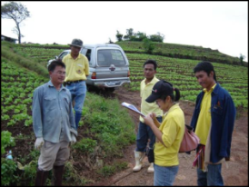
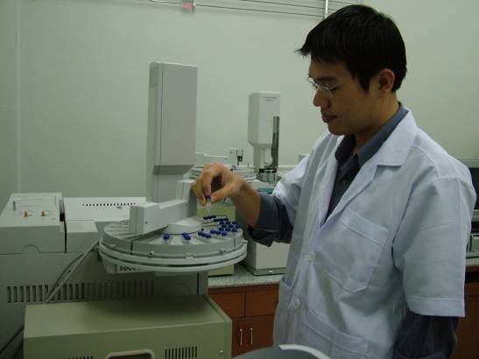
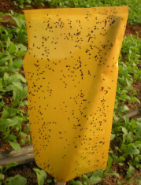
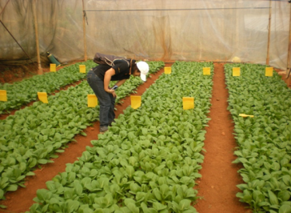
Quality Management System – food safety and environmental-friendly production
Established Plant Protection Centre, setting up plant clinic and local plant doctor staffs.
Farm visit to give advice to the farmer
Research on IPM with bio-pesticide, botanical pesticide and chemical pesticides for controlling plant pests.
Safety product
Setting up pesticide residue central analytical lab and small lab at each Development Center
Giving advice on how to use chemical pesticides correctly and safely
The production house was build to expand bio- control agents production to serve the farmer requirement
Using IPM
management for reduction of pesticides use

Slide 17
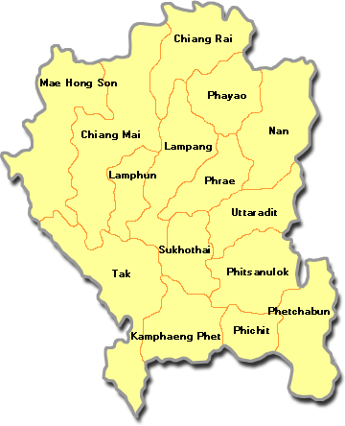
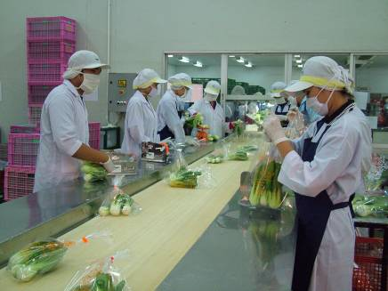
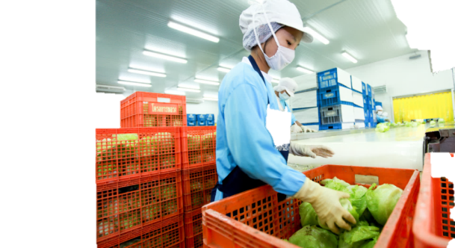
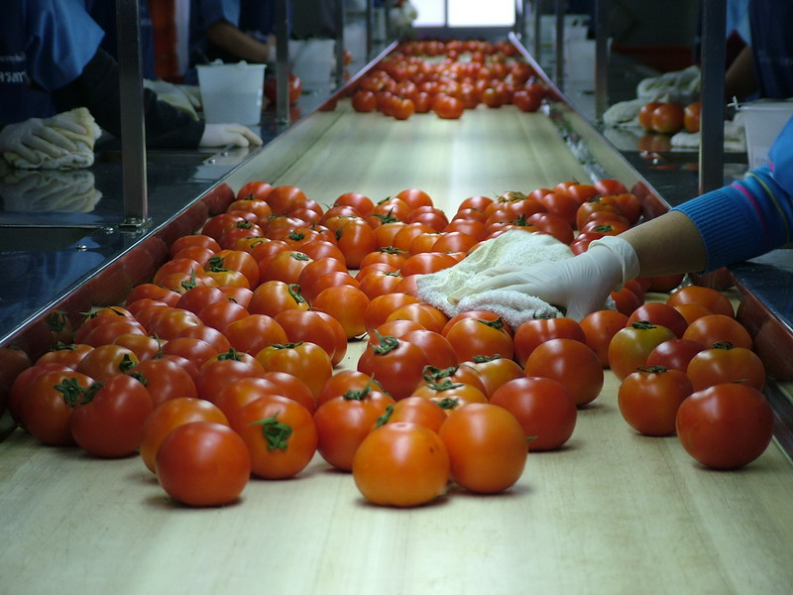
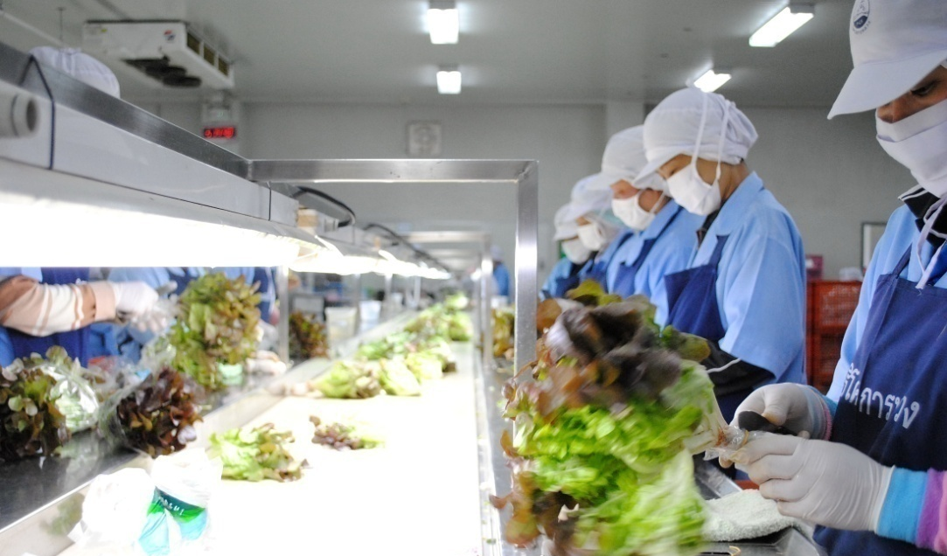
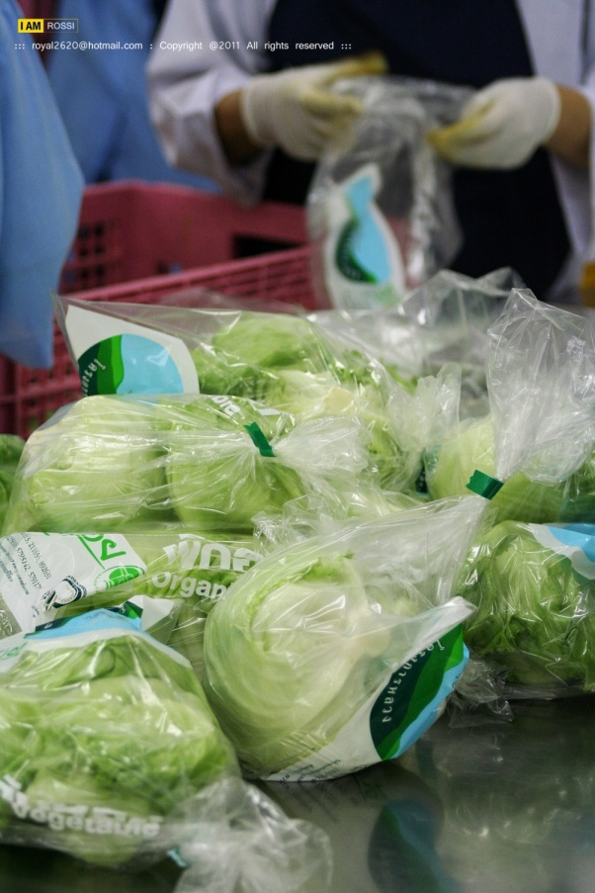
Postharvest Development
To meet the Food Safety Standard , the packing house both in Chiang Mai and Bangkok as well as at farm level have been developed.
Total of 47 packing house are certified;
11 stations are certified GMP/HACCP
36 stations are certified GMP by Ministry of Health
Mokcham
Angkhang
Phatang
Kaenoi
Huailuk
Maepoonluang
Huainumkhun
Pangka
Monngo
Maelod
Huaipong
Watchan
Maephae
Nonghoi
Huainamrin
Maesamai
Pamieng
Packing house In CM
Pangda
Tungrao
Teentok
Pangung
Tungroeng
Maethanuier
Maehae
Huaisiao
Tungluang
Maesapok
Inthanon
Khunwang
Maeto
Maesariang
Khunpae
Chiang Mai
Phrabathuaitom
Lertor
Tak

Slide 18
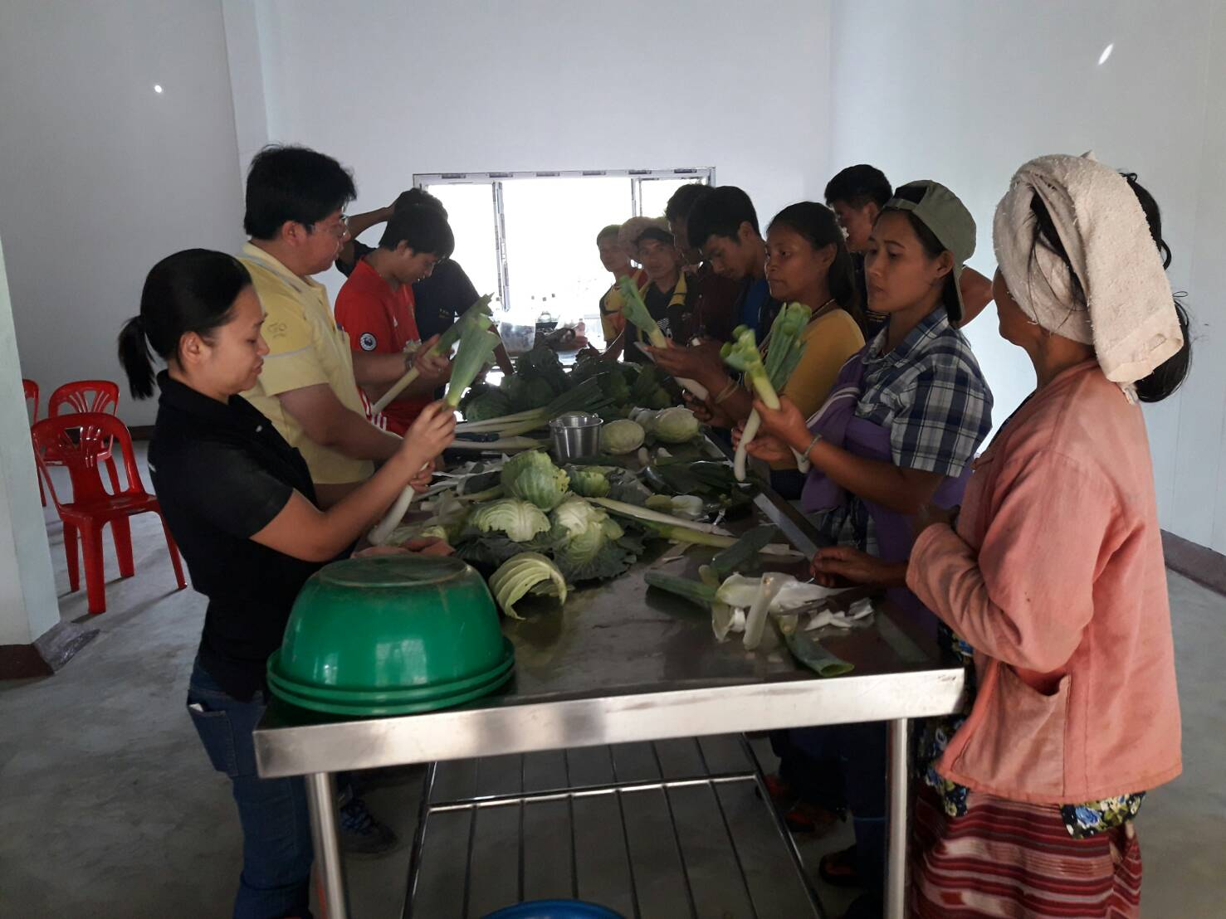
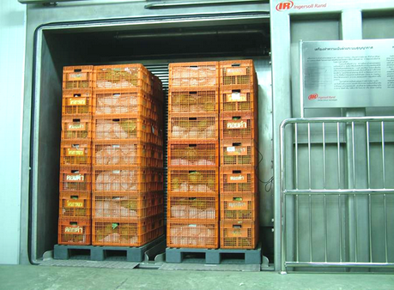
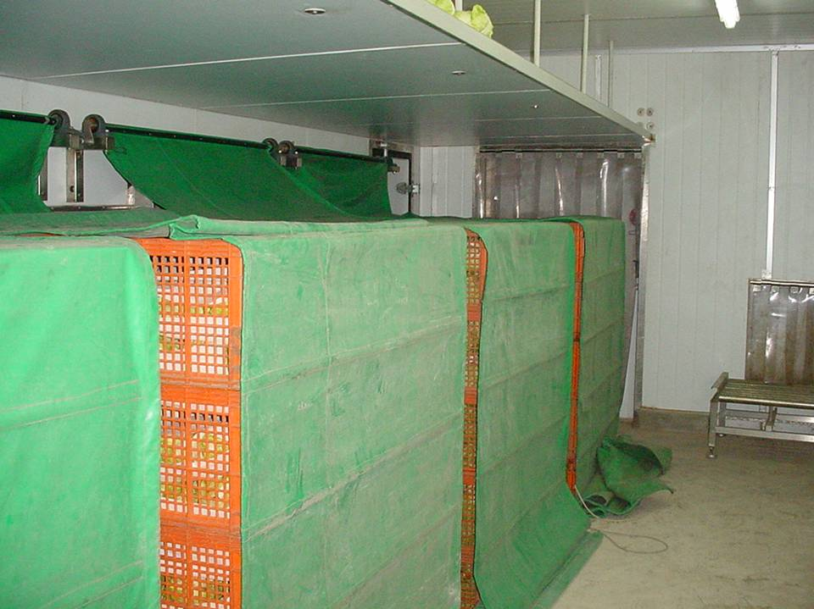
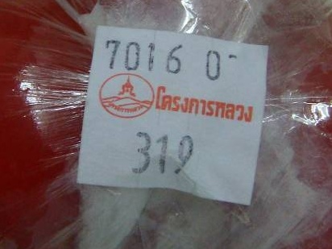
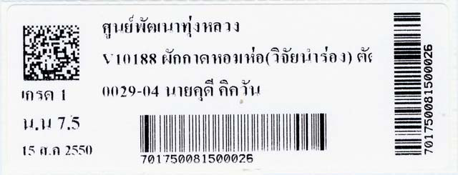
Pre-cooling system maintain highland product quality, prolong product shelf live and reduce loss,
Quality Management System – food safety and environmental-friendly production
Postharvest training
Hydro Vacuum Cooling
Research and development of Postharvest
Traceability system
Force Air Cooling

Slide 19
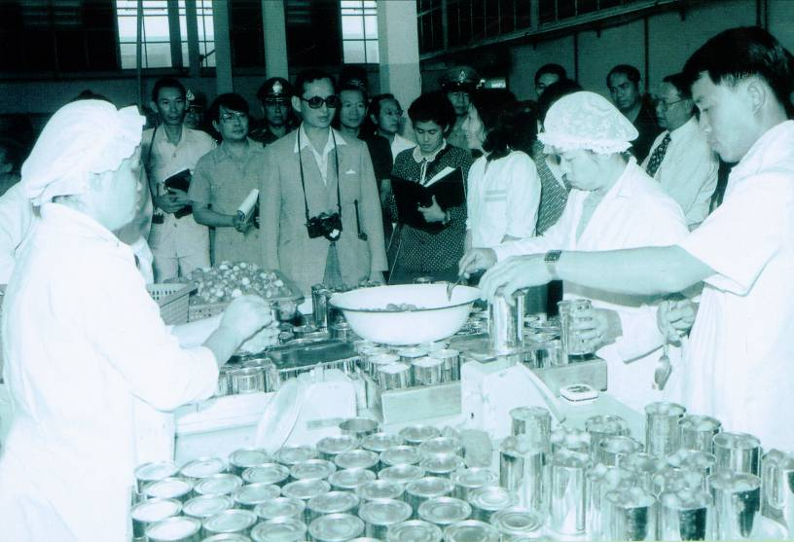
Value added of processed product
Past
Present
In 1972 His Majesty the King suggested to have Food Processing Plant at Chiang Mai university.
There are more than kinds of processing products produced by Royal Project Factory.
Reduce
loss
Royal Project Foundation Herbal care
gain
value
for fresh produce
Doi Kham
Food Products Co., Ltd.
Buoyancy price for farmer

Slide 20
Logistic development stage
Separated transportation
Grouping transportation
Directly from farm to customer
1
Sub center
1
Sub center
CM: Chiang Mai
1
2
Major center
Main center
1
2
Packing house
In CM
2
1
3
3
:
Packing house
In CM
Packing house
In CM
:
:
2
:
2
:
:
:
.
.
.
.
.
.
.
.
.
Packing House in Bangkok
.
.
.
:
:
Packing House in Bangkok &customer
38
Packing House in Bangkok
:
:
8
8
39
Royal Project Development Center
38
Royal Project Development Center
Royal Project Development Center

Slide 21
Cluster system of Royal Project Development Center
Cluster system purpose
RPF Center grouping is made to strengthen the supply chain management for the highlands.
Promote efficient use facilities.
Provide knowledge exchange and sharing among communities .

Slide 22
Marketing Development Stage
Phase 5
Phase 4
(2009-present)
(1999-2008)
- Production cost efficiency is enable to improve its competitiveness.
- High end market and niche market are the most favorable ones.
Phase 3
(1989-1998)
- Launched production standard system including promotion in international markets
Phase 2
Phase 1
(1979-1988)
- Registered to be Foundation, more effective execution and refined marketing programs
(1969-1978)
- The Marketing Unit facilitated marketing for farmer, regular promotion of agricultural produce
- Focused on infrastructure development for transportation
- Research on market opportunity of agricultural produce

Slide 23
Achievement of Royal Project Marketing under
Alternative Development Approach
Marketing supported the success of elimination of opium poppy cultivation.
Marketing create a stable and endure career either the Royal Project’s hill tribe farmers and other highland farmers.
Model of comprehensive and complete agriculture in the highlands is focused on food safety and environmental-friendly.
Causing the highland economic circulation based on fair price.
Alternative crops to opium become economic crop of Thailand and can be substituted imported products.

Slide 24
Role of Marketing in Alternative Development approach on
the success of holistic development in the Royal Project areas
Research for appropriate crops/livestock and cultivation method
Research knowledge extend to
the hill tribe famers
Creating market channel for the opium replacing crops for income generation
Development & Extension
Research
Marketing
Opium poppy
elimination
Improve livelihood
Restore and conserve natural resource
Safety produce
Reduce chemical pesticide use
Using GAP/Organic production
Testing pesticide residue
Generating income from opium substitute crops
Control land use
Reforestation
Soil & water conservation

Slide 25
Farmer Income
Categories |  | Income (Baht)
1 | Vegetables/Herb | 524.36
2 | Processed Food | 42.98
3 | Processed Herb | 13.6
4 | Coffee/tea | 36.48
5 | Fruit | 94.77
6 | Flower | 39.64
7 | Rice and upland crops | 9.62
8 | Livestock/Fishery | 9.76
9 | Mushroom/Processed mushroom | 21.12
10 | Others | 1.96
Total (Royal Project) |  | 794.28
11 | Product from other Royal patronage | 164.53
Grand Total |  | 958.81

Slide 26
Way Forward
Royal Project Marketing
Continue
Maintain
Extend
The Royal Project Marketing Goal
Maintain Production standard
Build upon Sustainable Marketing
Helping hill tribe farmers to earn steady income based on correct farming and conservation of environment
Maintain the produce at marketing standard quality, sustainable development and efficiently supply chain
Enhance the competitiveness of highland agricultural produce to be resilient for economic, social and climatic change and disruptive technology

Slide 27
Way Forward
Sustain high quality product from food safety production standard and environmental-friendly
Reduce production cost throughout supply chain to enhance its competitiveness
Create new product to meet customer need
Apply premium pricing strategies to maintain premium product positioning
Product
Price
Create value added products with standard food processing
Place
Value creation through marketing communication activity.
Promotion
Boost marketing channels and market share through premium product positioning in niche market
People
Enhance young smart farmers with rural entrepreneurship
Develop online marketing channels to create competitiveness
Foster the RPF Development Centre and communities in highland to be a leading learning centres of social enterprise.
Maintain good relationship across supply chain.

Slide 28
Conclusion
Opium poppy disappeared from Thai highland areas due to income generation from alternative crops.
Marketing is an important basis of alternative development success.
However, income generation from agricultural production must be balanced to natural resource and environment conservation and social community.
The Royal Project Model is the best process for balancing in all dimension.

Slide 29
Thank you

