Slide 1
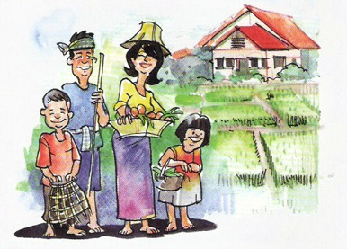
Sustainable Highland Development:
Health cares and nutrition
Kraisid Tontisirin
Senator
Professor emeritus, Mahidol University
Chairman of Nutrition Development Foundation
Presentation at the International Conference .. On Sustainable Highland Development: The Royal Project Model.
Royal Park Rajapruek, Chaing Mai
22-24 December 2019

Slide 2
Presentation Outline
The Royal Highland Development Project
Alleviation of food insecurity and under-nutrition
in Thailand
Sustainable health and nutrition cares
Conclusion

Slide 3
The Royal Project Foundation
1969 H.M. the King Rama 9 initiated the RoyaProject during his visit to an opium growing village in Doi Pui
1972, The UN/Thai Program for Drug Abuse Control was begun.
Subsequently, research and development supported by the USDA to the Royal Project and Kasetsart University
1992, the royal project changed its name to the Royal Project Foundation (RPF) and became a public organization for the people's benefit permanently.

Slide 4
Thai Highlands
Areas:
67.22 million rai (= 10.76 million hectares)
4,148 villages in 20 provinces area in northern and western part (Chaing Mai: 34.1%, Mae Hong Son: 13.69%, Chaing Rai: 13.40%)
Hill-tribe population: 233,826 households (740,494 people)
Source: HRDI strategy 2017 - 2021

Slide 5
Main problems of highland in Northern Thailand during the sixty .
Poverty
Opium poppy cultivation
Deforestation: Slash and burn cultivation
Lack of basic services & infrastructures
Source: https://www.youtube.com/watch?v=ACFKH-02v74

Slide 6
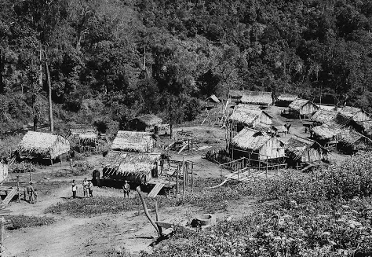
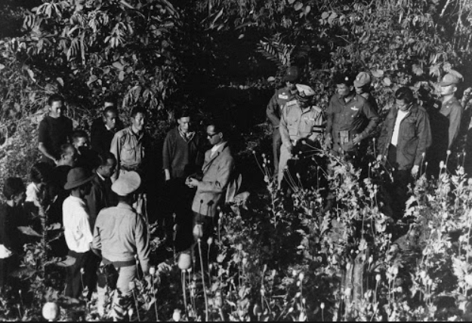
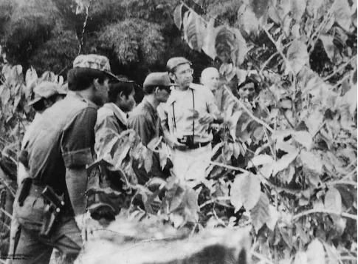
Peaches research
Opium field in the past
Royal coffee project
Source: https://artsandculture.google.com/partner/royal-project-foundation

Slide 7
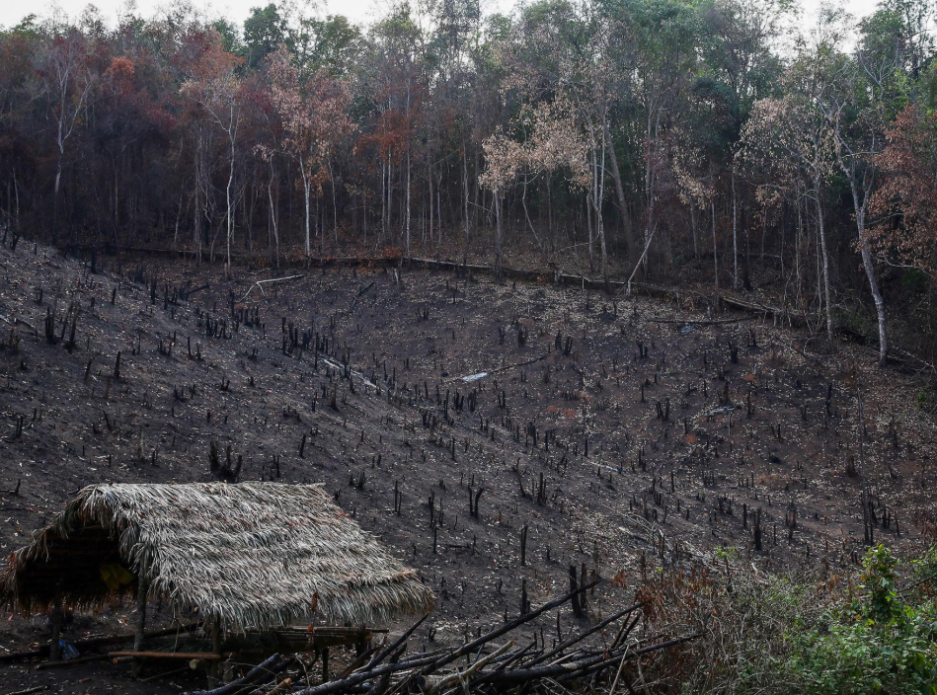
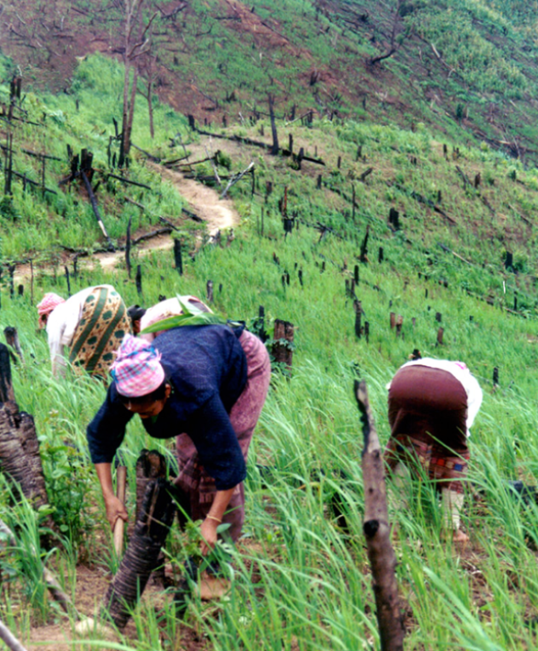
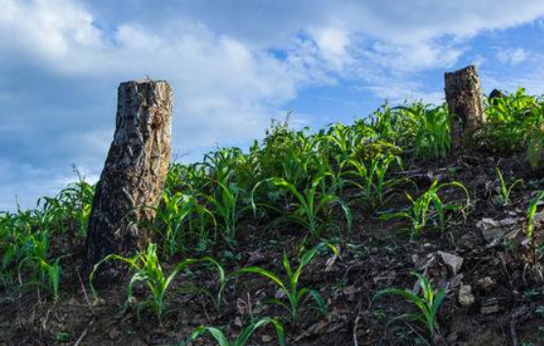
Source: the Royal Project Foundation
Slash and burn cultivation on highland

Slide 8
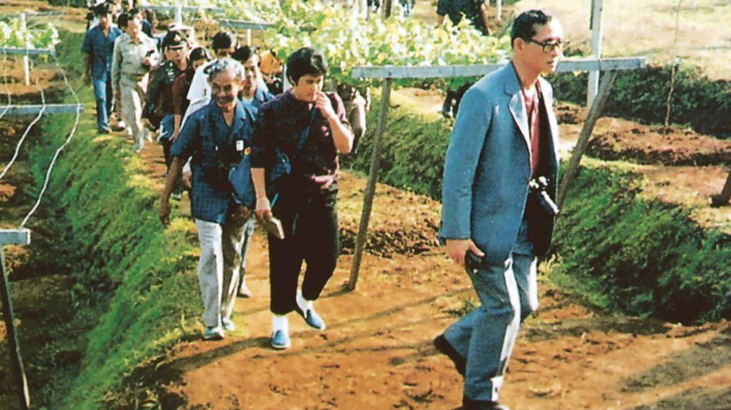
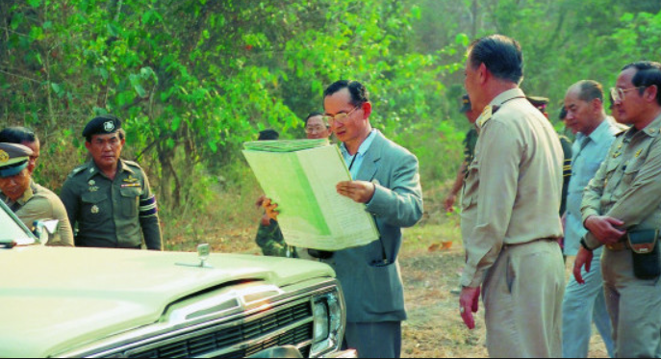
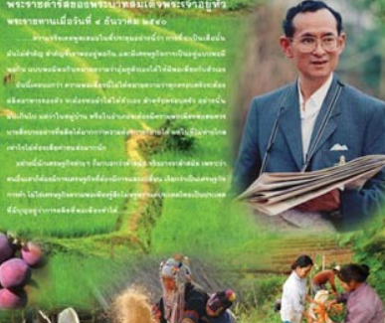
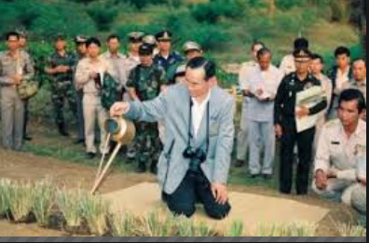
Source: the Royal Project Foundation

Slide 9
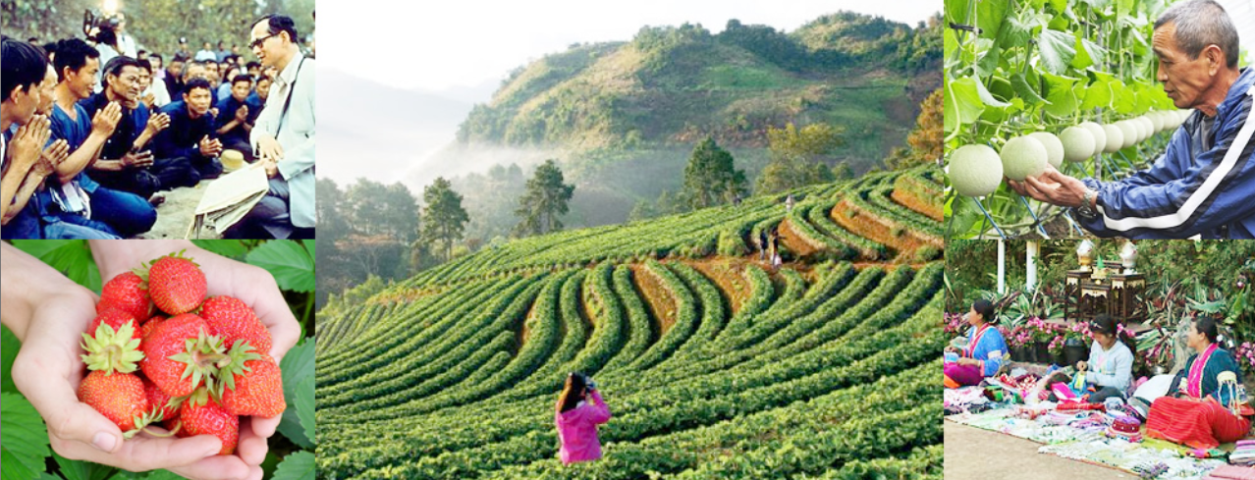
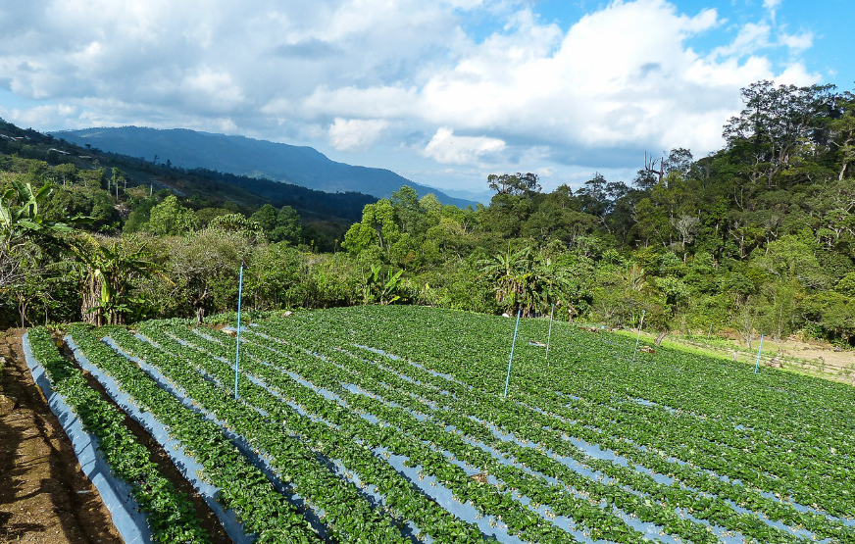
The Royal project Foundation
* From:https://www.thaizer.com/features/following-in-the-footsteps-of-the-king-thailands-royal-projects/

Slide 10
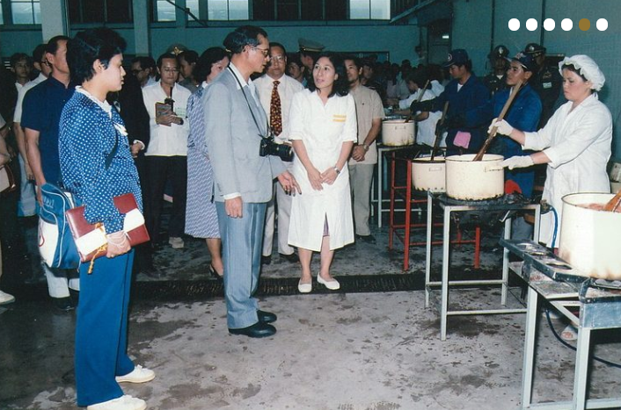
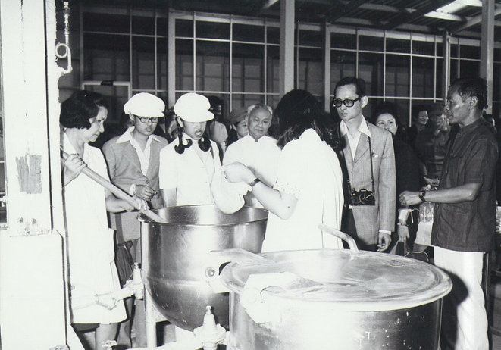
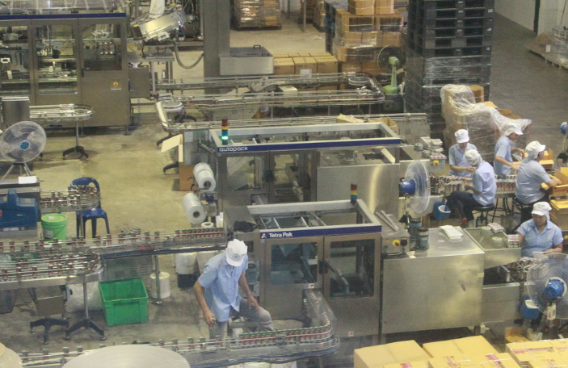
The Royal project: food processing/factory
Doi Kham:Gift set online order

Slide 11
The Royal Project Foundation
The goals of the Royal Project Foundation are:
To help hill tribes achieve a better life
To prevent the destruction of natural resources
To stop opium growing
To care for make best use of the soil in each area
To increase the amount of alternative agriculture for the benefit of Thailand's economy
There are 38 development centers spread across five provinces in northern Thailand
Source: the Royal Project Foundation

Slide 12
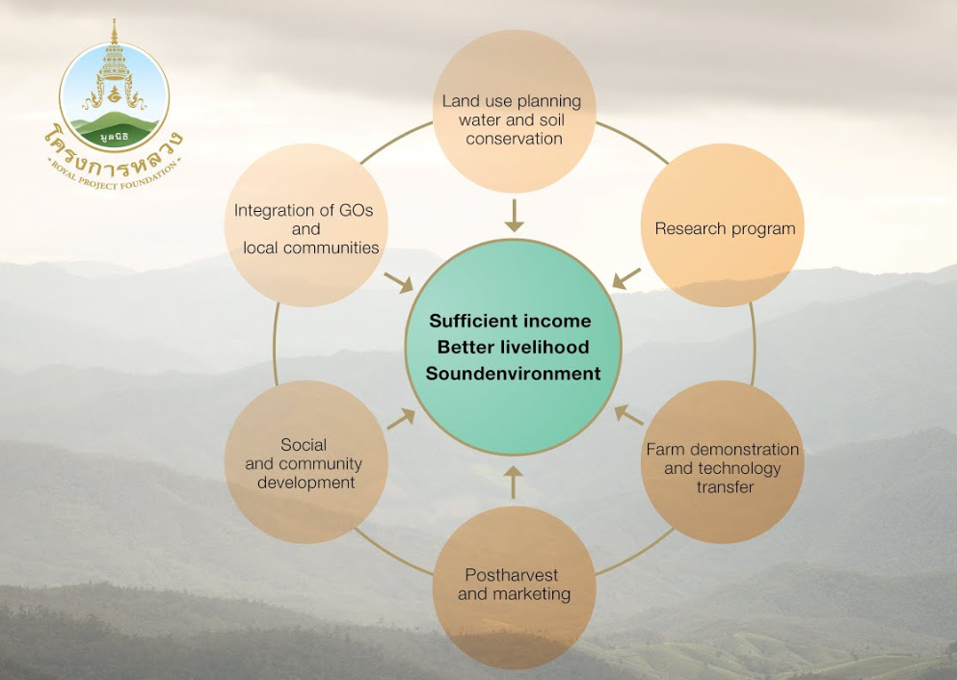
Strategies and actions of the Royal project
Source: the Royal Project Foundation

Slide 13
Benefits
To 288 villages 168,445 people living in the highland through its 38 development centers in 5 Northern provinces; Chiang Mai, Lampung, Chiang Rai, Phayao, and Mae Hong Son.
The expansion to other highland areas in Chiang Rai, Mae Hong Son, Tak, Nan, Kamphaeng Phet and Kanchanaburi.
The successful outcomes: raising incomes, improvement quality of life of people and communities, crop replacement, strengthening of people and communities and the restoration of watershed forests in the highlands, scaling up in others areas and technical cooperation with many countries in highland development with Taiwan ROC, Lao PDR, Myanmar and Bhutan.

Slide 14
Key success factors of the Royal Project in highland as business model
The Royal Brand
Create Shared Values: social issues and business values
Multi stakeholders for actions and social enterprises. .co-venturing business
Management principle with active people participation
https://www.youtube.com/watch?v=ACFKH-02v74

Slide 15
Presentation Outline
The Royal Highland Development Project
Alleviation of food insecurity and under-nutrition
in Thailand
Sustainable health and nutrition cares
Conclusion

Slide 16
Agriculture/
Food supply/
Service
Promotion
Prevention
Treatment
Rehabilitation
Food
Nutrition
Health
Nutrition is a link between food and health,
regarding the fulfillment of energy, protein and micronutrient
requirements and non-nutrients from food in human life course
Ultimate goals
Good nutrition & Well-being for all
Kraisid Tontisirin, Mahidol University

Slide 17
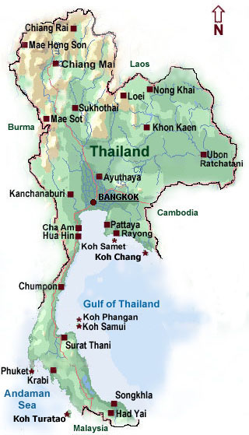
Population of 68.3 m.
Area of 514,000 sq. kilometers
Success in reduction of maternal and child malnutrition since the eighty under the Poverty Alleviation Plan (PAP)
Currently facing with double burden of malnutrition (DBM), a coexistence of
under and over nutrition, and related
non-communicable diseases (NCDs)
Thailand has been a major food exporter
Mountain areas confine mainly in the Northern Region
Thailand
17
Kraisid Tontisirin, Mahidol University

Slide 18
Great progress in reducing hunger in Thailand*
Hunger fell from 35% to 7% (1990-2015) or reduced by 79%
Number of hungry people fell from 20 to 5 million in same period or reduced by 75%
Thailand has achieved MDGs
Undernourishment in Thailand
*Slide courtesy from IFPRI with some modification
Sources: FAO 2017, Tontisirin et al. 2014

Slide 19
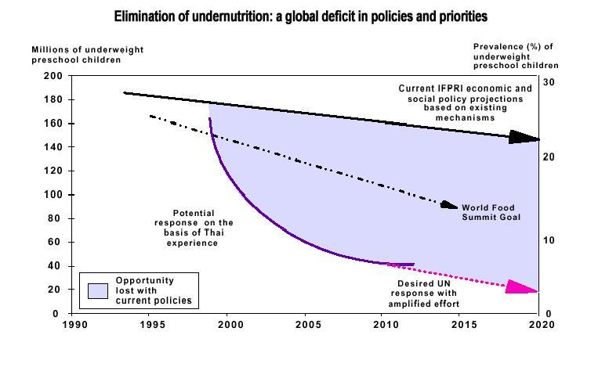
Elimination of undernutrition:
a global deficit and priorities*
*From ACC/SCN 1999
Kraisid Tontisirin, Mahidol University

Slide 20
National Rural Development Committee
Poverty Alleviation Plan
(PAP)
Multi-stakeholder Comm.
Nutrition goals and
indicators are incorporated
to strategies and actions.
Community based
approaches
Provision of basic
services with mass
mobilization:1volunteer
/10 households
Agri.& food production for subsistence econ.,
suppl. food for mothers, complementary food for IYC & dairy farm for school children
Kraisid Tontisirin, Mahidol University

Slide 21
Basic Principles of the PAP
Priority to specific areas with high poverty concentration
Develop living standard to subsistence level with minimum basic services to be available everywhere in the specified areas
Emphasis on the need of making improvements so that people can gradually do more to take care of themselves
Emphasis on low-cost technology that people can handle themselves
5. Maximum community participation
Kraisid Tontisirin, Mahidol University

Slide 22
Community-Based Approaches
Is an integrated program implemented
at local level (district level and below)
National commitment with sound nutrition
improvement strategies and goals
Community actions: basic services, mass
mobilization, mutual efforts/actions to reach
all people and to prevent malnutrition
Kraisid Tontisirin, Mahidol University

Slide 23
Components of a successful community based program
Minimum Basic Services
(Health, Education, Agr. Extension)
Supportive System
Training
Funding
Problem Solving
Supervision
Menus (Activities)
Antenatal Cares (ANC)
Growth Monitoring and Promotion (GMP)
Food production
Food and nutrition education
Food sanitation & safety
School lunch and milk
program since 1992
Other activities
Facilitators
Interface
(service providers and
community leaders)
Plan/goals
Implementation
Monitoring/evaluation
Mobilizers
(1:10 households)
Community Leaders
Family
Individual
Basic Minimum Needs Goals/Indicators
Kraisid Tontisirin, Mahidol University

Slide 24
Success components of community-based program
1. Provision of basis services
2. Active community organization/leader engagement
3. Community volunteers of 1:10 households
4. Community goals and indicators for situation analysis, planning, actions and evaluation
5. Community actions including remedial actions
Kraisid Tontisirin, Mahidol University

Slide 25
Improvement of maternal & child nutrition, Thailand
 | 1980 | 1990 | 2006
ANC coverage % | 35 | 75 | 95
Anemia in pregnancy % | 50-75 | 18.8 | 10
LBW % | 16 | 10 | <10
Underweight of under 5 % | 51 | 20 | <10
Recent trend of nutritional status of under 5*
* Source: NHES 2; Holistic Development of Thai Children; NFNS 5; NHES 4; and NHES 5
Kraisid Tontisirin, Mahidol University

Slide 26
Nutritional status of underfive in upland Chiang Mai*
*From IDRC project 2016: Nutrition and food security in upland of Thailand (One year intervention)
Kraisid Tontisirin, Mahidol University

Slide 27
Presentation Outline
The Royal Highland Development Project
Alleviation of food insecurity and under-nutrition
in Thailand
Sustainable health and nutrition cares
Conclusion

Slide 28
National Food Committee
Str Framewk for Food Mgt
(SFFM)
Multi-stakeholder approaches
SFFM covers: Food Security, quality & Safety, Education & research, and Management
Linking of food, nutrition &
health implemented at
central & community levels
for nutrition and p/c of NCDs
Roles of agriculture and
food systems:
.Ensuring nutritious and safe food supply i.e fruits & veg; low sugar, fat & sodium food; legume & fishes, milk …etc
.Facilitation of trade and tourism
.Caring of environment & sustainable agriculture.
Kraisid Tontisirin, Mahidol University

Slide 29
From: http://www.un.org/sustainabledevelopment/sustainable-development-goals/
Kraisid Tontisirin, Mahidol University

Slide 30
King Bhumibol’s Sufficiency Economy Philosophy
The Middle Path
Moderation
Reasonableness
Self-Immunity
Knowledge and wisdom
Ethic and morality
Lead
to
Life/ Economy/ Social / Environment
Progress in balance, stable and sustainable way
Kraisid Tontisirin, Mahidol University

Slide 31
Vision
“Thailand ensures food and nutrition security, and is a sustainable source of nutritious and safe food with premium quality for Thai and the world”
Kraisid Tontisirin, Mahidol University

Slide 32
Holistic Approach for Food Management in Thailand
Consumer Driven/Demand Pull
Agriculture
Food Systems
Consumer Health
& Well Being
Food & Non Food
Safe Food & Premium/ Nutrition Quality
Farming
Processing
Trade/
Environment
Sustainability
Consumption
Zoning (province data/ information)
Smart Farmers/
Smart Officers
GAP Mandatory
Productivity
Traceability
Household
OTOP
Industry
Service Outlets
Community
- Schools
- Workplaces
Economic
& Prosperity
Value Chain
Logistic Efficiency
Reduction of Food Loss and Waste
Strengthening Linkage between Individual Sectors
5P (Public - Private - Professional – People Partnership ) & Fair Income Distribution
R & D
Capacity Building
Area & Setting Based
Monitoring & Evaluation
Kraisid Tontisirin, Mahidol University

Slide 33
Theme 1 : Food Security
Principle : Ensuring a sustainable food security and effective management of food production resources by active stakeholders participation
Natural &
Agricultural
Resources
Supply
& Access
Production
Land & water
Mgt/reform
Enhancing food access at household & communities
Zoning for production
Balancing food,
feed & fuel
Innovation & technology
Capacity career &
development in agriculture
Logistics improvement
Active stakeholders participation
R & D along the food chain
Crisis management systems
33
Kraisid Tontisirin, Mahidol University

Slide 34
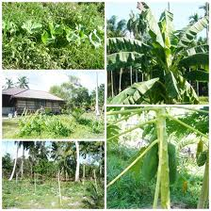
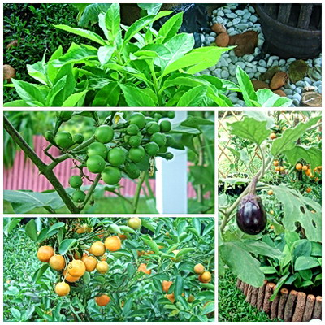
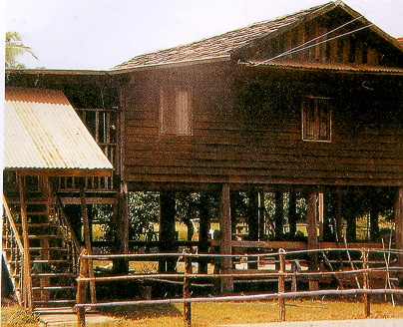
New theory for land uses in agriculture* agriculture*
Land is divided
in 4 areas
Vegetables/Fruits
House & gardens with animal foods
Rice field
(and paddy field fishery)
Water reservoir
and aquaculture
*From King Bhumibol’ s Sufficiency
Economy and land use aiming for
household food security
Source: http://www.kasetporpeang.com
Kraisid Tontisirin, Mahidol University

Slide 35
Theme 2 : Food Quality and Safety
Principle : Ensuring high quality and safe food to protect consumer health and to facilitate domestic/international trade
Trade & market promotion
Consumer protection and create fairness
Promote
compliance
Quality and safety assurance systems.
Food standard
Quality
Safety
Nutrition
Primary
product
Community food production
Food industry
R&D, GAP
Standard farm
Farm cluster/cooperative
Smart Farmers
R&D /innovation
Promote collecting and processing station
Food storage and processing/
food loss/waste reduction
Local culture/tourism
R&D /innovation
Value added
Strengthening/improve food
technology
R&D /innovation
35
Kraisid Tontisirin, Mahidol University

Slide 36
Organizational structure of MOPH Thailand
(1per10 households)

Slide 37
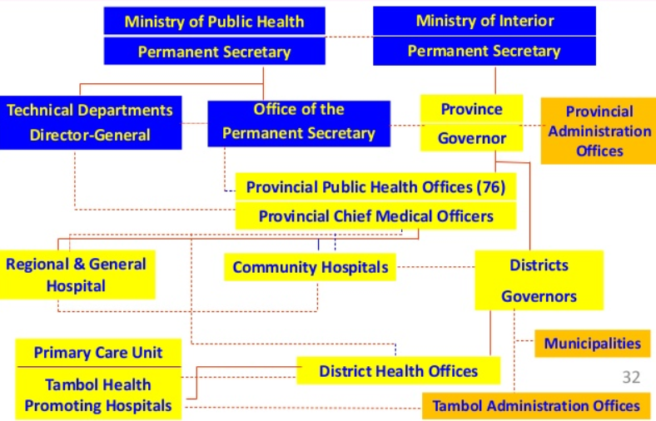
Provincial Health Administration Thailand
…Health Volunteers (1:10 Households)

Slide 38
Universal Healthcare Coverage (UHC)
Thailand has implemented UHC since 2002 and continued to be strengthened with quality cares.
Enhanced role for primary care… Affordable, available, holistic, self–sustaining and diverse cares.
UHC sustainability as a basis for SDG achievement.

Slide 39
The potential of primary care for achieving sustainability of Thailand’s universal health coverage policy*
*Kanitsorn Sumriddetchkajorn et al; Bulletin WHO 2019;97:415-422

Slide 40
Community Based Program for Health Promotion
Minimum Basic Services
(Health, Education, Agricultural Extension)
Supportive System
Menu (Activities)
Antenatal care
Growth monitoring /promotion
Elderly cares
Cares of NCDs
Food production
Nutrition education
Food sanitation
& safety
Other activities
(Tobacco and alcoholic
consumption control)
Recreation and physical
activities)
Etc.
Training
Funding
Problem Solving
Supervision
Facilitators
Interface
(service providers and community leaders)
Plan/goals
Implementation
Monitoring/evaluation
:
Community Leaders
Family
Individual
Volunteers
(1:10 households)
Minimum Indicators
of well-being & NCDs
40
Kraisid Tontisirin, Mahidol University
Notes:
40

Slide 41
Conclusion
The Royal Project of the King Rama 9 has provided lessons and approaches that improving quality of life and environment in highland could be achieved and scaled up to other areas.
Achieving food security, good nutrition and health required specific goals and indicators along with multi-strategic and multi-stakeholder approaches at multi-levels.
UHC Policy, Food management Strategy and Community actions include provision of basic services, active community participation, community volunteers (1:10 HH), remedial actions to alleviate food insecurity and malnutrition.
Kraisid Tontisirin, Mahidol University
Notes:
41

Slide 42
Thanks for your
attention

