Slide 1

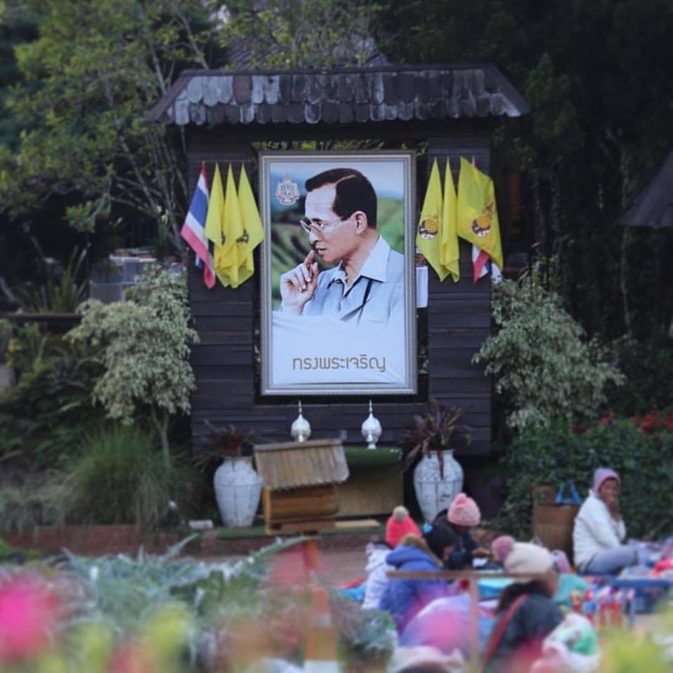
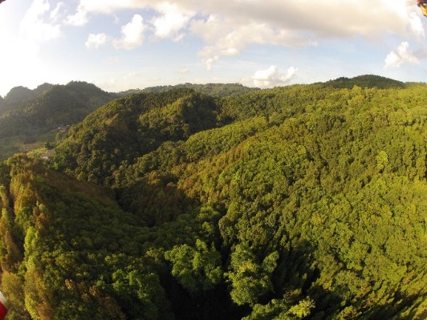
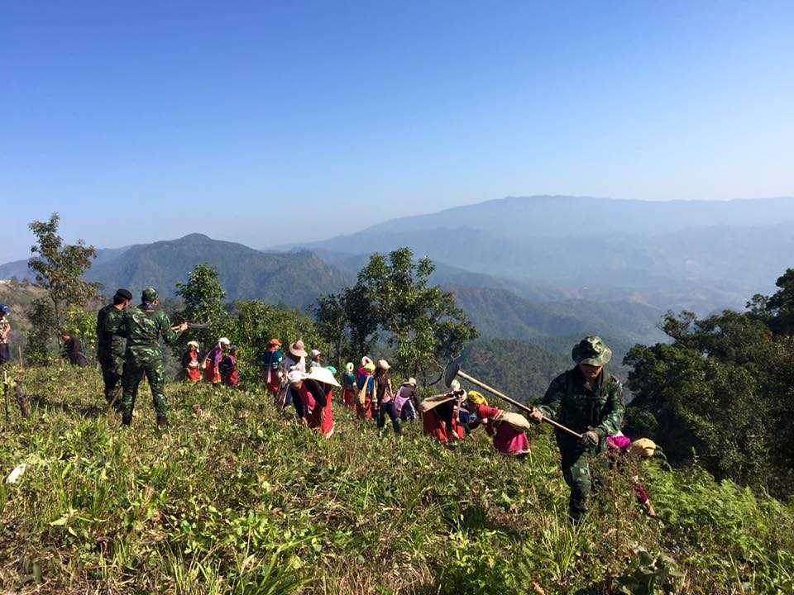
Socio-Economic and Marketing Sustainability under Alternative Development:
Community Forest Conservation and Development
Sapit Diloksumpun
Kasetsart University, Thailand
International Conference onRising to the Challenge of Sustainable Development Goals (SDGs) through Sustainable Highland Development: The Royal Project Model
22 – 24 December 2019
Royal Park Rajapruek, Chiang Mai, Thailand
Notes:
NOTE:
To change the image on this slide, select the picture and delete it. Then click the Pictures icon in the placeholder to insert your own image.

Slide 2
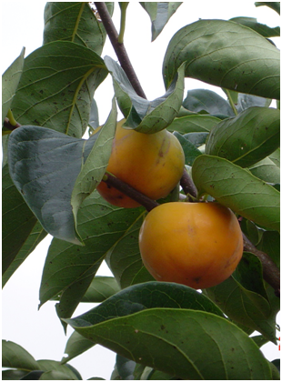
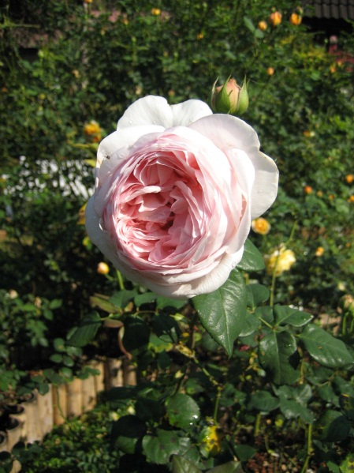
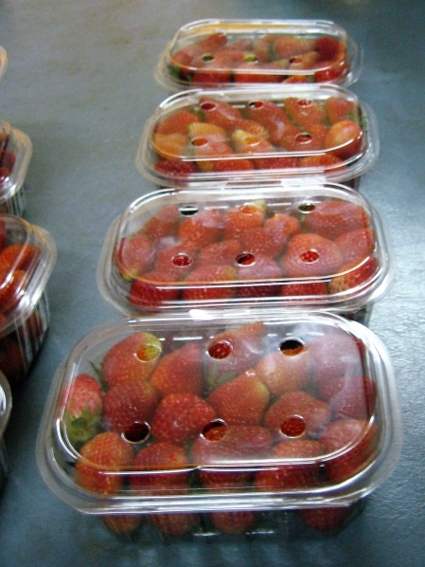
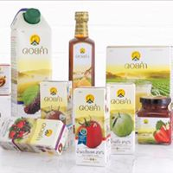
Socio-Economic and Marketing Sustainability
under Alternative Development

Slide 3
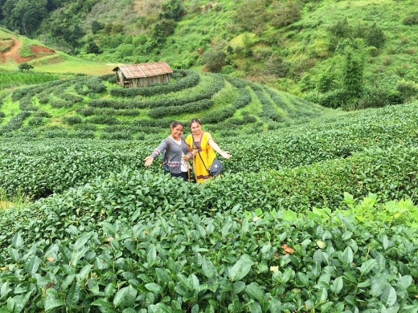
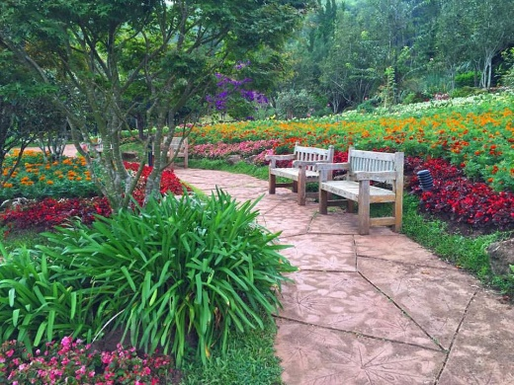
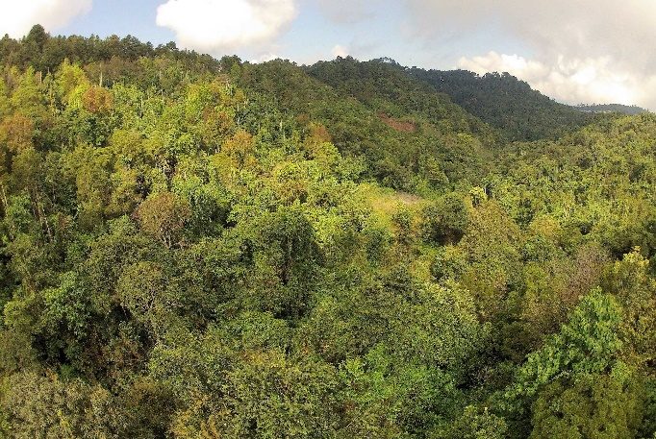
Sustainability:
Social, Economic and Environmental Aspects

Slide 4
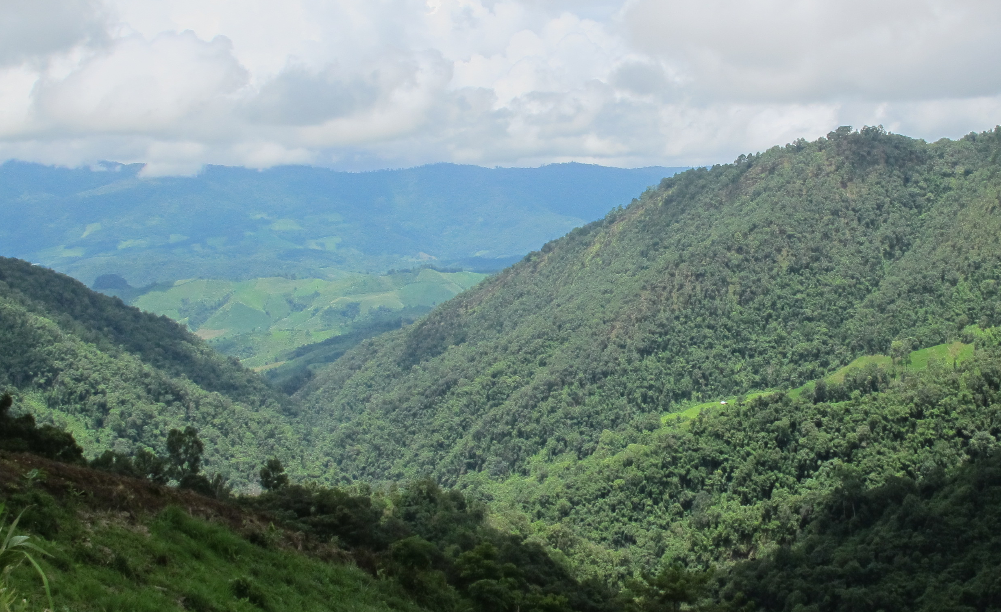
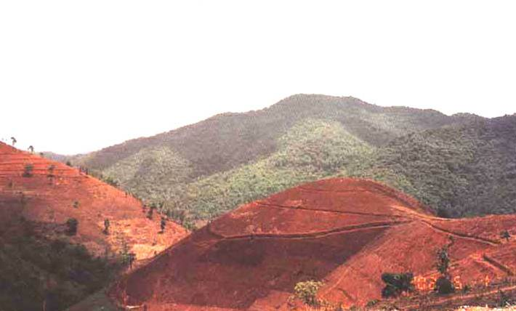
Past: Highland natural resources
Hill evergreen forest >> Degraded lands

Slide 5
Past: Situations of the highland
Opium
poppy cultivation
Poverty
Deforestation
Hill-tribe people
Notes:
Highland in northern Thailand serving as watershed and other ecological services to the country
General problems of the highland in northern Thailand during the past few decades

Slide 6
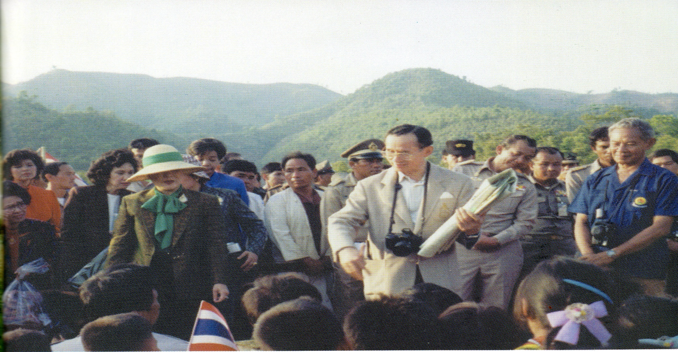
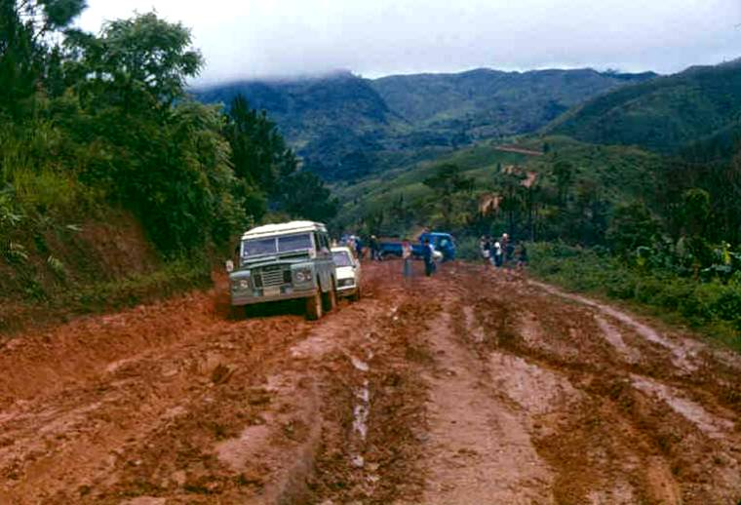
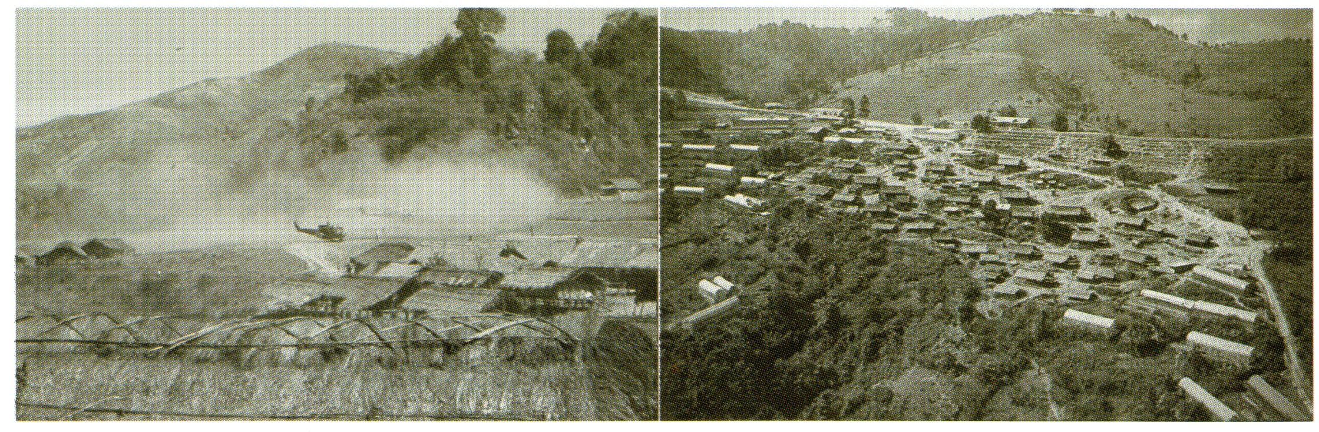
Royal Visits

Slide 7
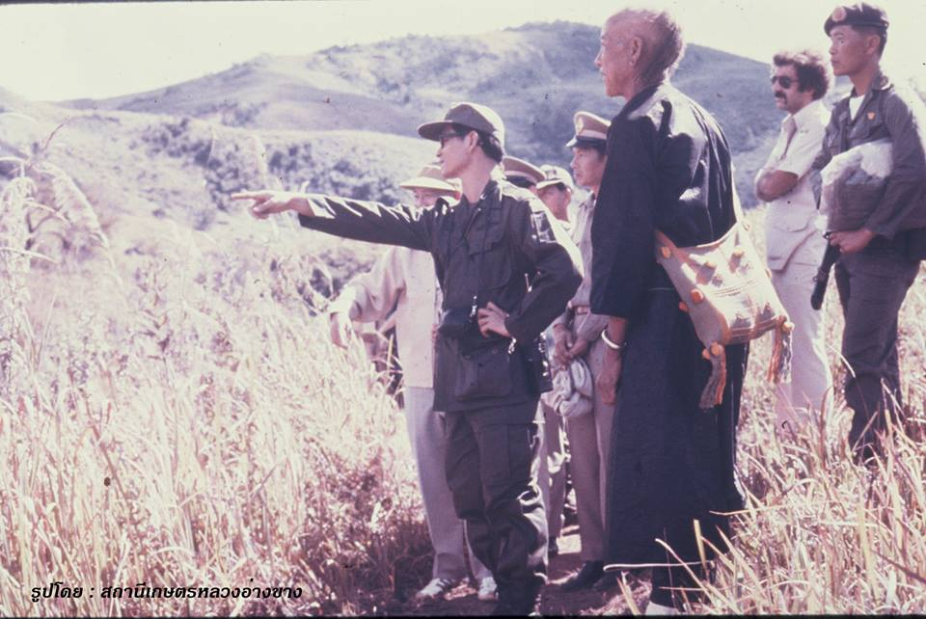
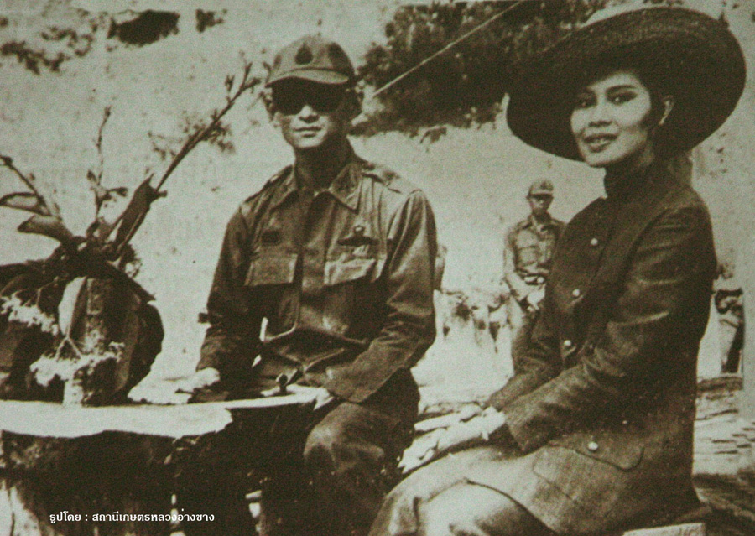
Royal visits
The Royal Project is one of initiated projects of H.M. the King Bhumibol, established in 1969
The Royal Agricultural Station (RAS) Angkhang, Chiang Mai Province, was then established as the first station.
The Royal Project Foundation was established in 1992
Photo: http://www.angkhangstation.com

Slide 8

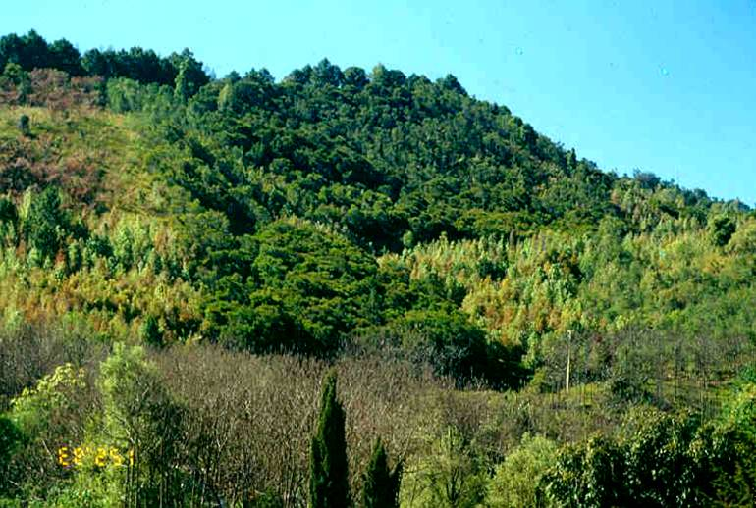
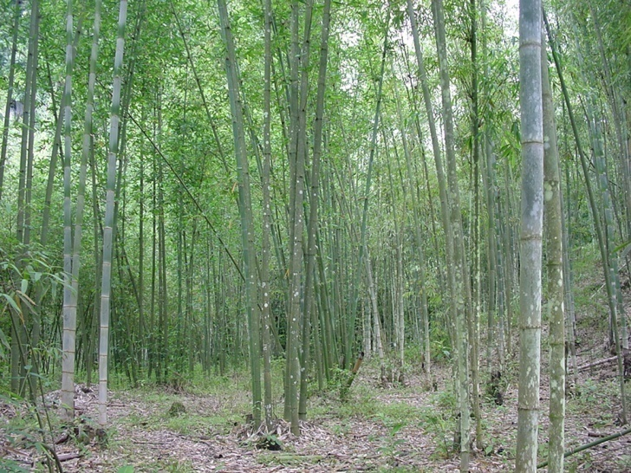
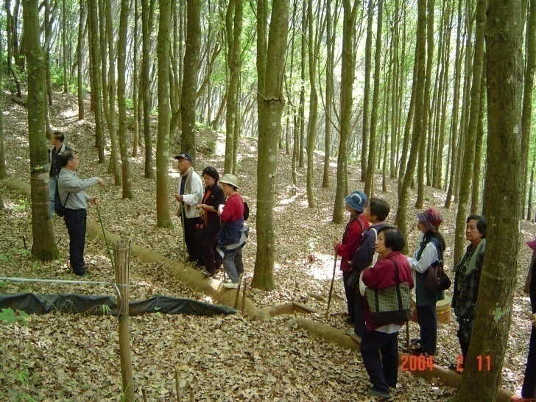
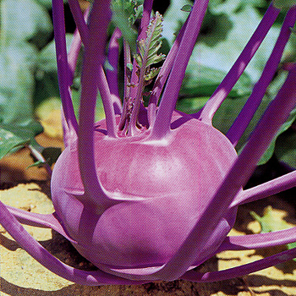
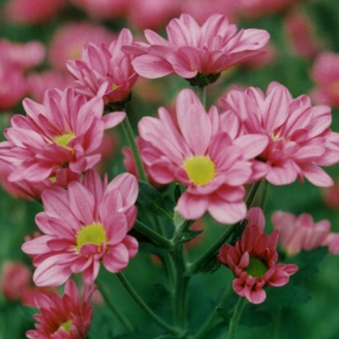
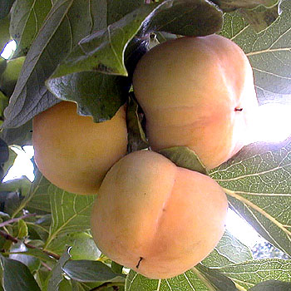
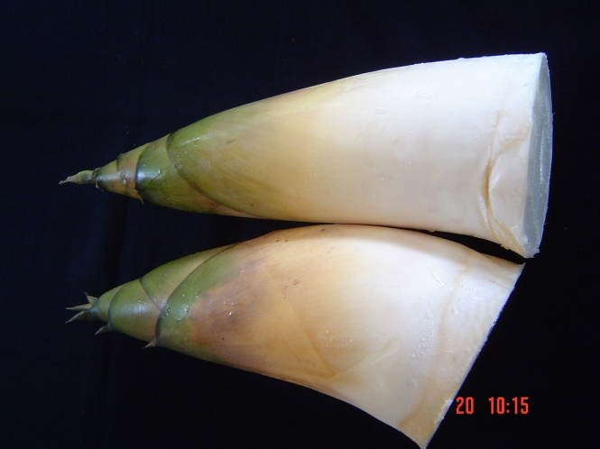
ROYAL PROJECT FOUNDATION

Slide 9
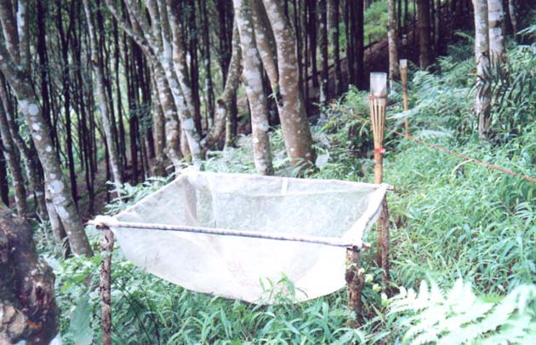
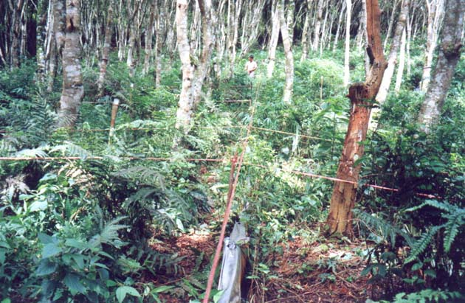
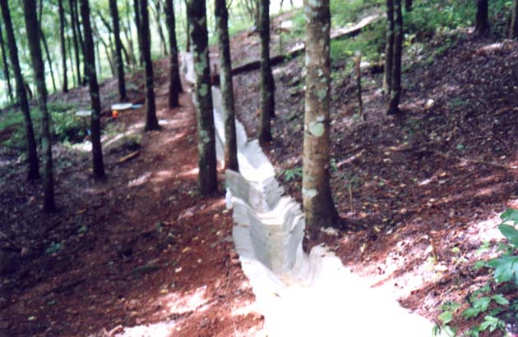
Objectives of the RPF
To eradicate opium poppy cultivation,
To improve life quality of hill-tribe people
To conserve and rehabilitate the watershed forests

Slide 10
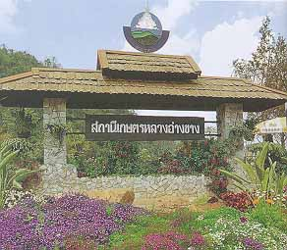
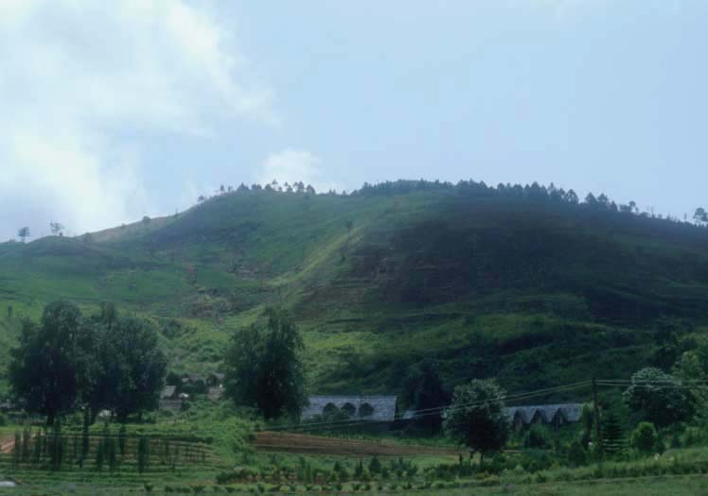
HIGHLAND REFORESTATION PROJECT
1981

Slide 11
H.M. the King Bhumibol’s Initiatives
Cultivation of substitution forests
Reservoirs through reforestation
Cultivation of three kinds of trees for four benefits
Creation of wet firebreak
Reforestation without planting
Land use initiatives
Multi-species plantation initiatives

Slide 12
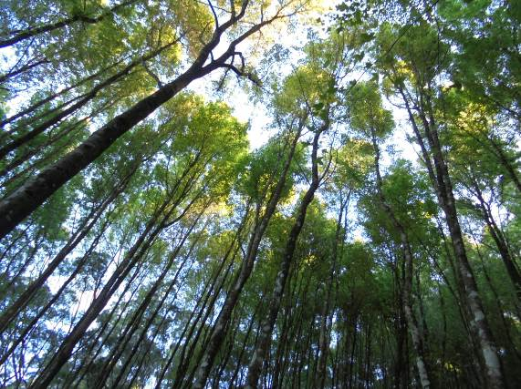
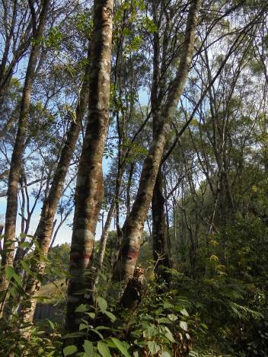
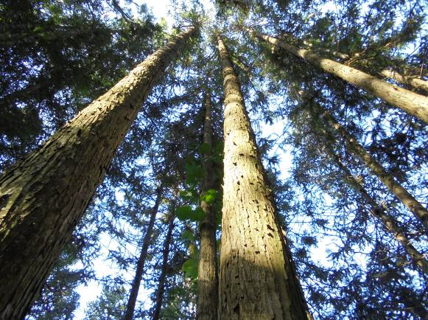
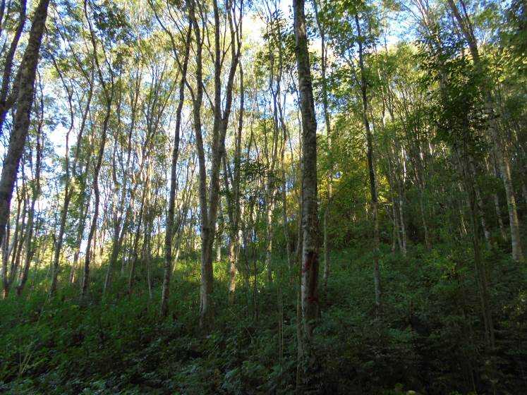
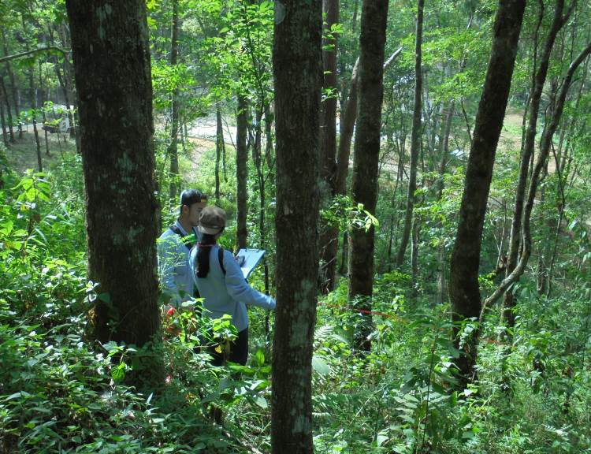
Highland Reforestation Project
Started in 1981 in collaboration with Kasetsart University, National Taiwan University and Taiwan Government
Key exotic tree species native to Taiwan
Liquidambar
Cunninghamia, Fraxinus, Cinnamomum
Acacia

Slide 13
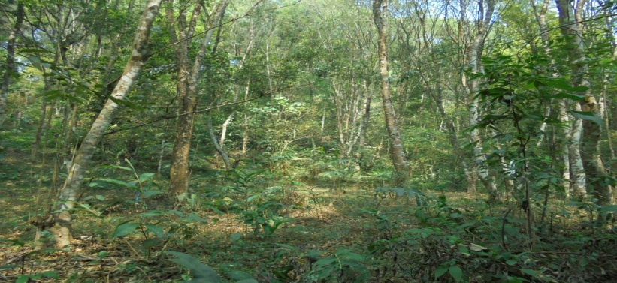
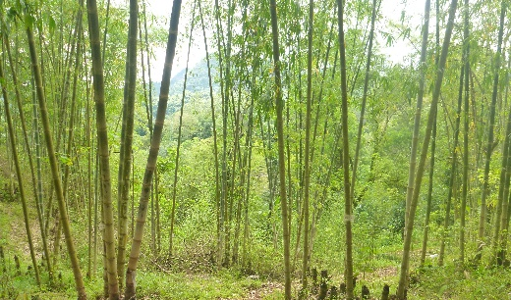
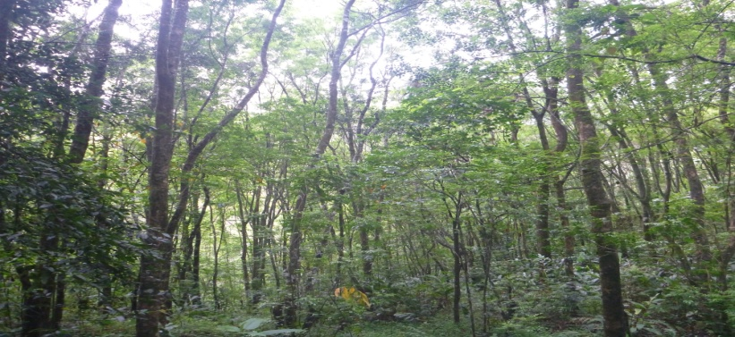
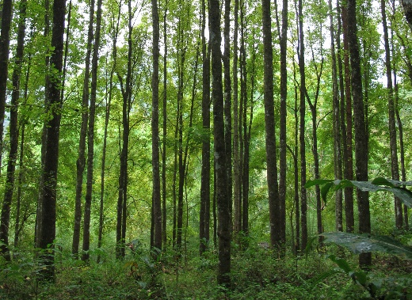
Highland Reforestation Project
Planting schemes
Scheme 4: Bamboo planting (Exotic &
Native species) for multiple uses
Scheme 1:
Exotic monoculture
Scheme 2:
Exotic mixed stand
Scheme 3:
Exotic and native mixed stand
1991-1996
“Village Forest Project”
1983-1999
Area expansion
1982-1988
Species trials and demonstration

Slide 14
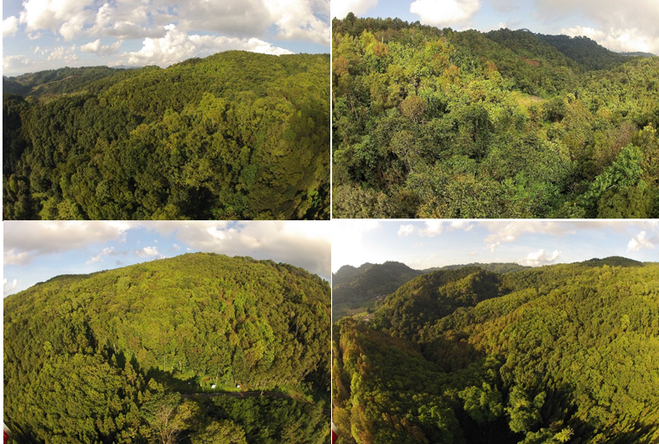
Evaluation of Highland Reforestation Project
through Low Emission Support Scheme (LESS) by TGO
Evaluation of the carbon sequestration in biomass and soil of the reforestation after 34 years of planting
Evaluation of its economic, social and environmental
co-benefits providing ecological services

Slide 15
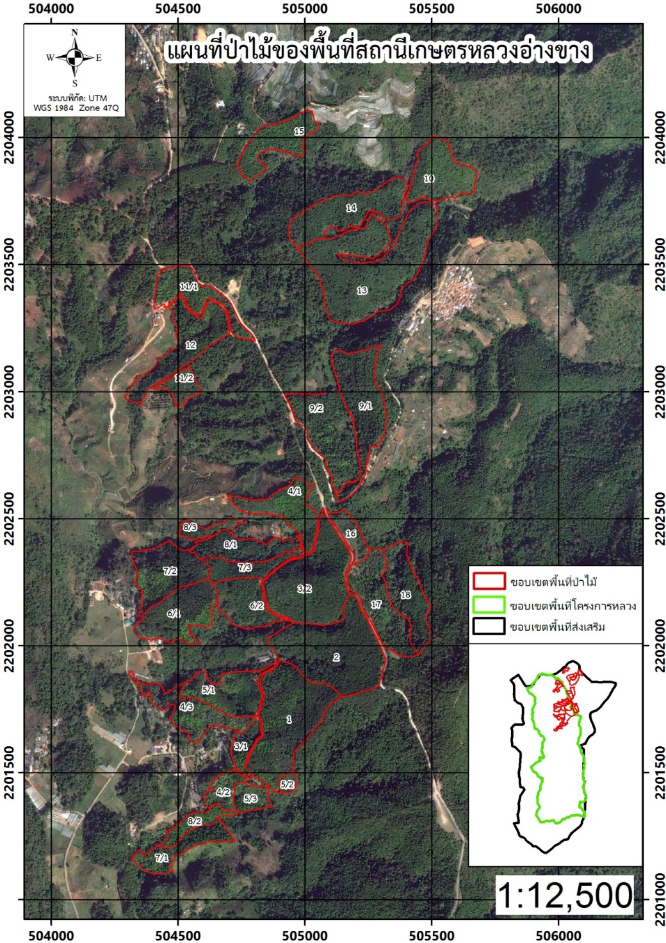
Reforestation area
Reforestation area at the RAS Angkhang
Total station area 1,260 ha
Reforestation area
- Exotic monoculture 28.43 ha
- Exotic mixed stand 61.40 ha
- Exotic and native mixed stand 27.73 ha
- Bamboo planting 13.64 ha
Reforestation area (excluding bamboo planting) 117.56 ha

Slide 16
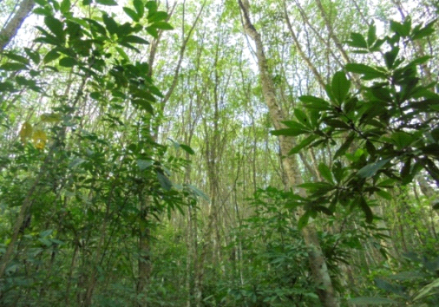
Stand characteristics
Scheme ❶ Exotic monoculture
Planted species: Fraxinus, Acacia, Liquidambar, Cinnamomum, Cunninghamia etc.
Native species from natural regeneration

Slide 17
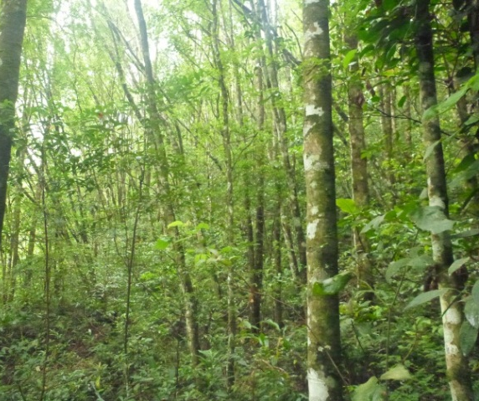
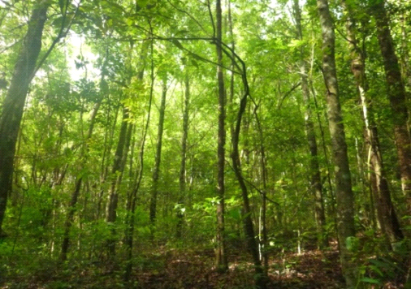
Stand characteristics
Scheme ❷ Exotic mixed stand
Planted species: Fraxinus, Acacia, Liquidambar, Cinnamomum, Cunninghamia etc.
Native species from natural regeneration

Slide 18
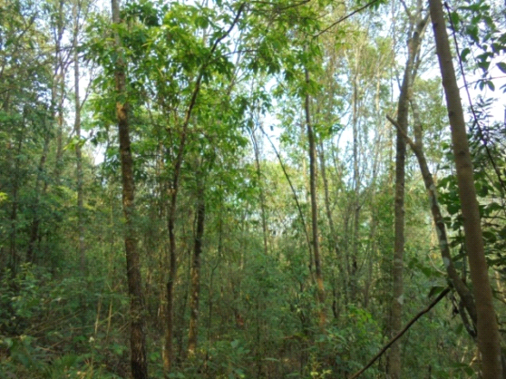
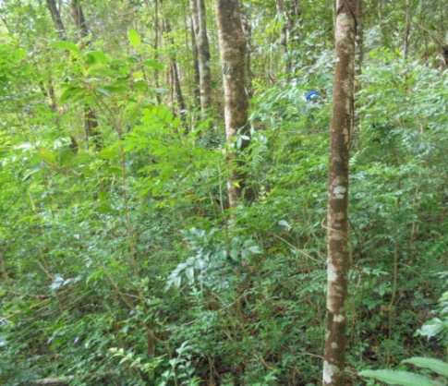
Stand characteristics
Scheme ❸ Village Forest Project
Planted species: Fraxinus, Acacia, Liquidambar, Cinnamomum, Cunninghamia etc. and native tree species
Native species from natural regeneration

Slide 19
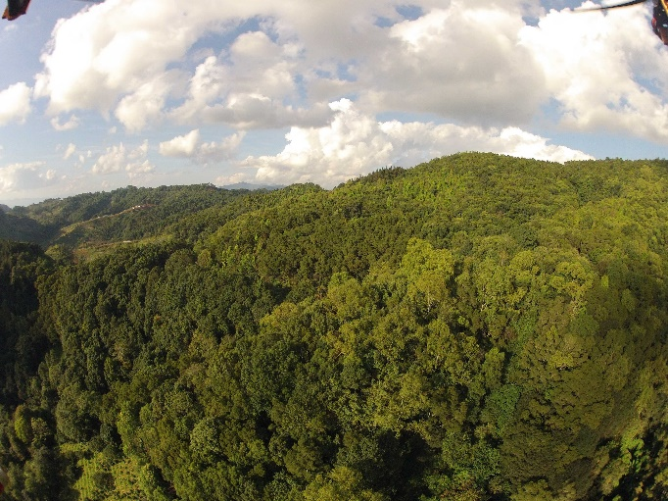
Carbon sequestration
Baseline (1981):
Deforested area
Carbon storage in the total biomass of trees and saplings
= 0 Mg/ha
Carbon storage in the soil
= 56.08 Mg/ha (calculation based on IPCC default)
2017: Reforestation in 3 planting schemes
Carbon storage in total biomass (above and below ground) of trees and saplings
Carbon storage in soil

Slide 20
Carbon sequestration
in tree biomass and soil
22.75
18.69
17.50
27.73 ha
28.43 ha
61.40 ha

Slide 21
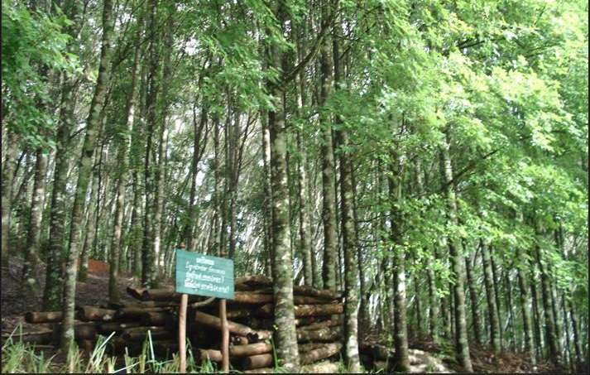
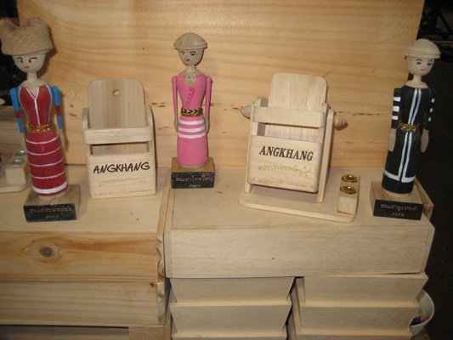
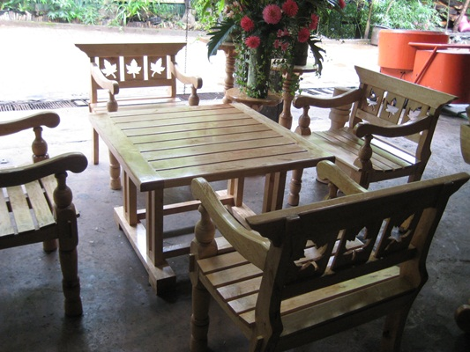
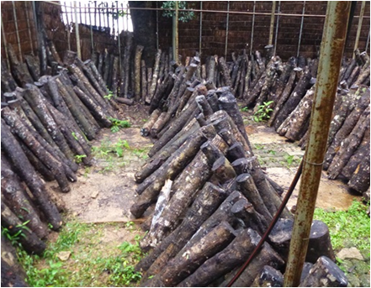


Co-benefits of highland reforestation
Economic, social and environmental aspects
Utilization of thinned woods: furniture, souvenirs, high quality charcoals, wood vinegar

Slide 22





Co-benefits of highland reforestation
Economic, social and environmental aspects
Utilization of bamboos: food
(bamboo shoots), supporting
tools, farm buildings, high
quality charcoals, wood
vinegar

Slide 23



Co-benefits of highland reforestation
Economic, social and environmental aspects
Demonstration center for wood technology and utilization established in 2004
  Transferring appropriate wood technology for local people and visitors
  Career development and extension

Slide 24





Co-benefits of highland reforestation
Economic, social and environmental aspects
Activities to develop people participation and conservation awareness eg. tree planting and management, forest fire control

Slide 25




Co-benefits of highland reforestation
Economic, social and environmental aspects
Beautiful scenery of the
reforestation area for tourist
attractions and learning center

Slide 26


Co-benefits of highland reforestation
Economic, social and environmental aspects
Biodiversity and natural regeneration of native tree species
  64 tree species in 31 families
  Evaluation on biodiversity of non-woody plants, animals and insects is ongoing

Slide 27
Natural regeneration of different planting schemes
(in 2017)
VFP
Mixed
VFP
Mono
Mixed

Slide 28

Co-benefits of highland reforestation
Economic, social and environmental aspects
Conservation of watershed area for ecological services
Conservation of water and soil through terraced planting

Slide 29

LESS Letter of Approval
ได้รับการรับรองและประกาศเกียรติคุณ ปริมาณการดูดซับก๊าซคาร์บอนไดออกไซด์ ทั้งหมด 67,830 ตันคาร์บอนไดออกไซด์
10 มี.ค.2560
Angkhang
LESS

Slide 30

Socio-Economic and Marketing Sustainability
under Alternative Development
Sustainability:
Social, Economic and Environmental Aspects
Sustainability for highland development:
Maintaining ecological services
through landscape restoration

Slide 31



Landscape highland restoration
H.M. the King Bhumibol’s philosophy and initiatives:
Self sufficiency economy
“Help them to help themselves”
“Planting 3 kinds of trees
to provide 4 benefits”
Land use initiatives

Slide 32
Maintaining ecological services through landscape restoration
Current land use classification
Improving livelihood of hill-tribe people through temperate fruit and forest trees

Slide 33
Maintaining ecological services through landscape restoration
Current land use classification
Improving livelihood of hill-tribe people through temperate agricultural crops
About 90% of the hill tribe people are farmers engaged in the Royal Project

Slide 34
Maintaining ecological services through landscape restoration
Practices
Allocation of planting areas e.g. fruit trees, annual crops, cut flowers, tea, herbs
Supports training and technology transfer to farmers
Product design and development and marketing

Slide 35
Best practices of landscape restoration for highlands
Landscape highland restoration
Land use zoning and its appropriate implementation
Reforestation through tree species selection and appropriate silvicultural practices
People participation and engagement including government, institutions, private sectors and local people
Improving livelihood of local people through fast growing trees and temperate agricultural crops
Environmental concerns: to minimize negative environmental impacts in all activities

Slide 36


Acknowledgement
Asst. Prof. Dr. Bunvong Thaiutsa
Biodiversity-Base Economy Development Office (BEDO)
The Royal Project Foundation, Royal Agricultural Station Angkhang
Kasetsart University, Faculty of Forestry

Slide 37

For more information:
Sapit Diloksumpun (sapit.d@ku.ac.th)
Notes:
NOTE:
To change the image on this slide, select the picture and delete it. Then click the Pictures icon in the placeholder to insert your own image.

