Slide 1
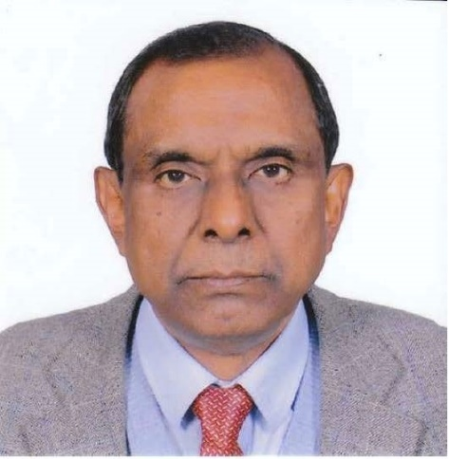
Keynote Addresses:
International Perspectives on Sustainable Land Use and Food Security on Highland
“Alternative Development for Sustainable Development on Mountainous Area”
Mr. Golam Rasul
Chief Economist of International Centre for Integrated Mountain Development (ICIMOD), Nepal

Slide 2
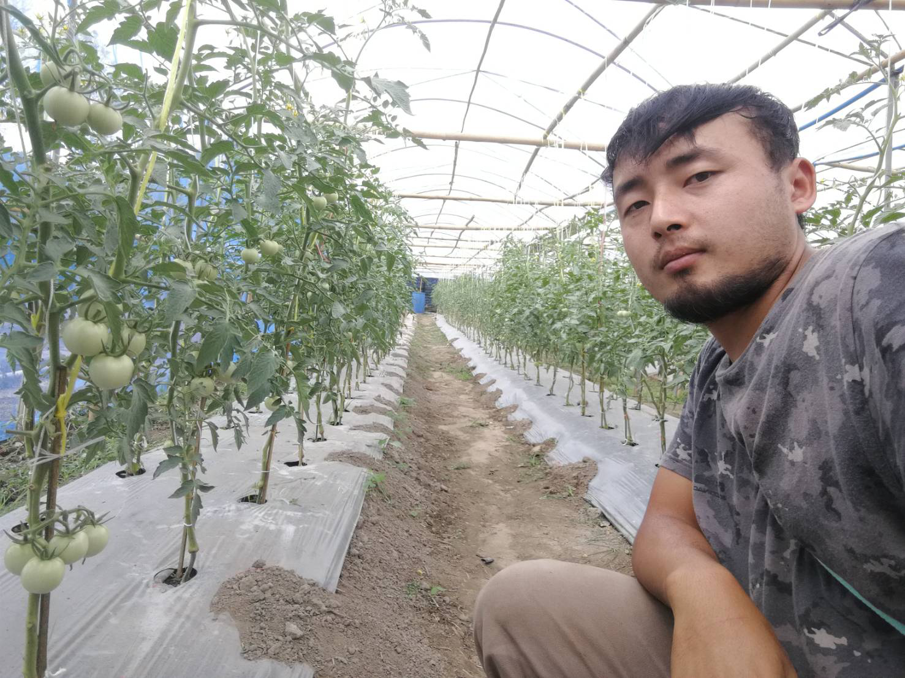
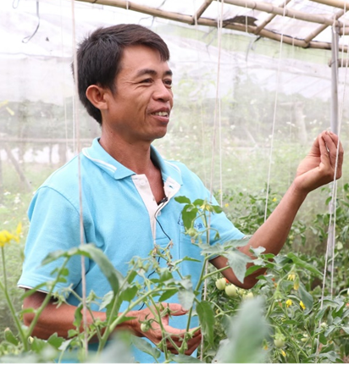
Panel Discussion – Alternative Development: Voices from Farmers
Panelists: AD farmers from RPF and HRDI, Thailand, Myanmar and Lao PDR
1. Mr. Luechai Choechokchai
2. Mr. Surapon Klinkhajonklai
3. Mr. U Maung Khon
4. Mr. Bounthanh Thepmanyla
Farmer Leader, Mae Hae Luang Highland Development Project Using Royal Project System, Chiang Mai, Highland Research and Development Institute (Public Organization)
Beneficiary farmer of the AD Programme of UNODC in Shan State, Myanmar
Huay Oun Village Headman, Oudomxay, Lao PDR
Thung Luang Royal Project Development Center
Moderator: Mr. Wirat Prapthuk, Director of Highland Research and Development Institute

Slide 3
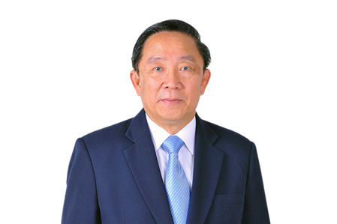
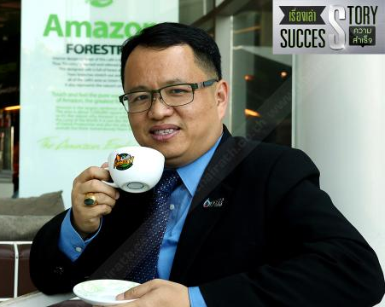
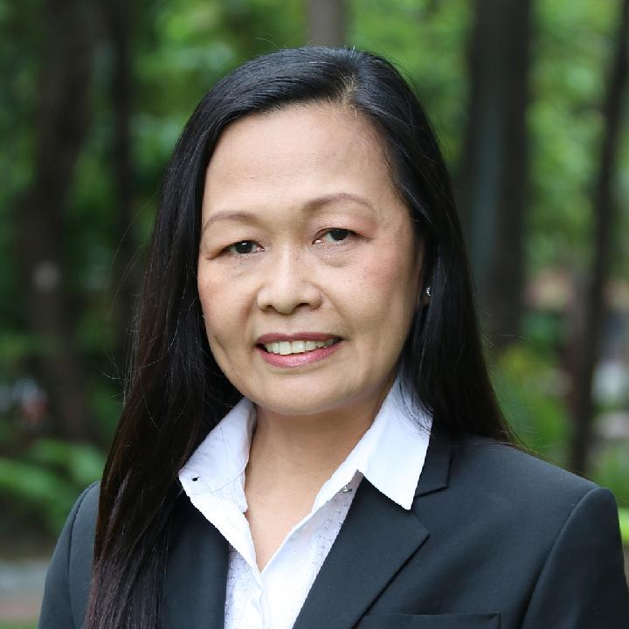
Panel Discussion – Socio-Economic and Marketing Sustainability under Alternative Development
Panelists : AD farmers from RPF and HRDI, Thailand, Myanmar and Lao PDR
“Marketing and Logistics Development”
“Green Marketing Strategy”
“Health Care and Malnutrition”
“Community Forest Conservation and Development”
1. Dr. Anchan Chompupoung
2. Mr. Suchat Ramarch
3. Prof. Emeritus Dr. Kraisid Tontisirin
4. Assist. Prof.
Dr. Sapit Diloksumpun
Kasetsart University: Community Forest Conservation and Development
Assistant Director, Royal Project Foundation Office, Chiang Mai
Senior Executive Vice President, Non-Oil Retail Business PTT Oil and Retail Business Public Company Limited
Senator: Health Care and Malnutrition
Moderator: Assoc.Prof.Dr. Avorn Opatpatanakit, Vice President, Research and Academic Services, Chiang Mai University

Slide 4
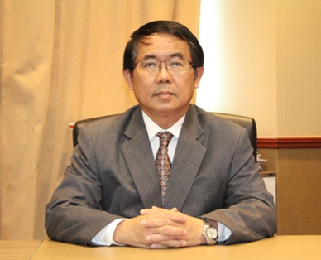
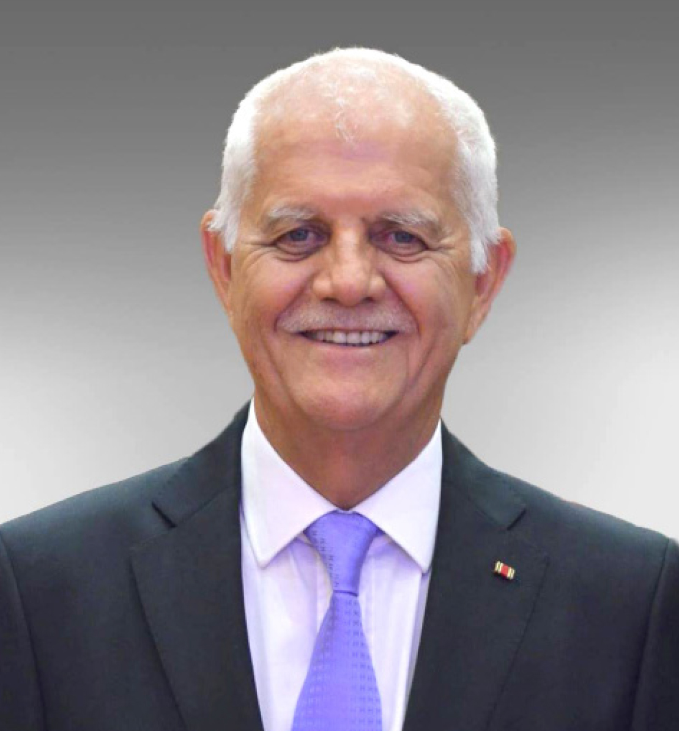
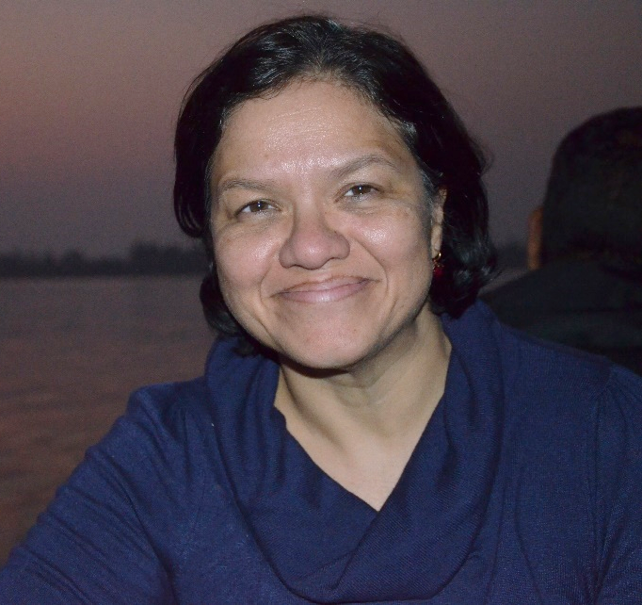
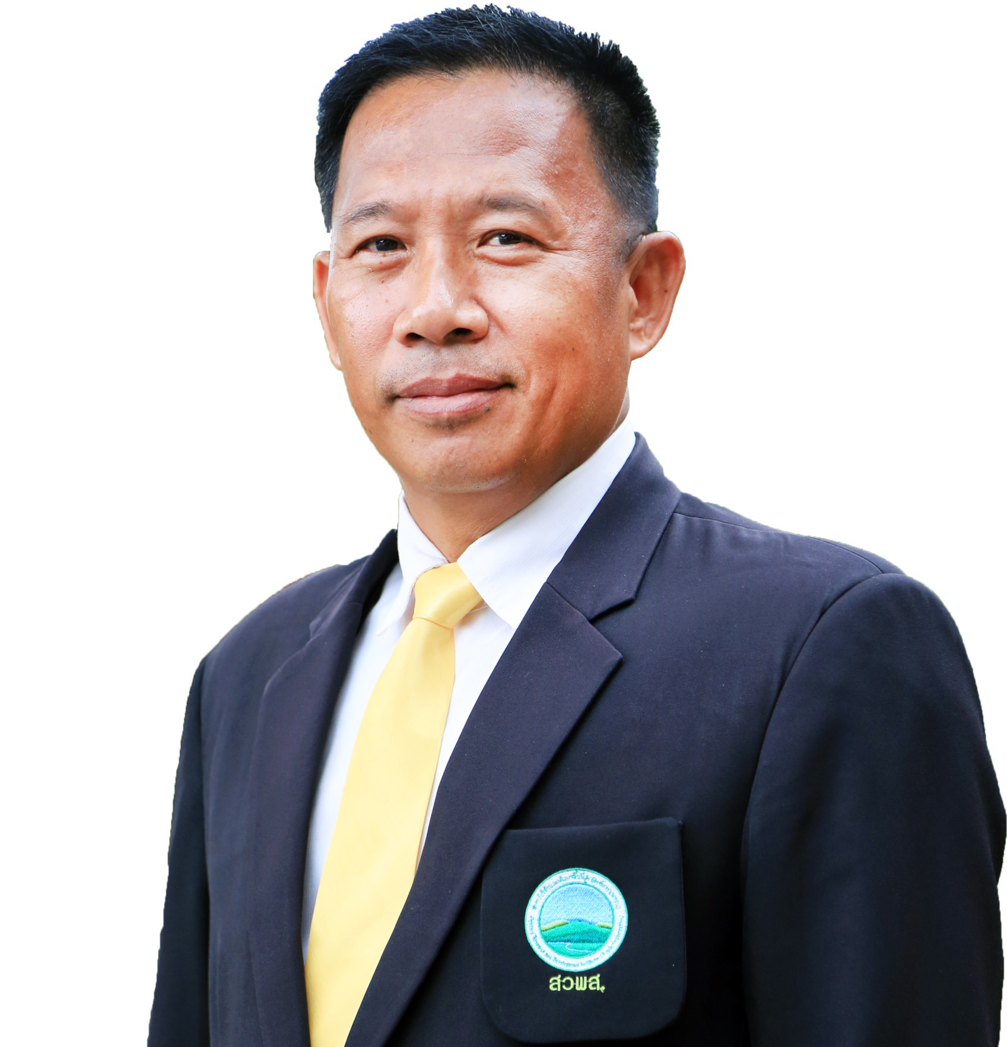
Panel Discussion –Experience on Alternative Development and Future Networking towards UN- SDGs
Panelists :
1. Mr. Pithaya Jinawat
2. Mr. Hagen E.W. Dirksen
3. Ms. Anubha Sood
4. Mr. Wirat Prapthuk
Member of National Narcotics Control Committee, Advisor, Office of Narcotic Control Board (ONCB), Thailand
Honorary Consul of Germany,
Chiang Mai
Senior Program Officer (Alternative Livelihoods & Counter Narcotics), UNODC Country Office for Afghanistan (COAFG)
Director, Highland Research and Development Institute
Moderator: Prof. Dr. Pongsak Angkasith, RPF Executive Board Member

